Slide 1
Multi-wavelength Depolarization & Raman lidar, High Spectral Resolution Lidar: Setup and modelization of the Argentinean Aerosol Monitoring Stations
Pablo Ristori, Lidia Otero and Eduardo Quel
Sebastián Papandrea
Francisco González, Osvaldo Vilar, Juan Carlos Dworniczak
División Lidar, Centro de Estudios en Láseres y Aplicaciones, UNIDEF (MINDEF - CONICET), CITEDEF, Juan Bautista de La Salle 4397, B1063ALO, Villa Martelli, Provincia de Buenos Aires, Argentina
Yoshitaka Jin, Nobuo Sugimoto
National Institute for Environmental Studies, 16-2 Onogawa, Tsukuba, Japan;
Proyecto PIDDEF Especial
Nº 31554/11
Notes:
Note: Lower part of the slide are the names of the projects “SPECIAL PIDDEF PROJECT 3155” PIDDEF: Research and Development Project of the Ministry of the Defense. SAVER.Net short name of “South American Environmental Risk Network” and long name “Social Management System for Environmental Risk in South America”. This project aims to propose this kind of system for the region

Slide 2
Aerosol Research Team (Division)
Lidar Division (LD)
National Institute for Env. Studies (NIES)
Eduardo Quel (Head LD)
Pablo Ristori
Lidia Otero
Jacobo Salvador (RG)
Sebastián Papandrea (student)
Milagros Herrera (student)
Juan Pallotta
Lucas Bali (Crisis Dept.)
Ezequiel Pawelko
Nobuo Sugimoto (HEAD)
Atsushi Shimizu
Yoshitaka Jin
Tomoaki Nishizawa
Notes:
These are the aerosol research teams at NIES and ARGENTINA. A new aerosol research team is being developped at “Universidad de Magallanes”, Punta Arenas, Chile. The new multiwavelength aerosol and water vapor lidar is intended to be built during the last quarter of 2015. The new structure of the Aerosol Research Team at the Lidar Division NOW includes Jacobo Salvador (in charge of Río Gallegos Aerosol Station), Sebastian Papandrea (Phd. Student whose thesis is related to the development of the HSRL lidars), Milagros Herrera (Diploma student which is involved on the development of empirical function denoising techniques and whose PhD thesis is going to be oriented on the development of inversion algorithms for near real time aerosol-related information retrieval). OTHER PhD STUDENTS KNOWN BY PREVIOUS CONTRIBUTIONS: Juan Pallota as seen during the poster session continues on the development of the multi-telescope scanning Raman lidar for Cherenkov Telescope array & Pierre Auger Project. For this project he contributes on the study of LIRIC algorithm being guided by Lucas Bali (Mathematician from the CITEDEF-Crisis Department). Ezequiel Pawelko continues working with the former lidar at Villa Martelli to study multispectral aerosol properties at Buenos Aires using the LICEL 32 Channel Multispectrometer.
(Note: Five argentinean researchers from this team had the intention to assist to this Congress. WLMLA offered partial grants but it was not possible to complement the grants with Argentinean funding)

Slide 3
Aerosol Monitoring Network Working Areas
Sebastián
Papandrea
HSRL and MWRL
Francisco González
Mechanical design
and construction
Mechanics
Nobuo Sugimoto
Yoshitaka Jin
HSRL
Optics
Electronics
Eduardo Quel
Pablo Ristori
Lidia Otero
Osvaldo Vilar
Optician
Juan Pallotta
Allignment Software and Control // Inversion Analysis
Juan Carlos
Dworniczak
Guillermo Acosta
Automation Control
Atsushi Shimizu
NIES Inversion Code &
Communication
Lucas Bali &
Milagros Herrera
Jacobo Salvador
Argentina
Japan
Communication Operation and Storage
Software
Notes:
The aerosol main five working areas are displayed here to illustrate the main activities of the aerosol researchers involved in the Aerosol Monitoring Network. In red you can see the Japanese Researchers (NIES) and in black the Argentinean Researchers. No discrimination was done concerning the Lidar Technology. At the outer rings it is possible to see the Technicians, Engineers and Researchers with most oriented activities. At the regions containing two areas it is possible to see Dr Shimizu (Software Analysis and Network operation like in AD-NET but this case for SAVER.Net ), Eng. Juan Pallotta (contributions related to the analysis of LIRIC inversion software and auto-alignment technology), Eng Guillermo Acosta (Grant Student to develop communications boards to link the container automatic functions to the lidar). At the inner regions you can see Yoshitaka Jin (HSRL Hardware Software, Mechanics, Optics and Electronics), Pablo Ristori (Lidar and Inversion Algorithm Development), Lidia Otero (Lidar and Case Analysis) and finally Prof Quel and Sugimoto.

Slide 4
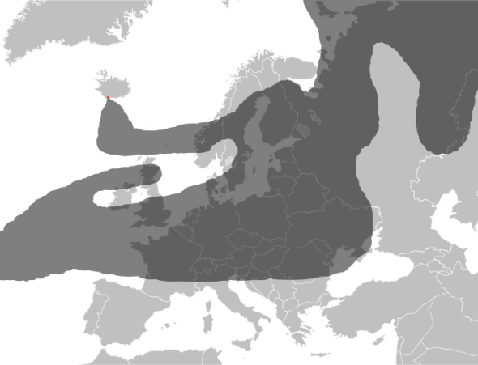
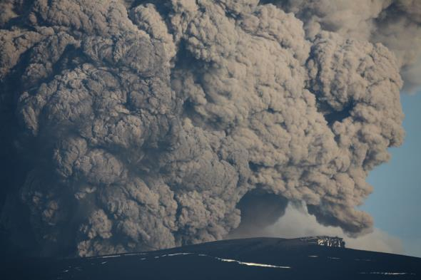
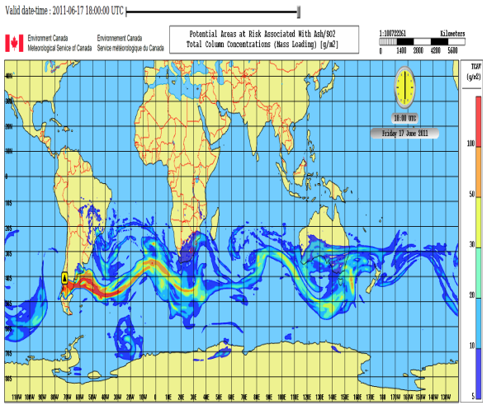
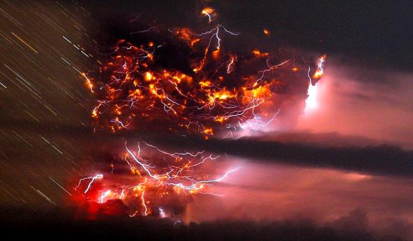
Global Volcanic Activity (2010-2011)
Notes:
The major driver of volcanic monitoring using advanced technologies and complementary instrumentation were institutions like the ICAO (International Civil Aviation Organization) with recommendations like the risk management of flight operations with known or forecast volcanic ash contamination information after the Eyjafjallajökull volcanic eruption in Iceland, 2010. One year later Puyehue Cordón Caulle erupted and several protocols like volcanic ash concentration flight regulations were activated whith irregular maximum thresholds depending on the airline and a lot of uncertainties along the Argentinean region.

Slide 5
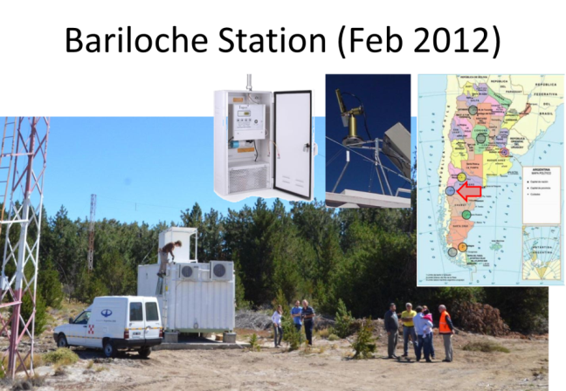
Notes:
During the last three years several stations were mounted in Patagonia. As presented during the last ACTRIS meeting in October 2014, two stations were installed during year 2012, one at the end of 2013 and the last during July 2014. The sites were placed at the National Weather Service locations, which is the beneficiary Institution of this Project. The priority was determined by the Argentinean Government via the Ministry of the Defense. The second location (Comodoro) was initially intended to be Trelew, but the final location has much more important aerial activity.

Slide 6
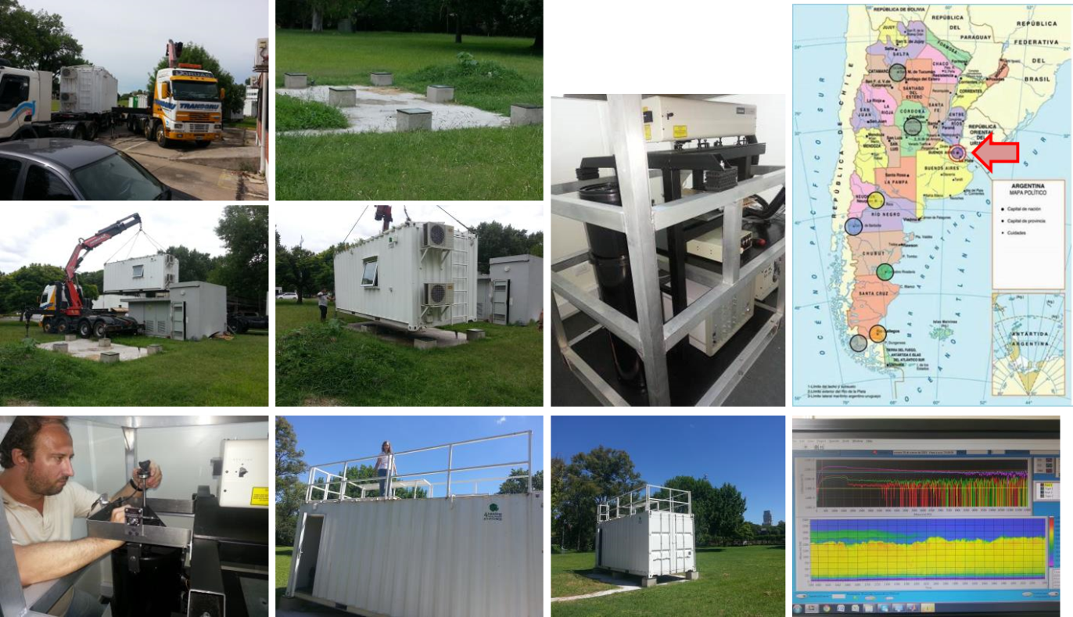
Aeroparque Station (Jan 2015)
Notes:
The last site was intalled at Buenos Aires Capital City during January 2015 at the new Headquarters of the National Weather Service. After being installed this place, all other stations (except Río Gallegos Station which is continuously being controlled by Dr. Salvador head of the OAPA, Atmospheric Observatory of Austral Patagonia) were revisited and realigned. All the data was collected and uploaded to the SAVER.Net servers. Only new data is being transferred from the sites to the server reaching a real time analysis using NIES inversion algorithms. Test (telecover etc) were performed for Buenos Aires, Comodoro Rivadavia, Neuquén and Aeroparque Stations.

Slide 7
Lidar Structure
Multiwavelength Lidar System Concept
Emmision at 355, 532 and 1064 nm
Reception:
355 nm co and cross-polarized
532 nm co and cross-polarized
1064 nm
384 nm N₂ Channel
408 nm H₂O Channel
607 nm N₂ Channel
Aluminum structure to hold the whole system and protect the components
Iron structure to reduce thermal effects and keep the critical optical elements aligned
Notes:
My part is from this slide. Here is the lidar structure of the special project. All the multiwavelength lidar systems are built to include both elastic and Raman channels for aerosol and water vapor observations. There are several case studies observed by this lidar at Villa Martelli, Buenos Aires. Now these studies are intended to be expanded to the whole Argentinean region at the regions mentioned before by Elian Wolfram.
It must be noticed that the construction of these lidars priorize the deployment of the main instrumentation of the project and that the Raman and Depolarization channels are being installed in a second installation (except Raman for Bariloche and Depolarization for Comodoro Rivadavia which are already operational)

Slide 8
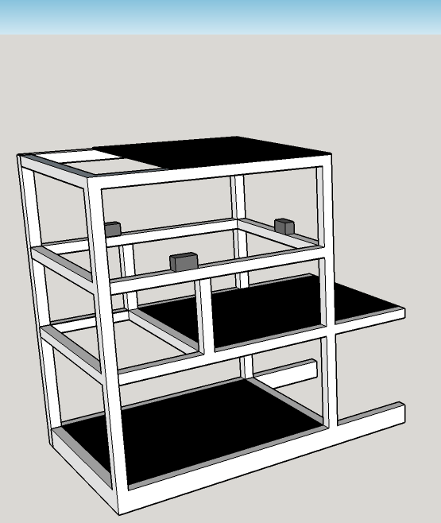
Lidar Structure
Multiwavelength Lidar System Concept
Emmision at 355, 532 and 1064 nm
Reception:
355 nm co and cross-polarized
532 nm co and cross-polarized
1064 nm
384 nm N₂ Channel
408 nm H₂O Channel
607 nm N₂ Channel
Aluminum structure to hold the whole system and protect the components
Iron structure to reduce thermal effects and keep the critical optical elements aligned
Notes:
The external structure is built in Aluminum to hold all the lidar subsystems and lidar structures.

Slide 9
Lidar Stucture
Multiwavelength Lidar System Concept
Emmision at 355, 532 and 1064 nm
Reception:
355 nm co and cross-polarized
532 nm co and cross-polarized
1064 nm
384 nm N₂ Channel
408 nm H₂O Channel
607 nm N₂ Channel
Aluminum structure to hold the whole system and protect the components
Iron structure to reduce thermal effects and keep the critical optical elements aligned
Notes:
The main lidar sub-structure is made in iron and holds the laser, the telescope and the spectroscopic box to avoid thermal expansion-induced misalignments. However the temperature is kept constant inside the 3m x 3m x 3m lidar room using heaters and air conditioning units.

Slide 10
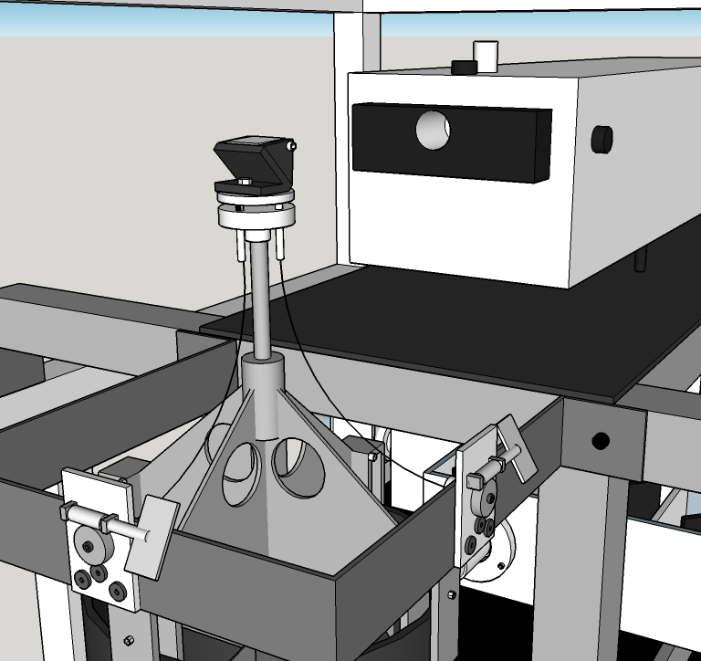
Lidar Structure
Emmision by fused silica prism total internal reflection
Alignment precision reach 1.67 mrad per turn (1/20th reduction)
To reduce undesirable telescope shadowing during the alignment a torsion resistant cable transmit the torque to the alignment screws
The alignment structure is attached to the iron frame then it is mechanically decoupled from the telescope
Notes:
(Read the slide)

Slide 11
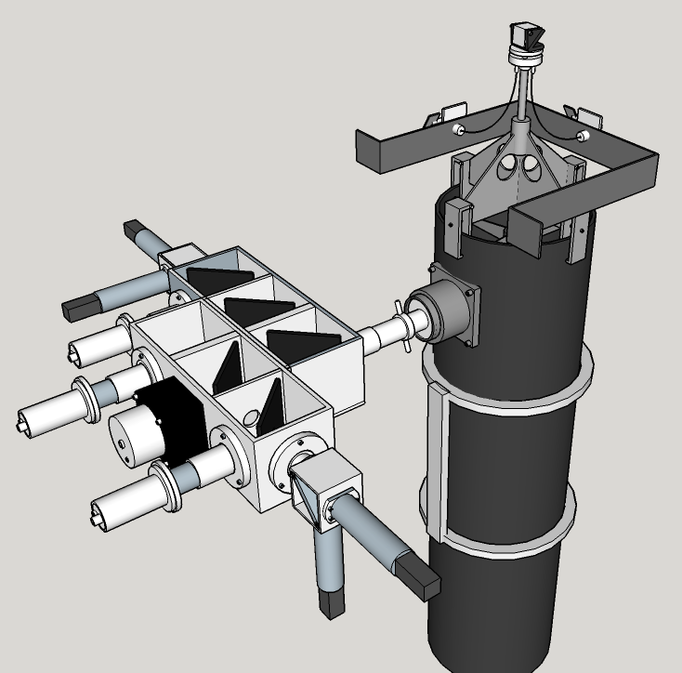
Lidar Structure
Spectroscopic Box air coupled to the telescope.
All UV channels H10721-110
All Vis channels H10721-20
LICEL 3mm APD
Notes:
The telescope is a commercial f/5 newtonian telescope which has at its focal plane a diaphragm that limits the field of observation of the system. The structure holding the diaphragm also comuncates the light beam to the spectroscopic box with the elastic, Raman and depolarizing units.

Slide 12
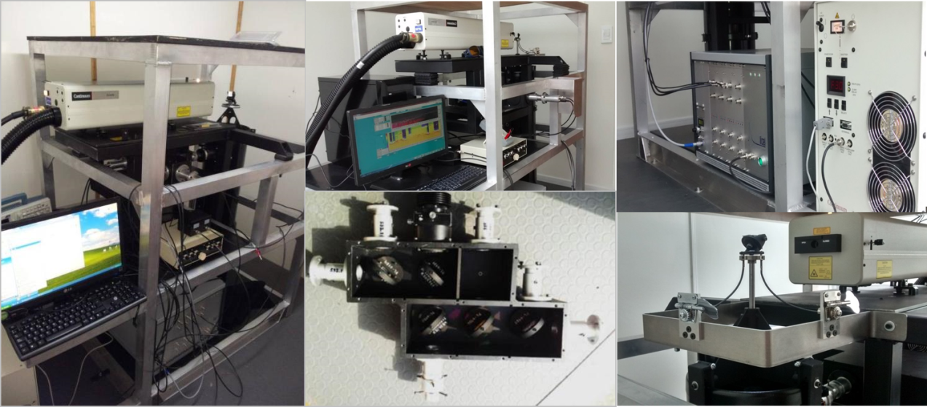
Lidar Structure Photos
Notes:
Photograph of the lidar strucrure and some observations.

Slide 13
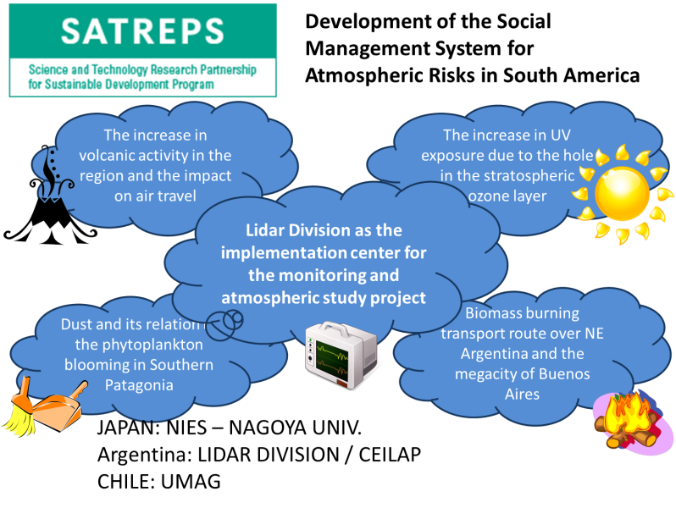
SATREPS Presentation: Goals
Notes:
Now I’d like to present about high-spectral resolution lidar system related to the SATREPS project. The important goal of this project is to contribute to these activities the volcanic ash monitoring like biomass, contamination and patagonian dust monitoring. Also increase of UV radiation due to Ozone depletion - related Risk Management Activities.
I’d like to show you some tips of the development.

Slide 14
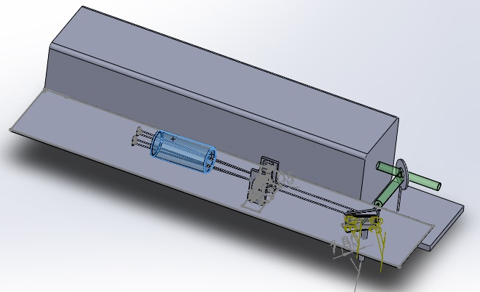
High Spectral Resolution Lidar Design
Notes:
The HSRL is using the Iodine absorption filter technique at 532nm. In our system, the emmision calibration unit was conceived to be physically attached to the laser unit. This permits to move the seeder and laser with the whole structure anywhere and operate it even without the presence of the detection unit. This emission calibration unit is set to tune laser wavelength to the Iodine absorption line.

Slide 15
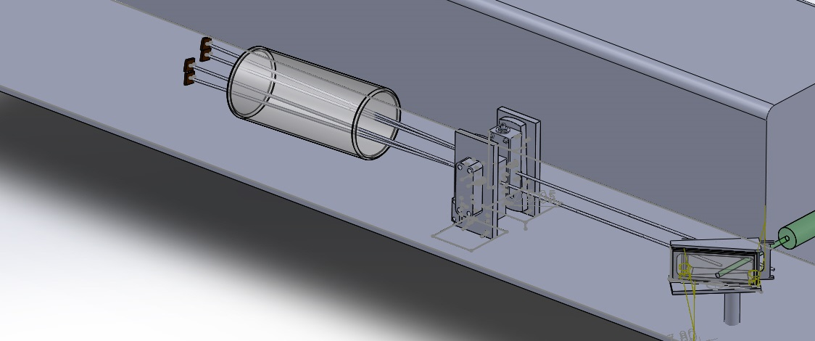
HARDWARE/DESIGN & CONSTRUCTION
Notes:
This emission calibration unit consists of a optical glass to generate two beams, and two acoustic optical modulator to shift the laser wavelength in few pm, and Iodine cell, and finally photodiode. The laser beams are measured after passing this Iodine cell. Scanning the laser wavelength by changing the laser cavity, we can find the iodine absorption line from the measured laser signal.

Slide 16
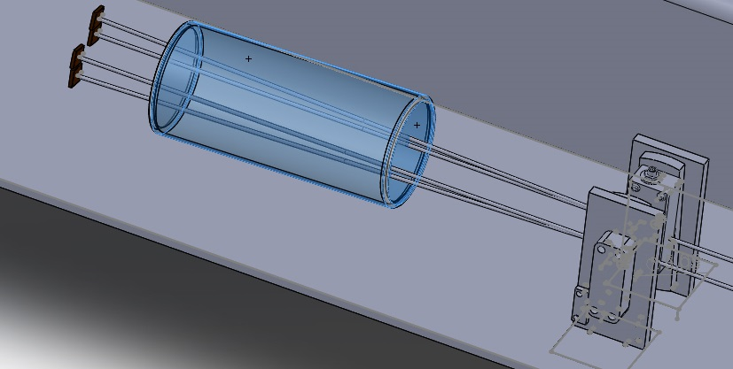
HARDWARE/DESIGN & CONSTRUCTION

Slide 17
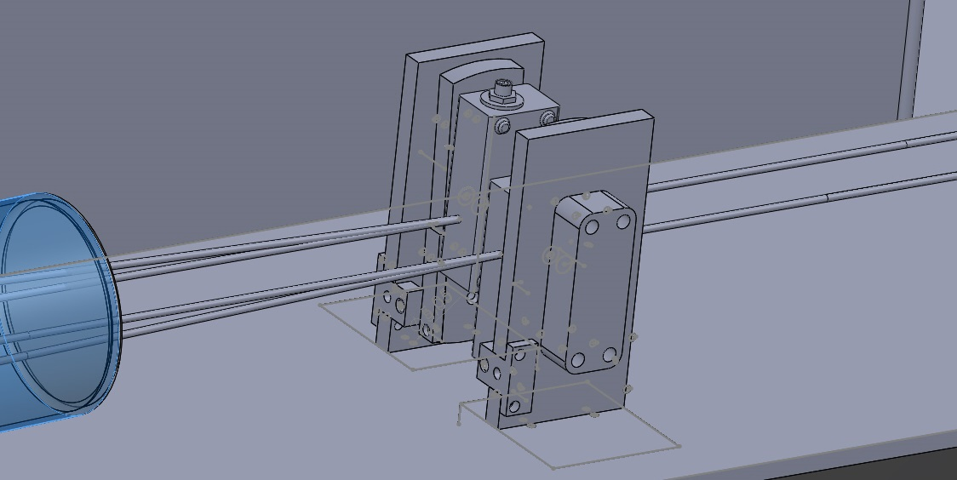
HARDWARE/DESIGN & CONSTRUCTION
Notes:
This part is a mount for AOM desgined by Pablo and quite new. The two units share the same angle in the same direction but are placed in oposite directions, then the wave propagates in different directions.

Slide 18
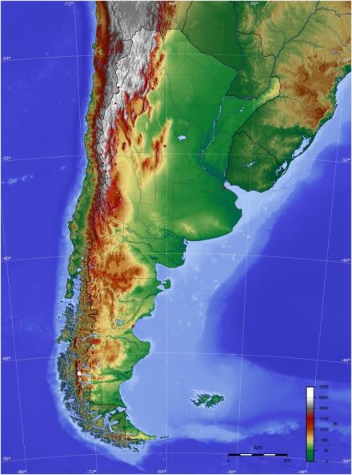
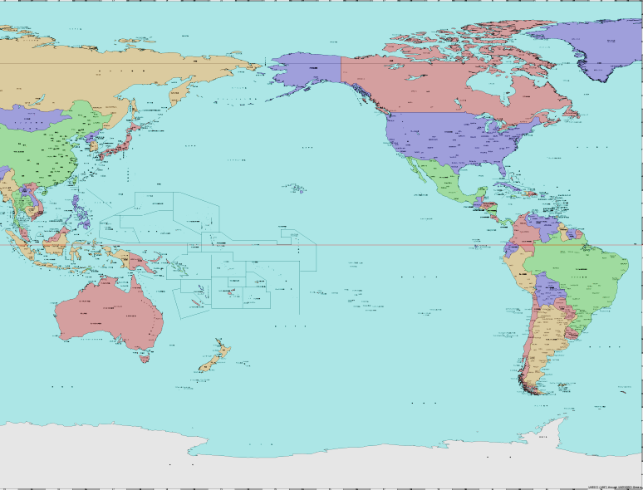
Software Retrieval and Analysis

Slide 19
Software Retrieval and Analysis
Each Station links to the NIES FTP server for backup.
FTP server is then downloaded to Prof. Sugimoto SFTP server.
Data analysis is done at NIES
Data analysis will be done at CITEDEF
Comodoro experience shows that near real time analysis is possible

Slide 20
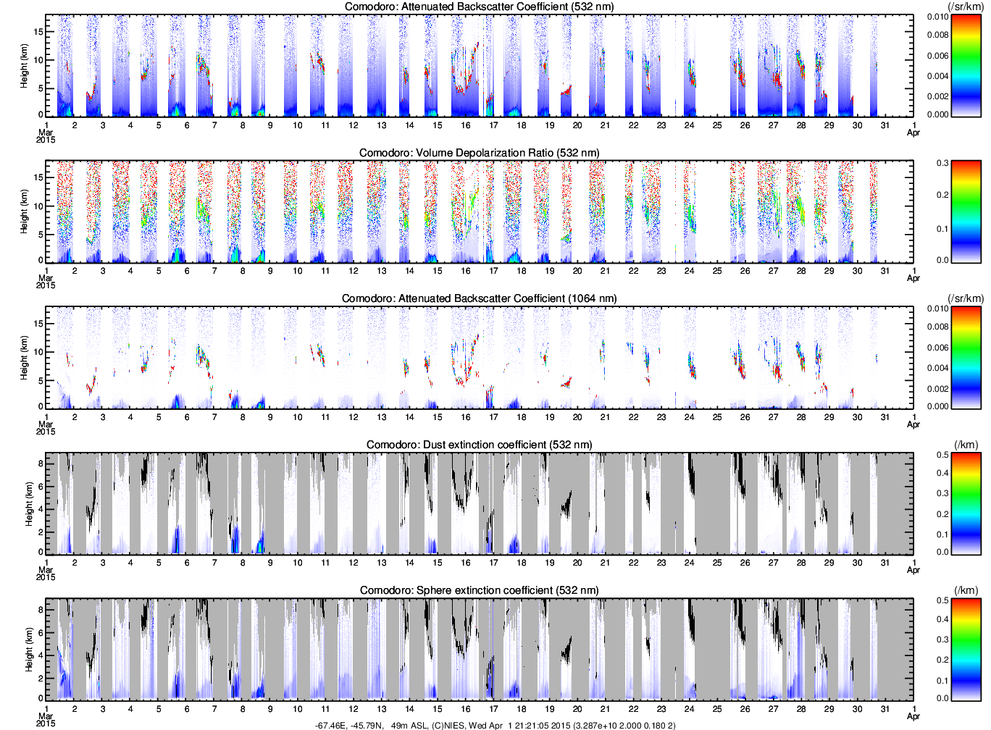
Software Retrieval and Analysis
March 2015
Notes:
The analysis method was presented by my poster presentation yeasterday.

Slide 21
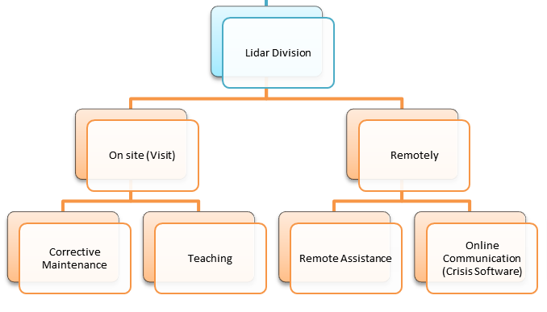
OPERATION/LIDAR DIVISION & UMAG
Lidar Maintenance and Teaching
Bariloche: December 2014
Comodoro: Third week 2015
Neuquén: Fourth week 2015
Río Gallegos and Aeroparque
Continuous, not scheduled
Remote Assistance
Based on Team Viewer. No VPN. Need to be improved.
Innovared may be studied as a possible solution
Online Communication
Crisis software already implemented for SABER.Net already presented at the National Risk Management System, MINCyT
Comunication channel is going to migrate to Crisis Software
Notes:
Pablo runs and runs for maintenance and teaching.

Slide 22
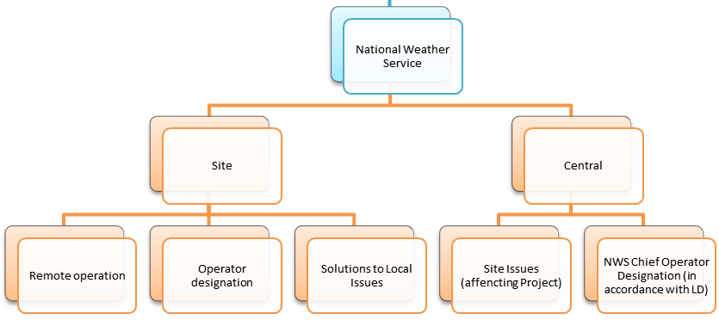
OPERATION/NWS & UMAG
Operator course planned for April 20 to April 24, 2015
Forcasters course planned for 2nd half of 2015
Teaching on regular basis already discussed, application structure pending
Notes:
Some sourses will be planed.

