Slide 1
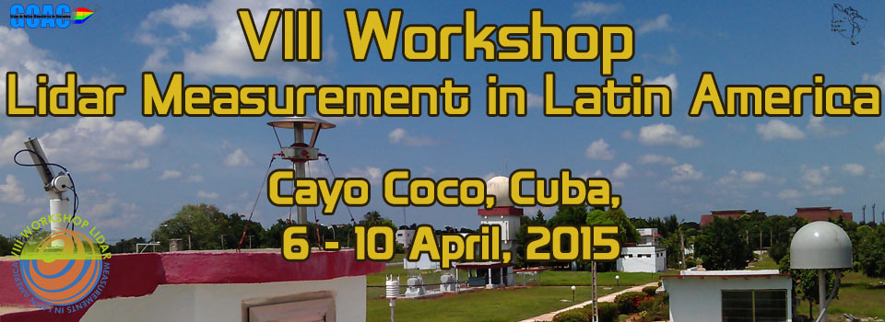



UNIVERSIDAD NACIONAL DE COLOMBIA
Sede Medellín
Lidar Observatory of the Atmosphere-LOA
Lasers and Spectoscopy Group
Radiative Forcing Effects on Planetary Boundary Layer Evolution in the Tropical Andean Zone, Medellin – Colombia: Synergy Lidar and Sun Photometer
Daniel Nisperuza, Andrés Bedoya, Dairo Alegría, Mauricio Múnera, and Álvaro Bastidas

Slide 2

Outline
SITE AND INFRASTRUCTURE
OVERVIEW
MEASUREMENTS AND RESULTS
CONCLUSIONS

Slide 3
Site and Infrastructure
SITE
The Lasers and Spectroscopy Group, promotes the development and use of technologies for atmospheric observation of aerosols in Colombia. The support of Latin American Lidar Network - LALINET with technical workshops to effective training of students and young researchers on lidar techniques, and local sponsorship of Air Quality Laboratory - CALAIRE, have enabled the building of the first Lidar Station at Medellín city (Lat: 6.26038°, Long: -75.5778°, Alt: 1471 m.a.s.l.). Overview of the aerosol remote sensing activities is shown here.
1471 m. a.s.l.

Slide 4
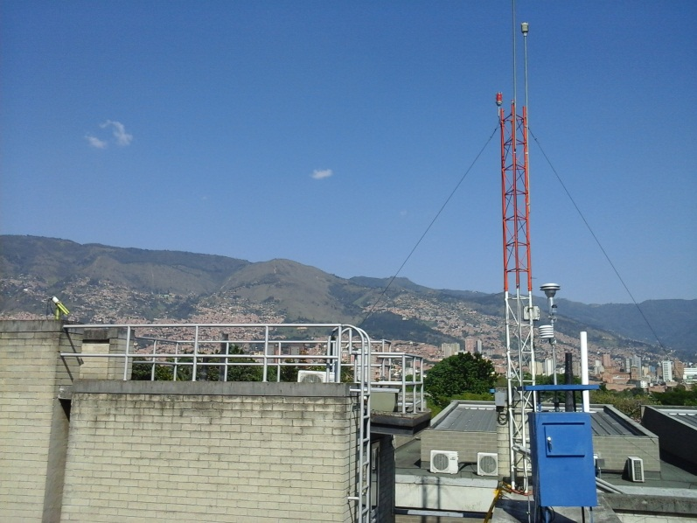
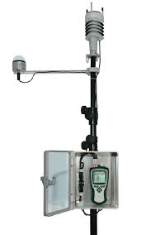
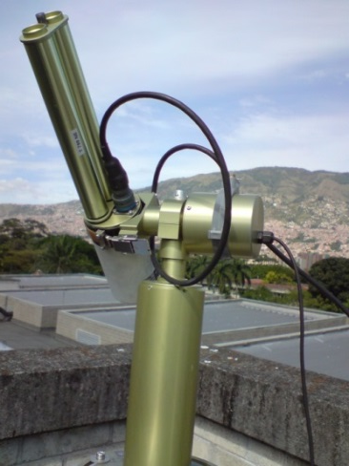
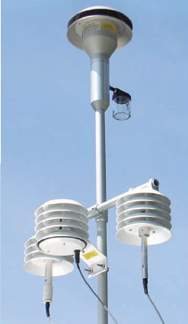
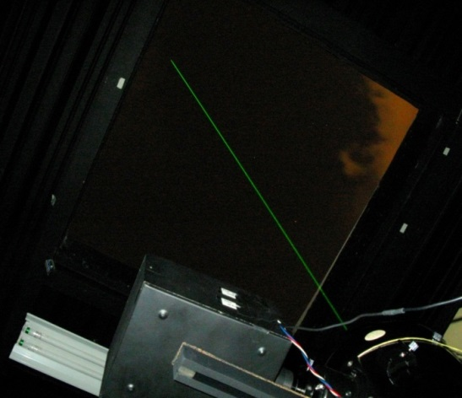
LALINET: Lidar Observatory of the Atmosphere
Observations of key atmospheric parameters related to aerosol and transport, air quality, and climate.
Weather Station
Sun Photometer
Lidar
PM2.5

Slide 5
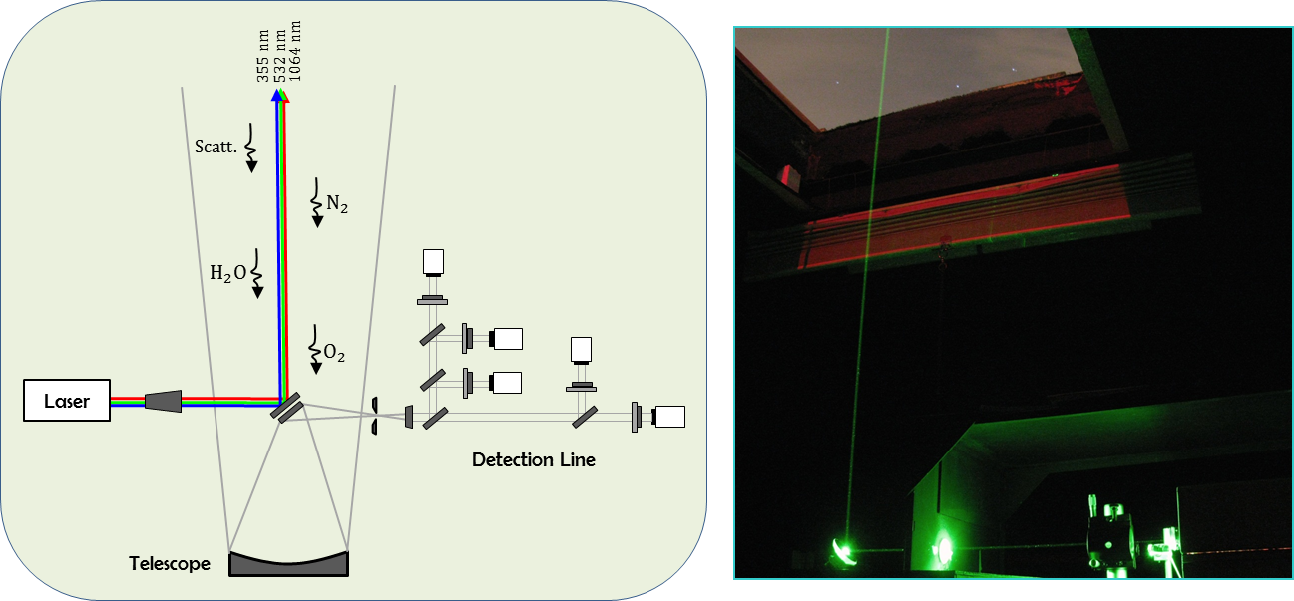
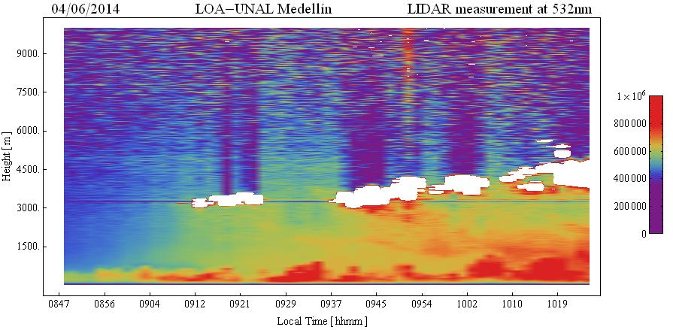
Lidar System
Laser Gain medium: Nd:YAG Energy: 0.4 J/1064 nm; 0.2 J/532 nm; 0.08 J/355 nm Divergence: 0.5 mrad Pulse length: 6 ns PRF: 10 Hz
Receiver Focal length: 120 cm Aperture: 20 cm Detectors: PMT´s
Specifications Configuration: Vertical coaxial Acquisition: 20 - 40 MHz/16 bit Spacial resolution: 3.5; 7.5; 15; and 30 m
Observation of vertical profiles
of optical aerosol properties.

Slide 6
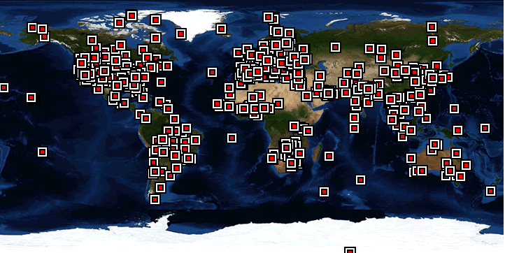
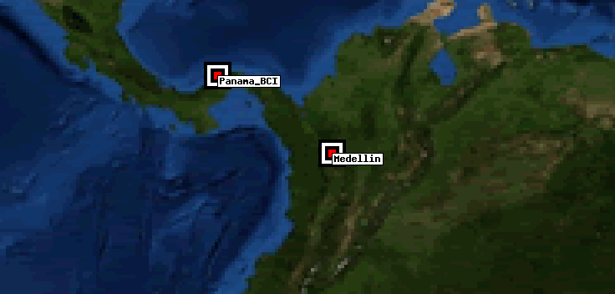
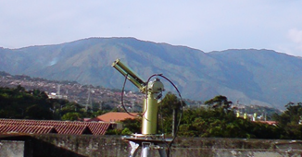
Sun Photometer NASA-AERONET, Medellín Site
Instrument characteristics and observational specifications
Detector Number of filters Number of collimators Field of view/Aperture Solar scanning Sky scanning Frequency of Sun acquisition Frequency of almucantar Frequency of principal plane obs. Frequency of zenith radiance obs. | Silicon 5 to 8 2 1.2°; one has 10 times the aperture of the other 4-quadrant detector Azimuth and zenith motors 0.5 airmass intervals for airmass > 2. Otherwise, 15 minutes apart. At airmass of 4 and 2; 4 times daily 4 per day Every 10 min, when not in any of the other observing modes
CE-318

Slide 7
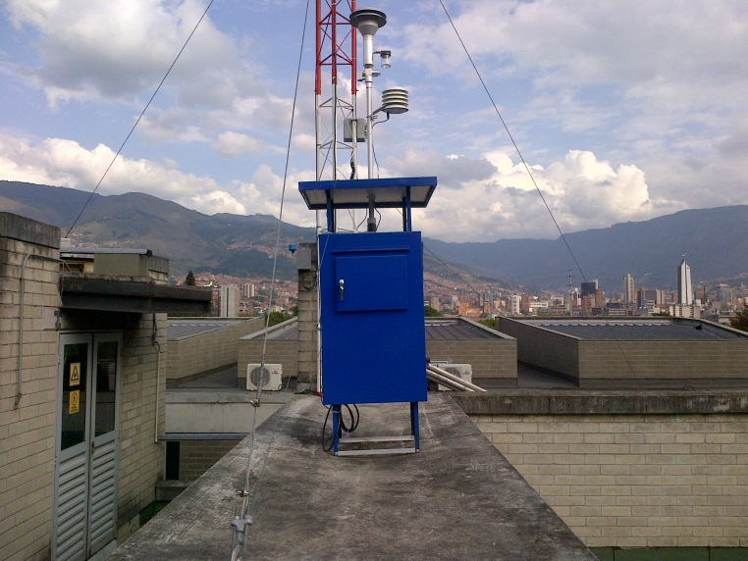
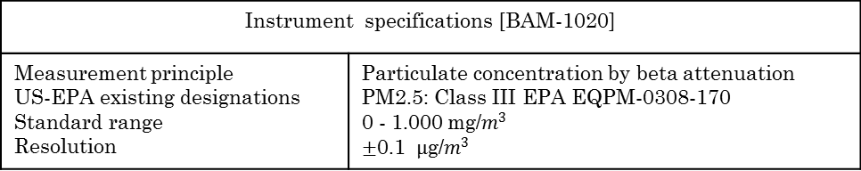
PM2.5 and PM10
Instrument specifications [BAM-1020]
Measurement principle US-EPA existing designations Standard range Resolution | Particulate concentration by beta attenuation PM2.5: Class III EPA EQPM-0308-170 0 - 1.000 mg/$m^{3}$ $$±\text{0.1 }µ\text{g}\text{/}m^{3}$$

Slide 8
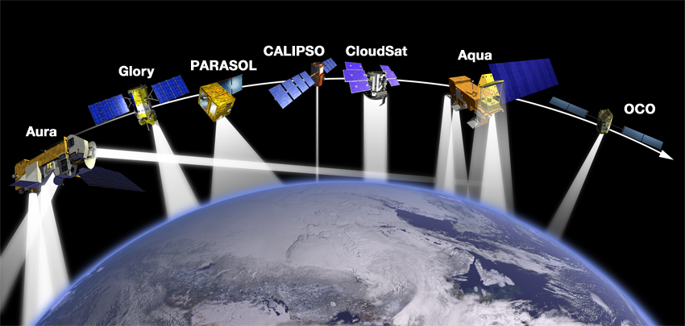

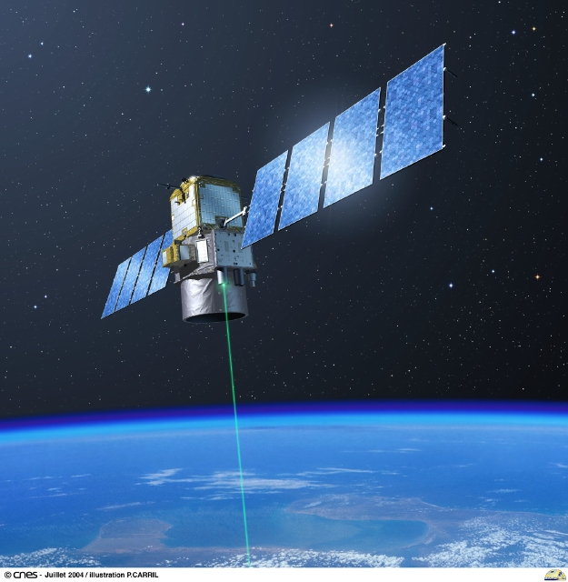
CALIOP
CALIPSO
Spectral selection
Telescope
Laser
Register
Atmosphere
A-Train Satellite constellation
CALIPSO
CALIOP instrumental characteristics
Laser | Nd: YAG.
Wavelength | 532 nm, 1064 nm
Energy | 220 mJ/@ 1064 nm 110 mJ/@ 532 nm
Frequency | 20.16 Hz
Telescope | 1.0 m diameter
Polarization | Lineal Paralell and Perpendicular at 532 nm
FOV | 130 µrad
Vertical resolution | 30-60 m
Horizontal resolution | 333 m, 1.5km, 5km
Dinamic range | 22 bits
Cloud – Aerosol LIDAR Infrared Pathfinder Satellite Observations

Slide 9
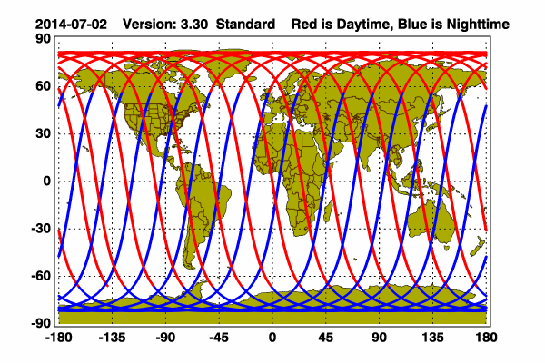
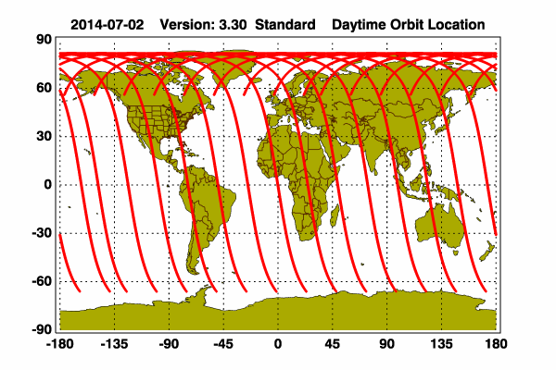
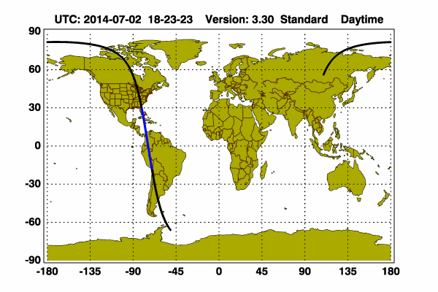
CALIPSO Trajectories
Polar trajectory
Daytime trajectory
300 m
13:46 Local Time
18:46 UTC
Daytime trajectory over America
Daytime trajectory
over Colombia
Daytime trajectory
over Aburra Valley

Slide 10
Overview
The planet boundary layer (PBL) is directly influenced by the Earth’s surface and responds to surface forcing with timescale of an hour or less [Stull,1988].
Height above
the earth surface
1 to 2 km
Inversion
Entriment zone
CBL
Residual Layer
Nocturnal Inversion
NBL
NBL
100 to 300 m
Sunrise
Sunset
Day Time
Classical daytime PBL evolution

Slide 11
Measurements and Results
Relative Humidity trend since May 2013 to December 2014

Slide 12
General measurements schedule (371 days)
Year | Month | Day
2013 | Jan. | 1 | 2 | 3 | 4 | 5 | 6 | 7 | 8 | 9 | 10 | 11 | 12 | 13 | 14 | 15 | 16 | 17 | 18 | 19 | 20 | 21 | 22 | 23 | 24 | 25 | 26 | 27 | 28 | 29 | 30 | 31
 | Feb. | 1 | 2 | 3 | 4 | 5 | 6 | 7 | 8 | 9 | 10 | 11 | 12 | 13 | 14 | 15 | 16 | 17 | 18 | 19 | 20 | 21 | 22 | 23 | 24 | 25 | 26 | 27 | 28
 | Mar. | 1 | 2 | 3 | 4 | 5 | 6 | 7 | 8 | 9 | 10 | 11 | 12 | 13 | 14 | 15 | 16 | 17 | 18 | 19 | 20 | 21 | 22 | 23 | 24 | 25 | 26 | 27 | 28 | 29 | 30 | 31
 | Apr. | 1 | 2 | 3 | 4 | 5 | 6 | 7 | 8 | 9 | 10 | 11 | 12 | 13 | 14 | 15 | 16 | 17 | 18 | 19 | 20 | 21 | 22 | 23 | 24 | 25 | 26 | 27 | 28 | 29 | 30
 | May. | 1 | 2 | 3 | 4 | 5 | 6 | 7 | 8 | 9 | 10 | 11 | 12 | 13 | 14 | 15 | 16 | 17 | 18 | 19 | 20 | 21 | 22 | 23 | 24 | 25 | 26 | 27 | 28 | 29 | 30 | 31
 | Jun. | 1 | 2 | 3 | 4 | 5 | 6 | 7 | 8 | 9 | 10 | 11 | 12 | 13 | 14 | 15 | 16 | 17 | 18 | 19 | 20 | 21 | 22 | 23 | 24 | 25 | 26 | 27 | 28 | 29 | 30
 | Jul. | 1 | 2 | 3 | 4 | 5 | 6 | 7 | 8 | 9 | 10 | 11 | 12 | 13 | 14 | 15 | 16 | 17 | 18 | 19 | 20 | 21 | 22 | 23 | 24 | 25 | 26 | 27 | 28 | 29 | 30 | 31
 | Aug. | 1 | 2 | 3 | 4 | 5 | 6 | 7 | 8 | 9 | 10 | 11 | 12 | 13 | 14 | 15 | 16 | 17 | 18 | 19 | 20 | 21 | 22 | 23 | 24 | 25 | 26 | 27 | 28 | 29 | 30 | 31
 | Sep. | 1 | 2 | 3 | 4 | 5 | 6 | 7 | 8 | 9 | 10 | 11 | 12 | 13 | 14 | 15 | 16 | 17 | 18 | 19 | 20 | 21 | 22 | 23 | 24 | 25 | 26 | 27 | 28 | 29 | 30
 | Oct. | 1 | 2 | 3 | 4 | 5 | 6 | 7 | 8 | 9 | 10 | 11 | 12 | 13 | 14 | 15 | 16 | 17 | 18 | 19 | 20 | 21 | 22 | 23 | 24 | 25 | 26 | 27 | 28 | 29 | 30 | 31
 | Nov. | 1 | 2 | 3 | 4 | 5 | 6 | 7 | 8 | 9 | 10 | 11 | 12 | 13 | 14 | 15 | 16 | 17 | 18 | 19 | 20 | 21 | 22 | 23 | 24 | 25 | 26 | 27 | 28 | 29 | 30
 | Dic. | 1 | 2 | 3 | 4 | 5 | 6 | 7 | 8 | 9 | 10 | 11 | 12 | 13 | 14 | 15 | 16 | 17 | 18 | 19 | 20 | 21 | 22 | 23 | 24 | 25 | 26 | 27 | 28 | 29 | 30 | 31
Year | Month | Day
2014 | Jan. | 1 | 2 | 3 | 4 | 5 | 6 | 7 | 8 | 9 | 10 | 11 | 12 | 13 | 14 | 15 | 16 | 17 | 18 | 19 | 20 | 21 | 22 | 23 | 24 | 25 | 26 | 27 | 28 | 29 | 30 | 31
 | Feb. | 1 | 2 | 3 | 4 | 5 | 6 | 7 | 8 | 9 | 10 | 11 | 12 | 13 | 14 | 15 | 16 | 17 | 18 | 19 | 20 | 21 | 22 | 23 | 24 | 25 | 26 | 27 | 28
 | Mar. | 1 | 2 | 3 | 4 | 5 | 6 | 7 | 8 | 9 | 10 | 11 | 12 | 13 | 14 | 15 | 16 | 17 | 18 | 19 | 20 | 21 | 22 | 23 | 24 | 25 | 26 | 27 | 28 | 29 | 30 | 31
 | Apr. | 1 | 2 | 3 | 4 | 5 | 6 | 7 | 8 | 9 | 10 | 11 | 12 | 13 | 14 | 15 | 16 | 17 | 18 | 19 | 20 | 21 | 22 | 23 | 24 | 25 | 26 | 27 | 28 | 29 | 30
 | May. | 1 | 2 | 3 | 4 | 5 | 6 | 7 | 8 | 9 | 10 | 11 | 12 | 13 | 14 | 15 | 16 | 17 | 18 | 19 | 20 | 21 | 22 | 23 | 24 | 25 | 26 | 27 | 28 | 29 | 30 | 31
 | Jun. | 1 | 2 | 3 | 4 | 5 | 6 | 7 | 8 | 9 | 10 | 11 | 12 | 13 | 14 | 15 | 16 | 17 | 18 | 19 | 20 | 21 | 22 | 23 | 24 | 25 | 26 | 27 | 28 | 29 | 30
 | Jul. | 1 | 2 | 3 | 4 | 5 | 6 | 7 | 8 | 9 | 10 | 11 | 12 | 13 | 14 | 15 | 16 | 17 | 18 | 19 | 20 | 21 | 22 | 23 | 24 | 25 | 26 | 27 | 28 | 29 | 30 | 31
 | Aug. | 1 | 2 | 3 | 4 | 5 | 6 | 7 | 8 | 9 | 10 | 11 | 12 | 13 | 14 | 15 | 16 | 17 | 18 | 19 | 20 | 21 | 22 | 23 | 24 | 25 | 26 | 27 | 28 | 29 | 30 | 31
 | Sep. | 1 | 2 | 3 | 4 | 5 | 6 | 7 | 8 | 9 | 10 | 11 | 12 | 13 | 14 | 15 | 16 | 17 | 18 | 19 | 20 | 21 | 22 | 23 | 24 | 25 | 26 | 27 | 28 | 29 | 30
 | Oct. | 1 | 2 | 3 | 4 | 5 | 6 | 7 | 8 | 9 | 10 | 11 | 12 | 13 | 14 | 15 | 16 | 17 | 18 | 19 | 20 | 21 | 22 | 23 | 24 | 25 | 26 | 27 | 28 | 29 | 30 | 31
 | Nov. | 1 | 2 | 3 | 4 | 5 | 6 | 7 | 8 | 9 | 10 | 11 | 12 | 13 | 14 | 15 | 16 | 17 | 18 | 19 | 20 | 21 | 22 | 23 | 24 | 25 | 26 | 27 | 28 | 29 | 30
 | Dic. | 1 | 2 | 3 | 4 | 5 | 6 | 7 | 8 | 9 | 10 | 11 | 12 | 13 | 14 | 15 | 16 | 17 | 18 | 19 | 20 | 21 | 22 | 23 | 24 | 25 | 26 | 27 | 28 | 29 | 30 | 31

Slide 13
PBL obtained by using WCT method

Slide 14
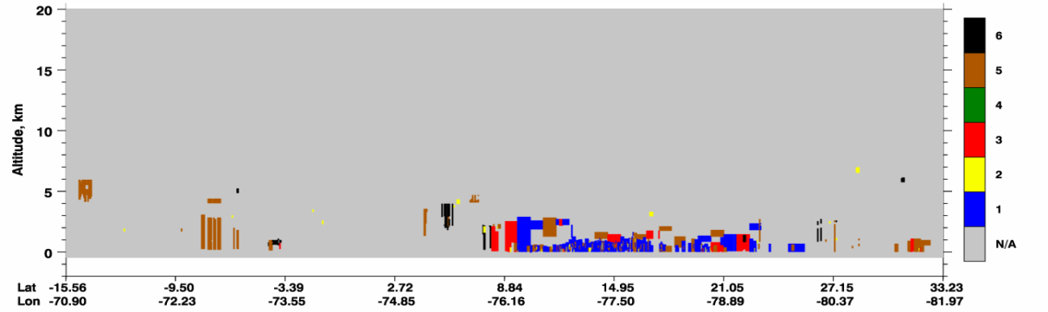
Aerosol layers from CALIOP
January 20 - 2013

Slide 15
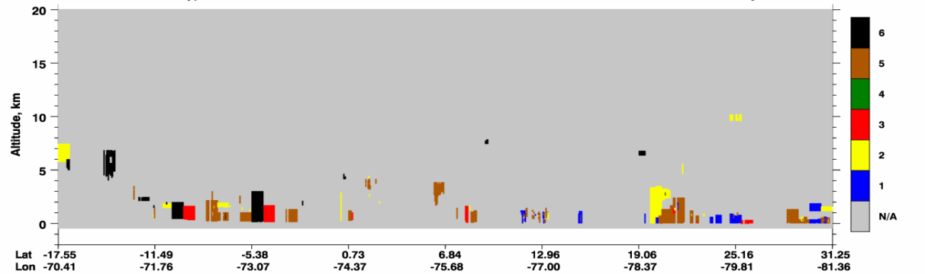
June 16 - 2014

Slide 16
Aerosol layer height and PBL height correlation

Slide 19
Time of PBL lifting

Slide 20
Conclusions
Synergy between Lidar-UNAL, sun photometer and satellite measurements allows the study of vertical structure of the atmosphere in Medellin – Colombia.
On days with similar weather conditions like relative humidity below 50% at 12:00 local time and clear sky, there is a predominance of the effects of solar radiation on Medellin atmosphere giving place to spatial redistribution of aerosol within of PBL around 09:30 – 09:45 local time.
Radiative forcing in Medellin can be seen in behavior of aerosol optical properties: AOD and backscatter coefficient. Backscatter coefficient show a spatial redistribution of aerosol facilitating a decreasing of AOD values while temperature is increasing on surface.

Slide 21
References
Kovalev K, Eichinger W, Elastic LIDAR: Theory, Practice and Analysis Methods, Ed. John wile & Sons, 2004.
Francesc Rocadenbosch, Lidar sensing of the atmosphere: Reciever design and inversion algorithms for an elastic system, Doctor-Egineer thesis, Universidad Politecnica de Cataluñoa, 1996.
Wallace, J., Hobbs, P. Atmospheric Science: An Introductory Survey, Ed. Academic Press – Elsevier, 2006.
Stull R.B., Wallace, J., Hobbs, P. The Atmospheric Boundary Layer: An introductory survey, Segunda Edición, Ed. Academic Press. 2006.
Daniel Nisperuza and Álvaro Bastidas, Development of a Tropospheric Lidar for Observations of the Planetary Boundary Layer above Medellín, Colombia, Journal of Physical Science and Application 1, 163-169. ISSN: 2195-5348, 2011.
S. Nuñez, Altura de la Capa de Mezcla: Caracterización Experimental y Aplicación de un Modelo Meteorológico para el Estudio de su Evolución Diurna, Tesis Doctoral, Universidad Complutense de Madrid, Madrid, 2001.
Mariana Adam, DEVELOPMENT OF LIDAR TECHNIQUES TO ESTIMATE ATMOSPHERIC OPTICAL PROPERTIES, PhD Thesis, Johns Hopkins University, Baltimore, Maryland, 2005.
Weitkamp, C. Range- Resolved Optical Remote Sensing of the Atmosphere. Germany: Springer. (2005).
De Tomasi Fernandino, Perroni Maria, PBL and Dust Layer Seasonal Evolution by LIDAR and Radiosounding Measurement over a Peninsular Site, Elsevier-doi:10.1016/j.atmosres.2005.06.010.
Wolfram, E., Salvador, J., Orte, F, D’Elia, R., Quel, E., Systematic Ozone and Solar UV Measurements in the Observatorio Atmosférico de la Patagonia Austral, Argentina, Revista Boliviana de Física Vol. 20, ISSN 1562-3823, Pág: 13-15, 2011.
Ana María Díaz Rodriguez, Caracterización de los aerosoles atmosféricos y su influencia en los niveles de radiación UV en la región de Canarias. Tesis Doctoral, Universidad de la Laguna, Islas Canarias, 2005.
Vergaz Benito Ricardo, Caracterización de los aerosoles atmosféricos, Óptica Pura y Aplicada Vol. 34, Pág: 57-77, 2001.
INFORME DEL ESTADO DEL MEDIO AMBIENTE Y DE LOS RECURSOS NATURALES RENOVABLES, IDEAM, 2010.
Jiménez J., Palacio C., Aproximación Conceptual al Diseño de una Red de calidad del Aire en el Valle de Aburrá – Colombia, IX Congreso Colombiano de Meteorología, Publica: IDAEM-Universidad Nacional de Colombia, 2011.
WILFORD ZDUNKOWSKI, THOMAS TRAUTMANN, ANDREAS BOTT, RADIATION IN THE ATMOSPHERE: A Course in Theoretical Meteorology. Ed. CAMBRIDGE UNIVERSITY PRESS, ISBN-13 978-0-511-27560-9, 2007.

Slide 22
M. Born and E. Wolf, Principles of Optics: Electromagnetic Theory of Propagation, Interference and Diffraction of Light, Ed. Pergamon Press, 1970.
J. Cabrera, F. Agulló, F. López, Óptica Electromagnética II: Materiales y Aplicaciones, Ed. Addison-Wesley, 2000.
Amnon Yariv, Quantum Electronics, Ed. John Wiley & Sons Inc. 1989.
A. Sepúlveda, Notas de Electrodinámica Clásica, Universidad de Antioquia, Departamento de Física, 1986.
J. Jackson, Classical Electrodynamics, Ed. John Wiley & Sons Inc. 1962.
Álvaro E. Bastidas, Construcción y montaje de un lidar elástico aplicado al estudio de partículas atmosféricas en suspensión y a la contaminación atmosférica en la región del Cauca, Tesis Doctoral, Universidad del Valle, 2004.
http://www.wolfram.com/mathematica/new-in-10/?src=google&416&gclid=CKG2tqT008MCFYQvgQodfWsAkw
B. A. Bodhaine, N. B. On the rayleigh depth calculations. Journal of atmospheric and oceanic tecnology, 8. (1999).
Whiteman, D. N. Examination of the traditional Raman lidar technique. I. Evaluating the temperature- dependent lidar equations. Applied Optics, 22. 2003.
C. Fröhlich, G. E. New determination of Raylegih dispersión in the terrestrial Atmosphere. Applied Optics, 3. (1980).
http://ready.arl.noaa.gov/HYSPLIT.php
H. M. J. Barbosa, F. J. S. Lopes, A. Silva, D. Nisperuza, B. Barja, P. Ristori, D. A. Gouveia, C. Jimenez, E. Montilla, G. L. Mariano, E. Landulfo, A. Bastidas, E. J. Quel, The first ALINE measurements and intercomparison exercise on lidar inversion algorithms, Opt. Pura Apl. 47 (2) 99-108. doi: http://dx.doi.org/10.7149/OPA.47.2.99 , 2014.
N. Sanna, Vector spherical harmonics: Concepts and applications to the single center expansion method, Computer Physics Communications 132 66–83, Elsevier, 2000.
A. Bedoya, Lidar Ultravioleta para estudiar el origen de aerosoles en la baja tropósfera de Medellín. , Tesis de Maestría, Universidad Nacional de Colombia Sede Medellín, 2014.
J. L. Guerrero-Rascado, E. Landulfo, J. C. Antuña, H. M. J. Barbosa, B. Barja, A. E.Bastidas, A. E. Bedoya, R. da Costa, R. Estevan, R. N. Forno, D. A. Gouveia, C. Jiménez, E., G. Larroza, F. J. S. Lopes, E. Montilla-Rosero, G. A. Moreira, W. M. Nakaema, D. Nisperuza, L. Otero, J. V. Pallotta, S., E. Pawelko, E. J. Quel, P. Ristori, P. F. Rodrigues, J. Salvador, M. F. Sánchez, and A. Silva, Towards an instrumental harmonization in the framework of LALINET: dataset of technical specifications, Proc. of SPIE Vol. 9246 92460O-1· doi: 10.1117/12.2066873, 2014.
James D. Klett, LIDAR Calibration and Extinction Coefficient, Applied Optics, Vol. 22, No 4, 1983.
James D. Klett, LIDAR Inversion with Variable Bascatter/Extinction ratios, Applied Optics, Vol. 24, No 11, 1985.
James D. Klett, Extinction Boundary Value Algorithms for LIDAR Inversion, Applied Optics, Vol. 25, No 15, 1986.
Fenn, R. Correlation between atmospheric backscattering and meteorological visual range. Applied optics, 5, 615-616. (1966).
Cattall, C. R. Variability of aerosol and spectral lidar and retrodispersión and extinction ratios of a key aerosol types derived from selected Aerosol Robotic Network Locations. Journal of Geophysical Research, 110. (2005).

Slide 23
He S. Q., L. C. A study on the aerosol extinction-to-retrodispersión ratio with combination of micro-pulse LIDAR and MODIS over Hong Kong. Atmospheric Chemistry and Physics, 6, 3243-3256. (2006).
J.D. Spinhirne et. al, Vertical distribution of aerosol extinction cross section and inference of aerosol imaginary index in the troposphere by lidar technique, Journal of Applied Meteorology, 1979.
Nikolay Kolev, Ivan Grigorov, Ivan Kolev, P.S.C. Devara, P. Ernest Raj y K.K. Dani, Lidar and sun photometer observation of atmospheric boundary-layer characteristics over an urban area in a mountain valley, Boundary-Layer Meteorol 124: 99-115, DOI 10.1007/s10546-006-9131-z,2007.
Rascado, J. L. Técnica lidar para la caracterización atmosférica mediante dispersión elástica y Raman. Granada: Universidad de Granada. 2009.
http://aeronet.gsfc.nasa.gov/
www.nasa.gov/
http://gaw.empa.ch/gawsis/reports.asp
http://www.actris.net/
A. Smimov, B. N. Holben, T. F. Eck, O. Dubovik, and I. Slutsker, Cloud-Screening and Quality Control Algorithms for the AERONET Database, REMOTE SENS. ENVIRON, 73:337-349, Elsevier 2000.
http://aeronet.gsfc.nasa.gov/new_web/Documents/AERONETcriteria_final1.pdf
http://disc.sci.gsfc.nasa.gov/giovanni/overview/index.html
http://www-calipso.larc.nasa.gov
http://www-calipso.larc.nasa.gov/about/atrain.php
http://www-calipso.larc.nasa.gov/about/payload.php
Winker, D. M., W. H. Hunt, and M. J. McGill, 2007: Initial performance assessment of CALIOP, Geophys. Res. Lett., 34, L19803, doi:10.1029/2007GL030135.
Winker, D. M., W. H. Hunt, and C. A. Hostetler, 2004: Status and Performance of the CALIOP Lidar, Proc. SPIE vol 5575, 8-15.
Kathleen Powell, Mark Vaughan, David Winker, Kam-Pui Lee, Michael Pitts, Charles Trepte Pauline Detweiler, William Hunt, James Lambeth, Patricia Lucker, Timothy Murray , Olivier Hagolle, Anne Lifermann and Michaël Faivre, Anne Garnier, Jacques Pelon, Cloud – Aerosol LIDAR Infrared Pathfinder Satellite Observations (CALIPSO) Data Management System Data Products Catalog, Document No: PC-SCI-503, Release 3.5 ii, National Aeronautics and Space Administration Langley Research Center, Hampton, Virginia 23681-2199, 2013.
CALIPSO Quality Statements, Lidar Level 2 Cloud and Aerosol Layer Products, Version Releases: 3.01-3.02, Atmospheric Science Data Center.
CALIPSO Quality Statements, Lidar Level 2 Vertical Feature Mask Product, Version Releases: 3.01-3.02, Atmospheric Science Data Center.
http://www.siata.gov.co/newpage/index.php

Slide 24
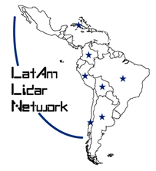



THANKS

