Slide 1






Comparison and merging of ozone profile data from lidar and other measurement techniques
S. Godin-Beekmann¹, S. Khaykin¹, M. Pastel¹, K. Hocke², E. Mahieu³, M. Palme⁴
¹LATMOS, UVSQ-CNRS, France
²U. Bern, Switzerland
³U. Liège, Belgium
⁴U. Bremen, Germany
VIII WLMLA , 6 – 10 April 2015, Cayo Coco, Cuba

Slide 2
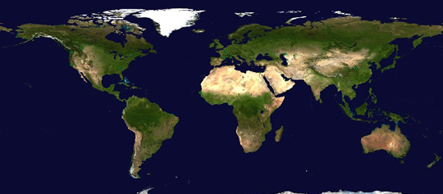
Background
NDACC: Implementation of several instrumental techniques for the long-term measurement of ozone vertical distribution, e.g. lidar, microwave and FTIR spectrometers
MACC – Monitoring Air Composition and Climate parameters: European project for the analysis and forecast of atmospheric composition & related parameters at global and regional scale (Copernicus programme)
Use of NDACC data to validate MACC ozone products (NORS European project)
Ny Alesund
Alpine stations
Izaña
La Réunion
VIII WLMLA , 6 – 10 April 2015, Cayo Coco, Cuba

Slide 3
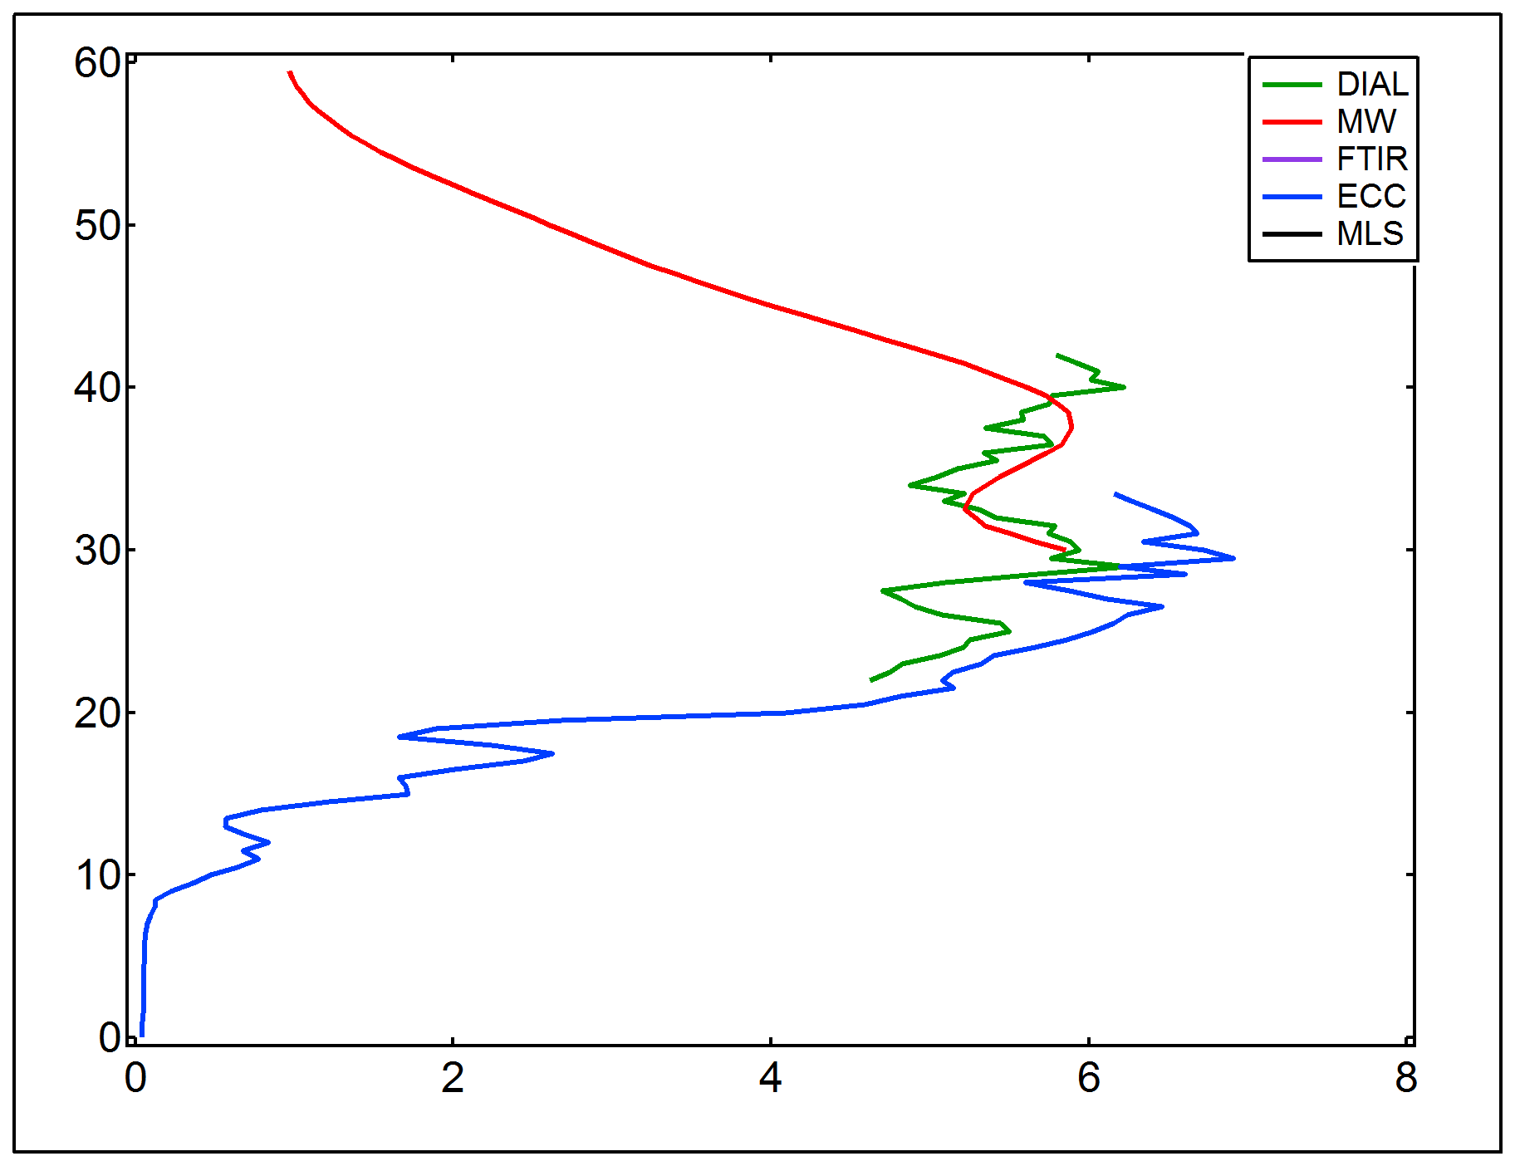
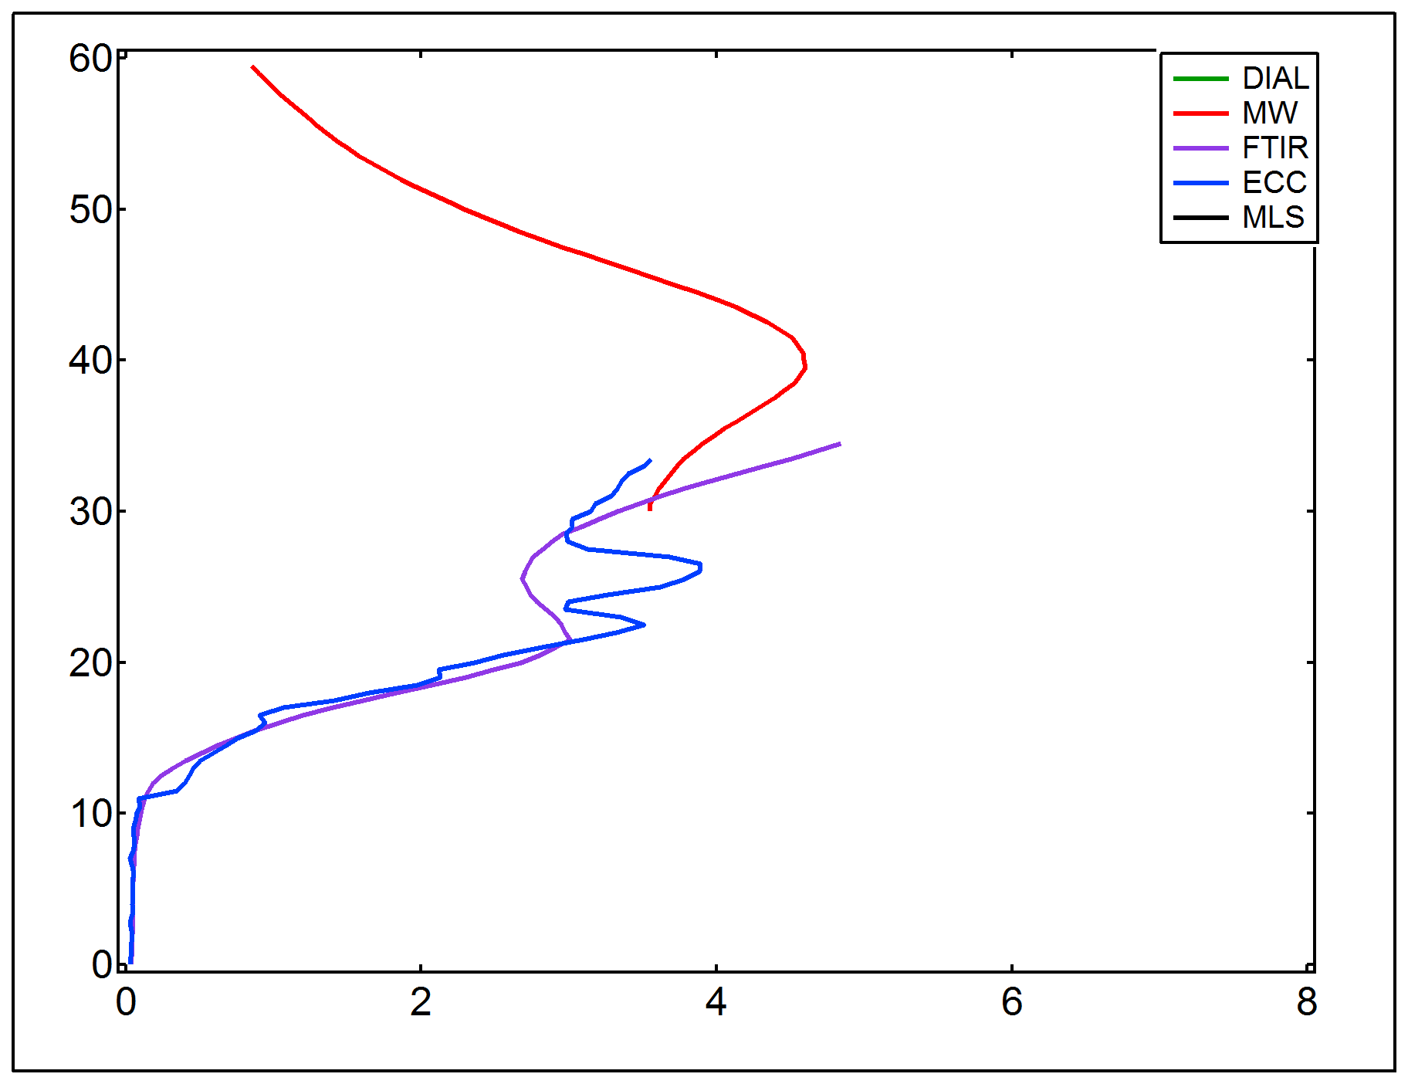
Rationale of the study
Within NDACC, the variety of ozone profile measuring techniques provide measurements with different altitude range, vertical resolution, uncertainty, etc...
Example of ozone profile measurements at NyAlesund
MW
MW
lidar
FTIR
sonde
sonde
Objectives
Develop a methodology for combining the various data sets and provide consistent ozone vertical distribution time series for MACC ozone fields validation
Provide easy to use ozone data series for end users
VIII WLMLA , 6 – 10 April 2015, Cayo Coco, Cuba

Slide 4
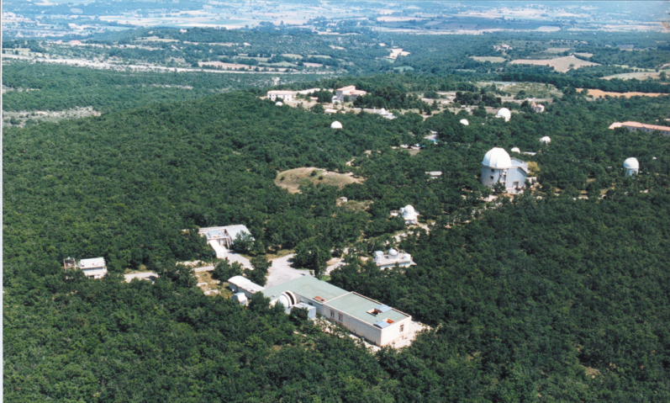
Ozone Measurements at OHP
Haute-Provence Observatory:
44°N, 6°E – part of NDACC
Various lidar measurements since late 70s and 80s: temperature, ozone, wind, aerosols, water vapor
Total ozone measurements:
  Dobson spectrometer since September 1983
  SAOZ UV-Visible spectrometer since January 1992
Ozone vertical distribution
  Stratospheric ozone lidar (1985 – routine from 1986)
  Tropospheric ozone lidar since 1991
  Ozone sondes: ECC from 1991 (SPC up to 1997, ENSCI)
  Dobson Umkehr since 1983
VIII WLMLA , 6 – 10 April 2015, Cayo Coco, Cuba

Slide 5
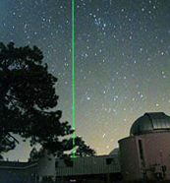
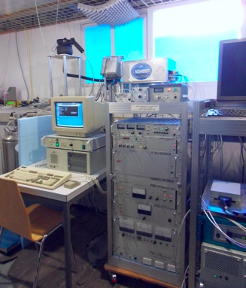
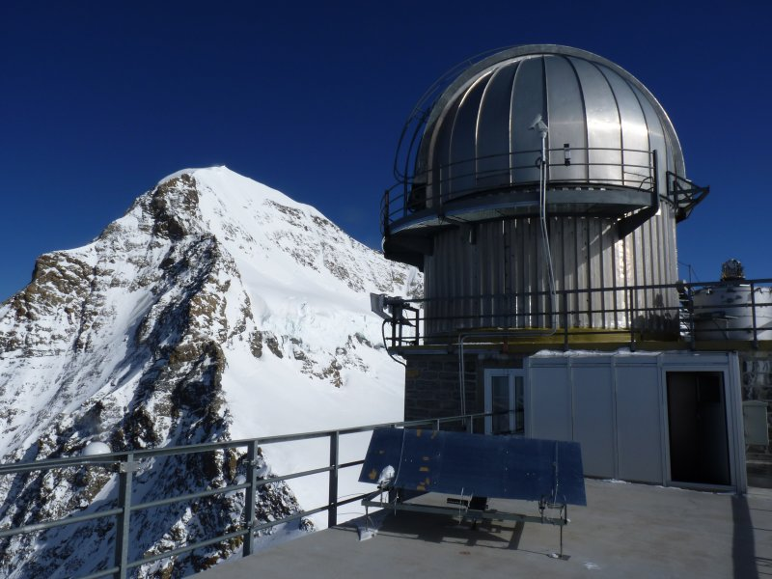
Measurement techniques
DIfferential Absorption Lidar technique
MicroWave Ozone spectrometer
Fourier Transform InfraRed spectrometer
Passive technique
Atmospheric absorption spectra used for the retrieval of ozone
wide spectral range 600 – 4500 cm⁻¹
high spectral resolution
Active technique
Emission of two laser radiations at wavelengths characterized by a different ozone absorption cross section (308 nm and 355 nm)
Passive technique
Measures ozone emission lines in the submillimeter range
VIII WLMLA , 6 – 10 April 2015, Cayo Coco, Cuba

Slide 6
Vertical resolution
Active remote sensing
Passive remote sensing
OHP lidar
Microwave Bern
FTIR Jungfraujoch
 | Altitude range (km) | Resolution (km)
LIDAR | 10 – 45 | 1 – 4.5
Microwave | 20 – 60 | 10 – 15
FTIR | 4 – 42 | 7 – 15
Ozone sondes | 0 – 35 | 0.3

Slide 7
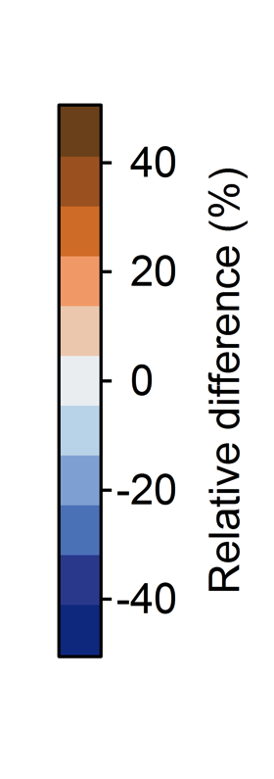
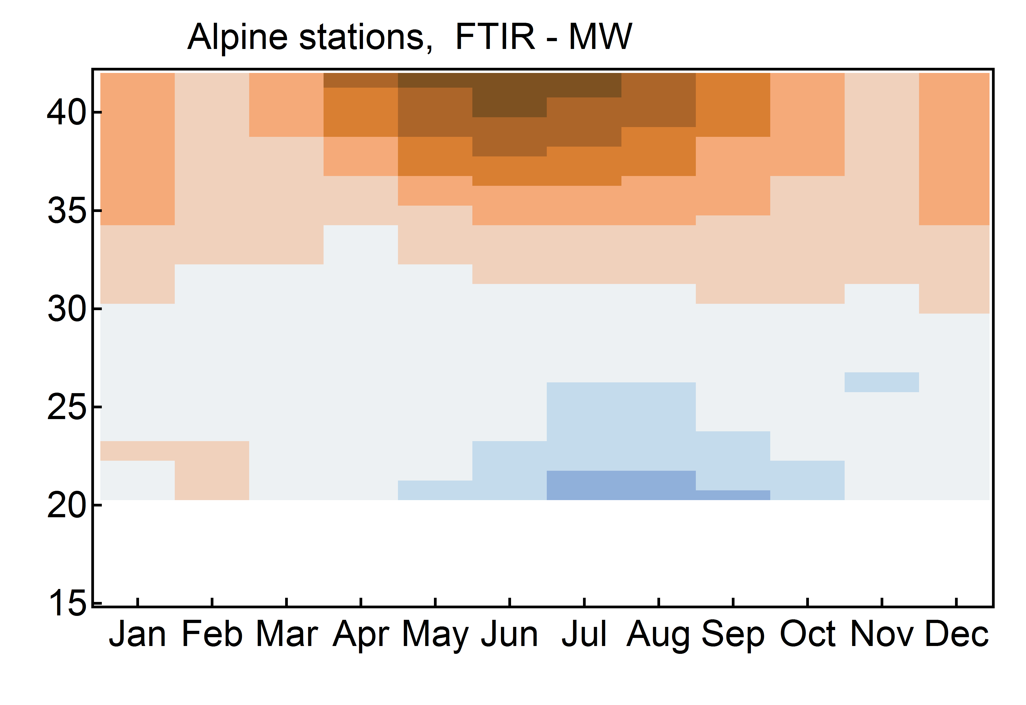
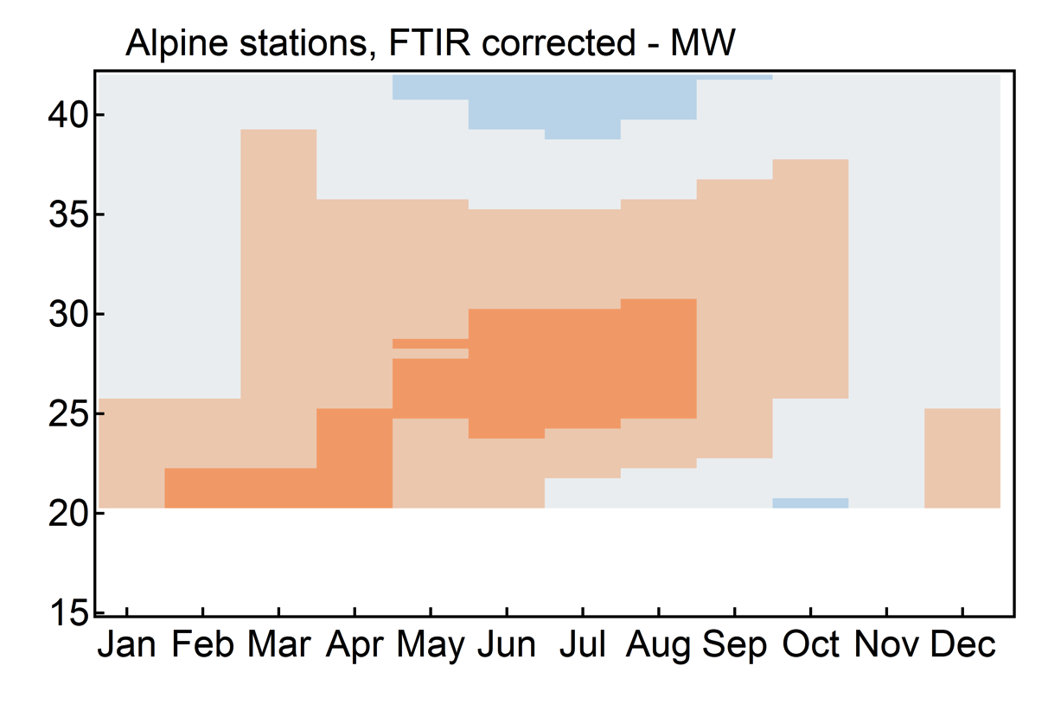
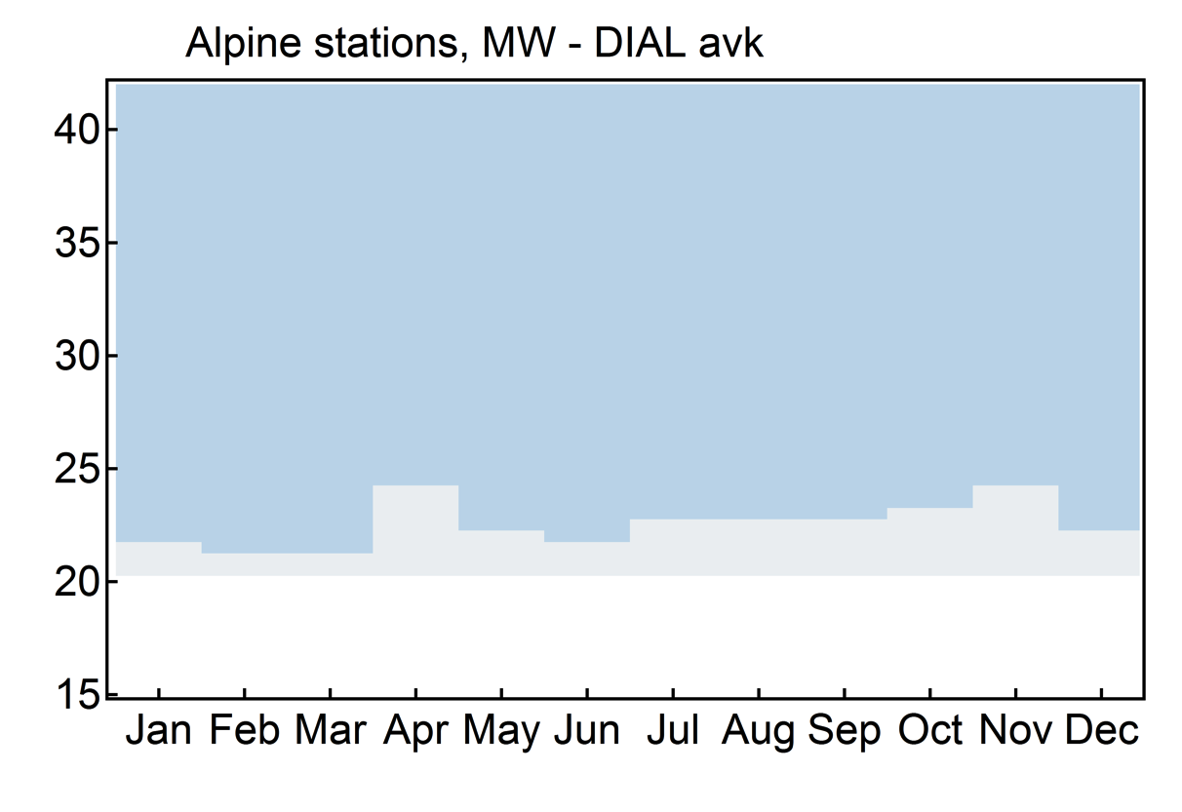
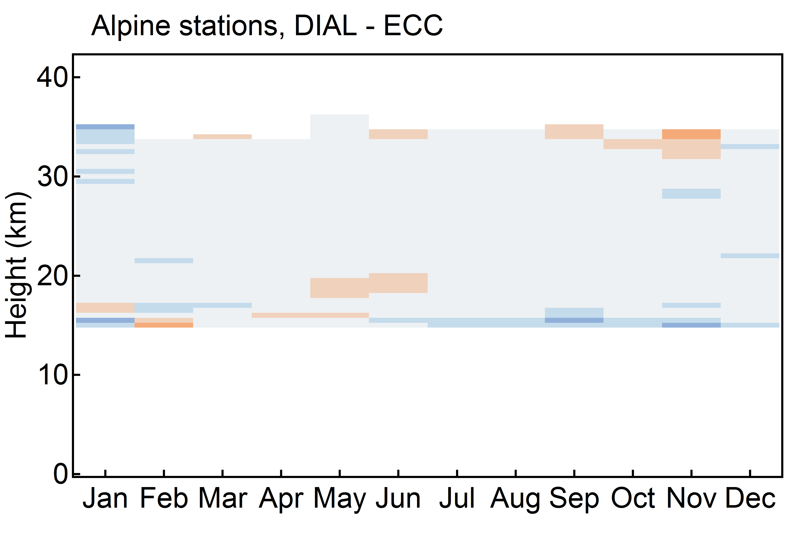
Evaluation of systematic differences
Example of Alpine station climatological differences
FTIR - MW
FTIR corr - MW
A priori profile correction
MW: monthly climatology
FTIR: annual climatology
-> correction of FTIR a priori
MW - DIAL smoothed
DIAL – ECC sondes
VIII WLMLA , 6 – 10 April 2015, Cayo Coco, Cuba

Slide 8
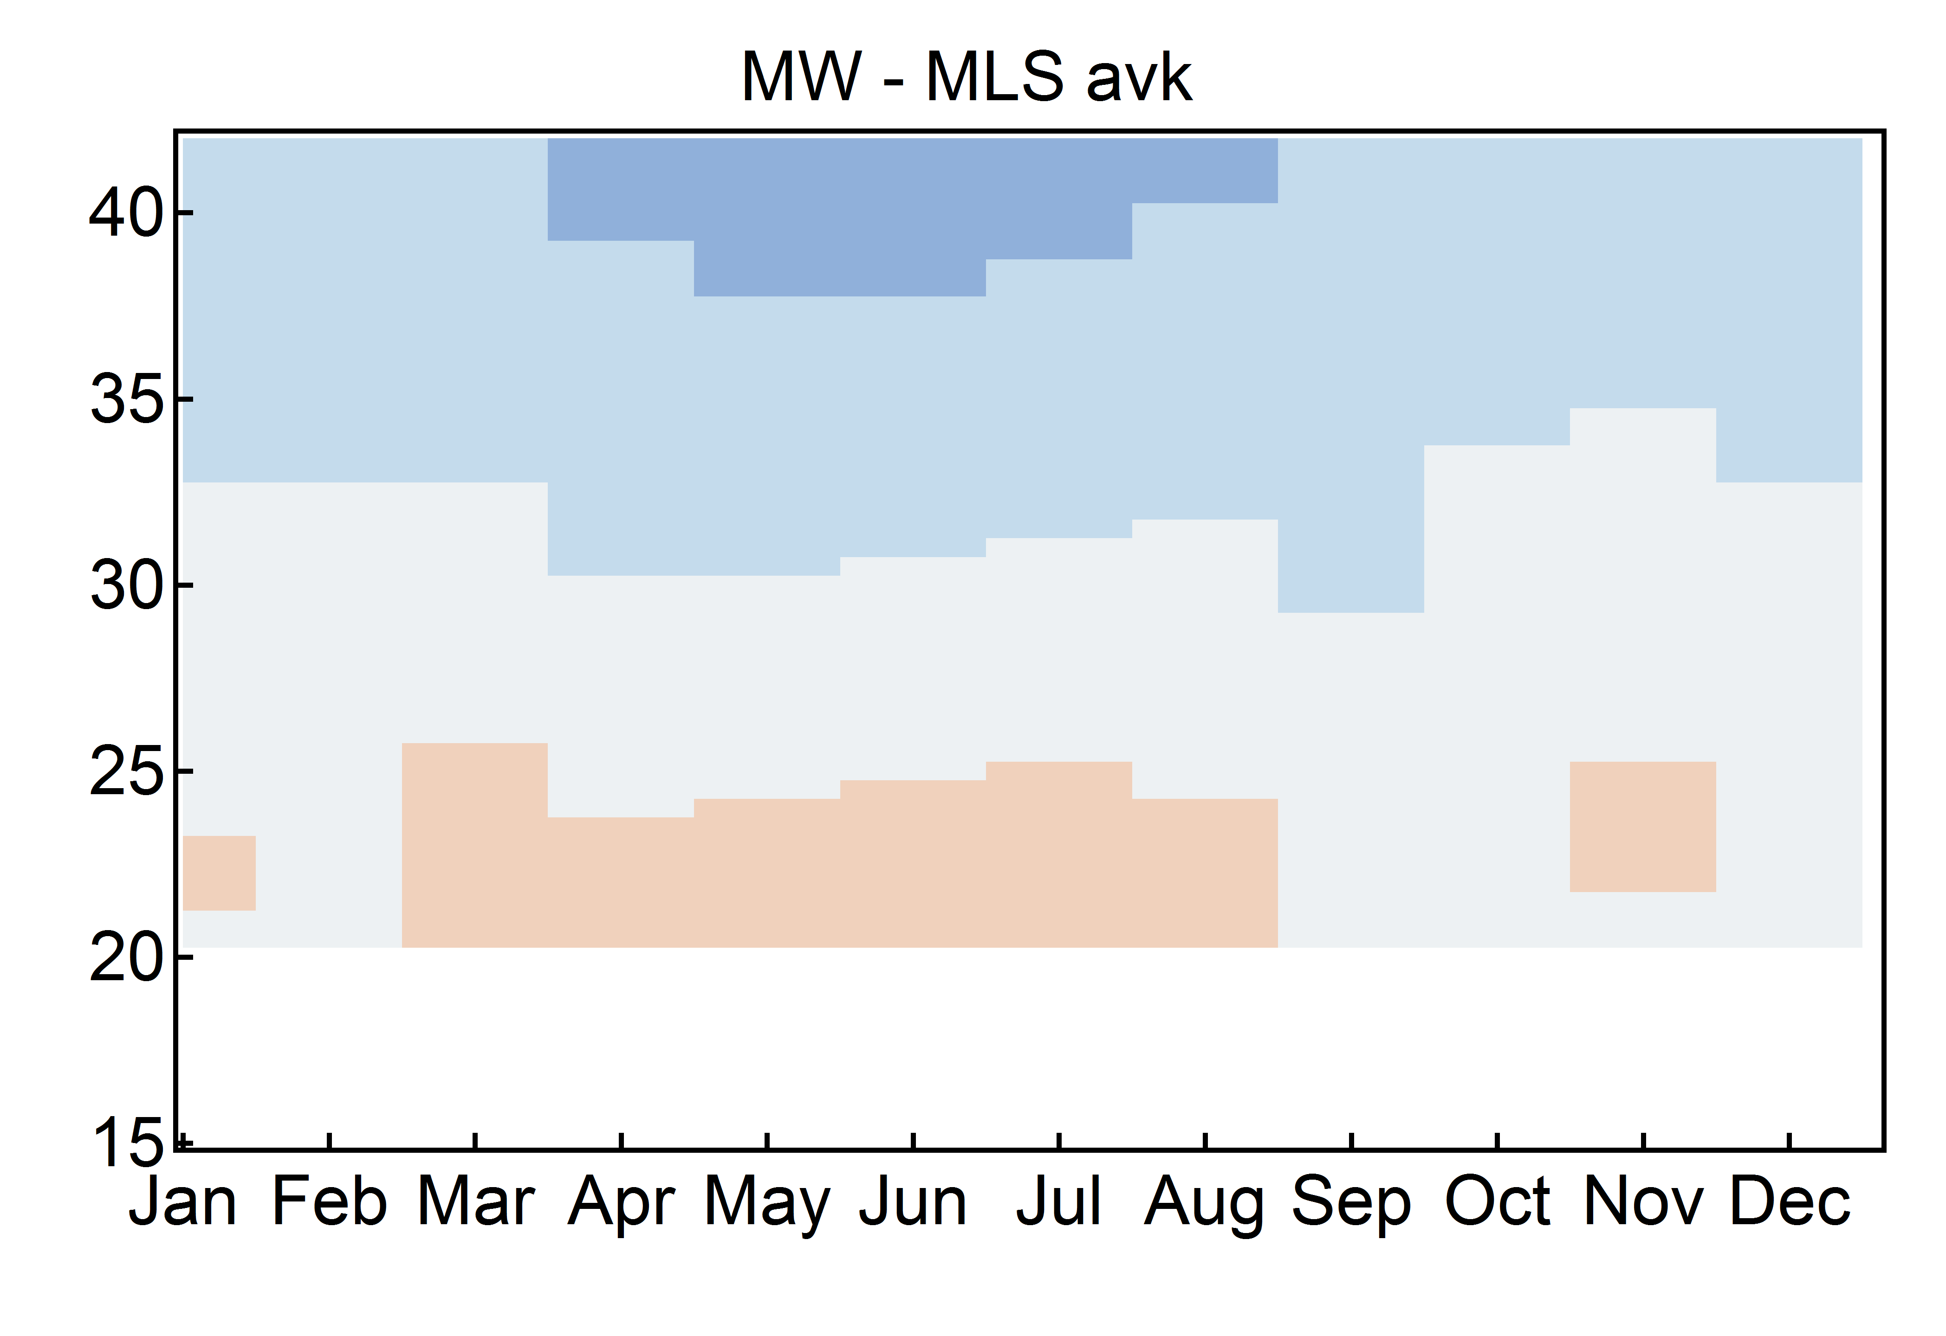
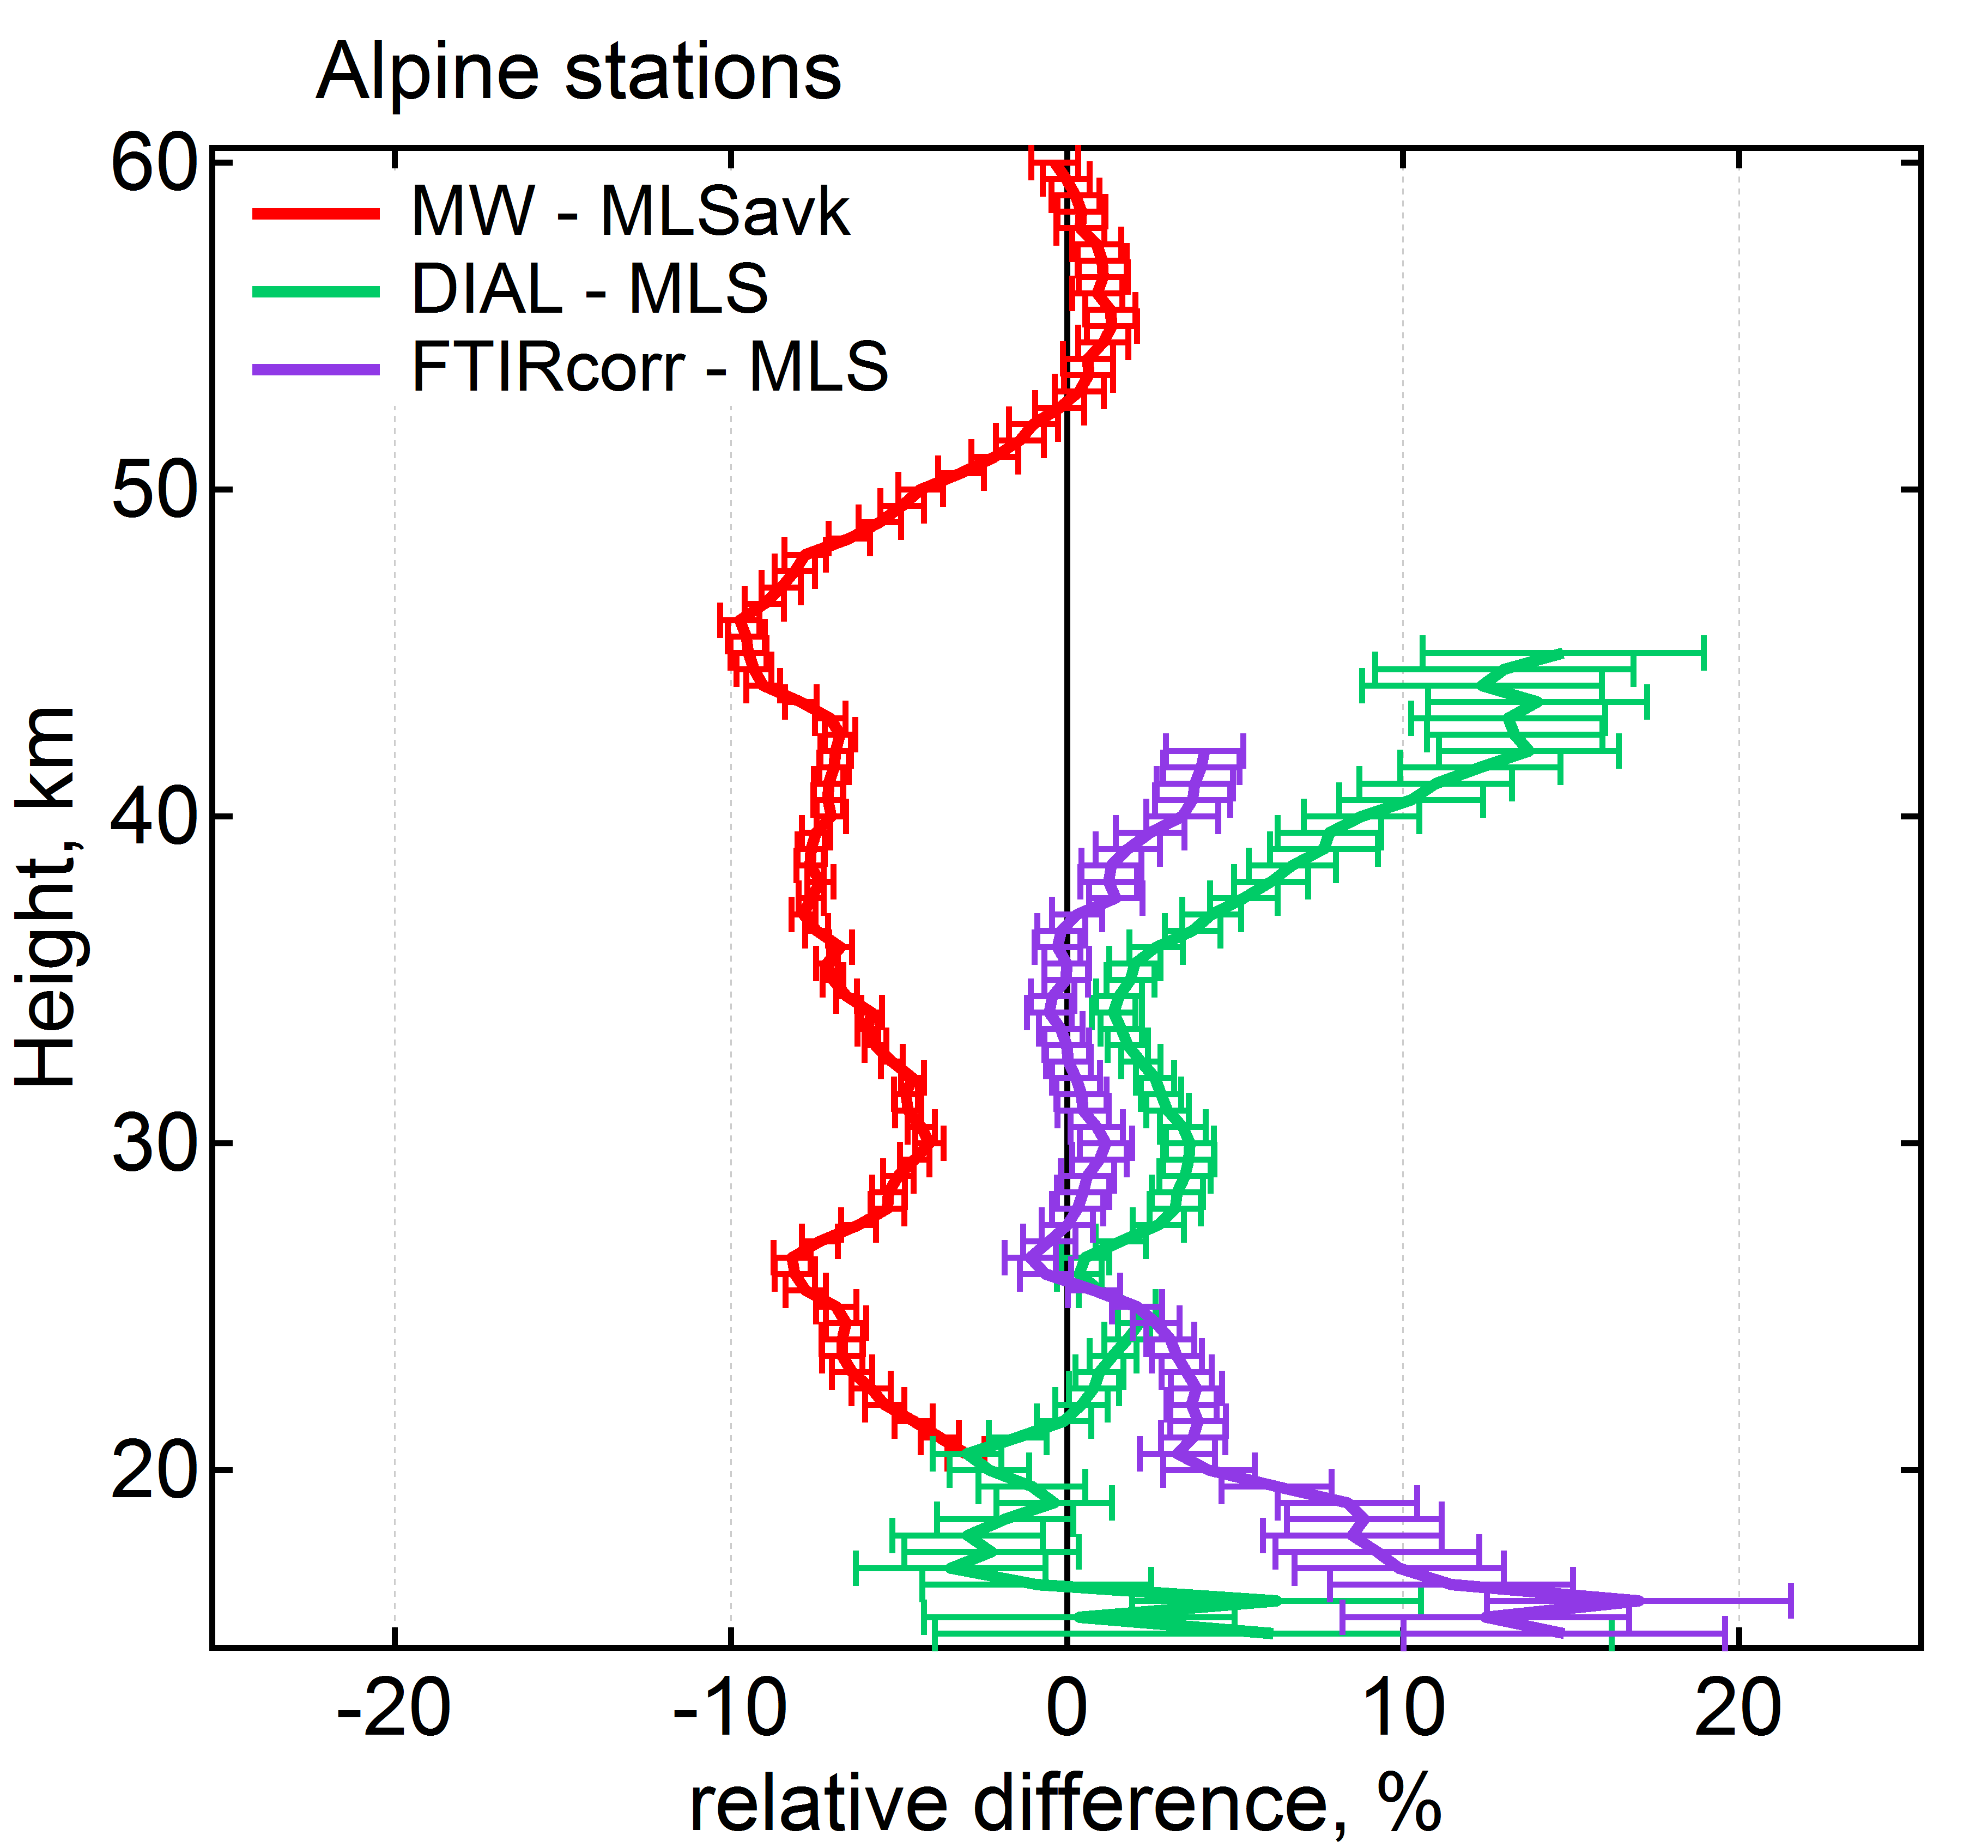
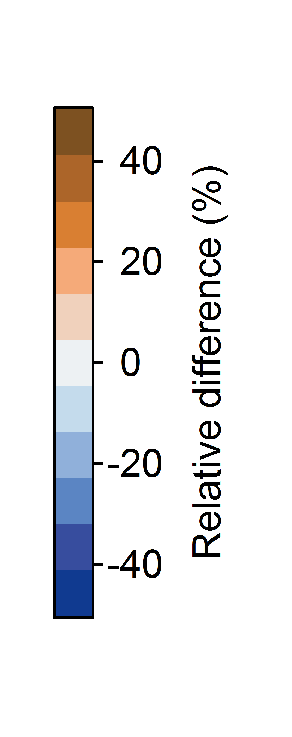
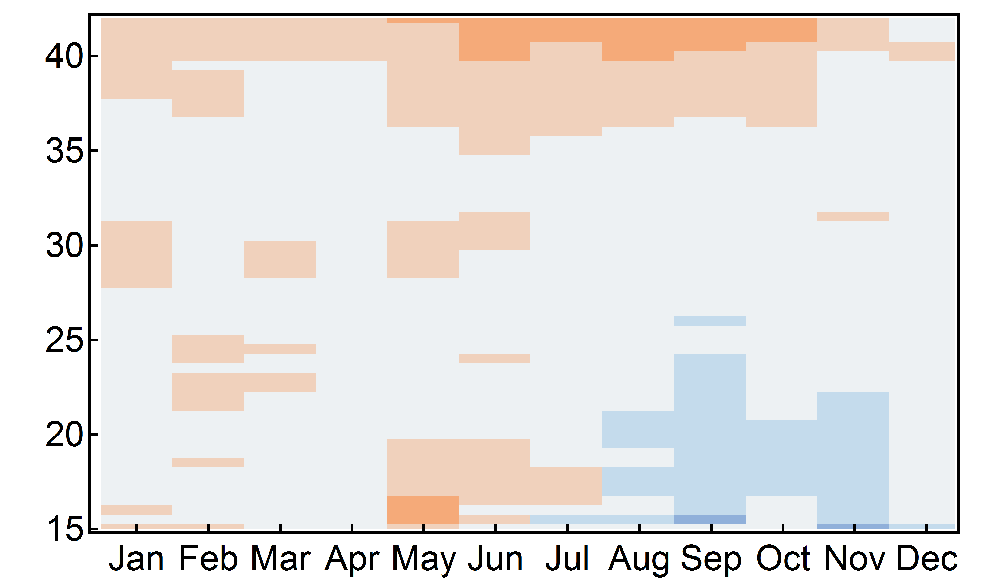
Systematic differences with AURA-MLS
MW - MLS smoothed
Annual average
DIAL – MLS
VIII WLMLA , 6 – 10 April 2015, Cayo Coco, Cuba

Slide 9
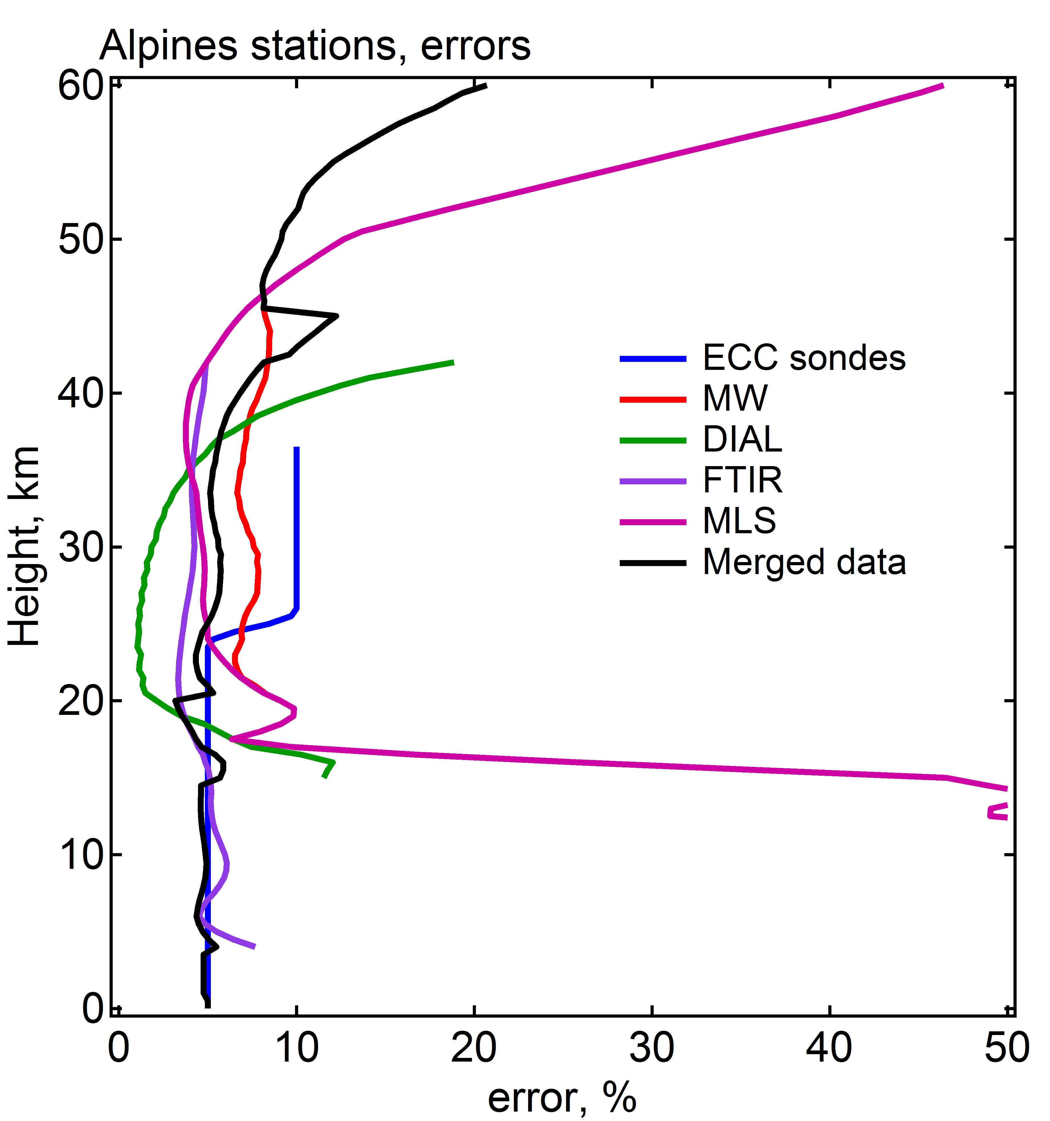
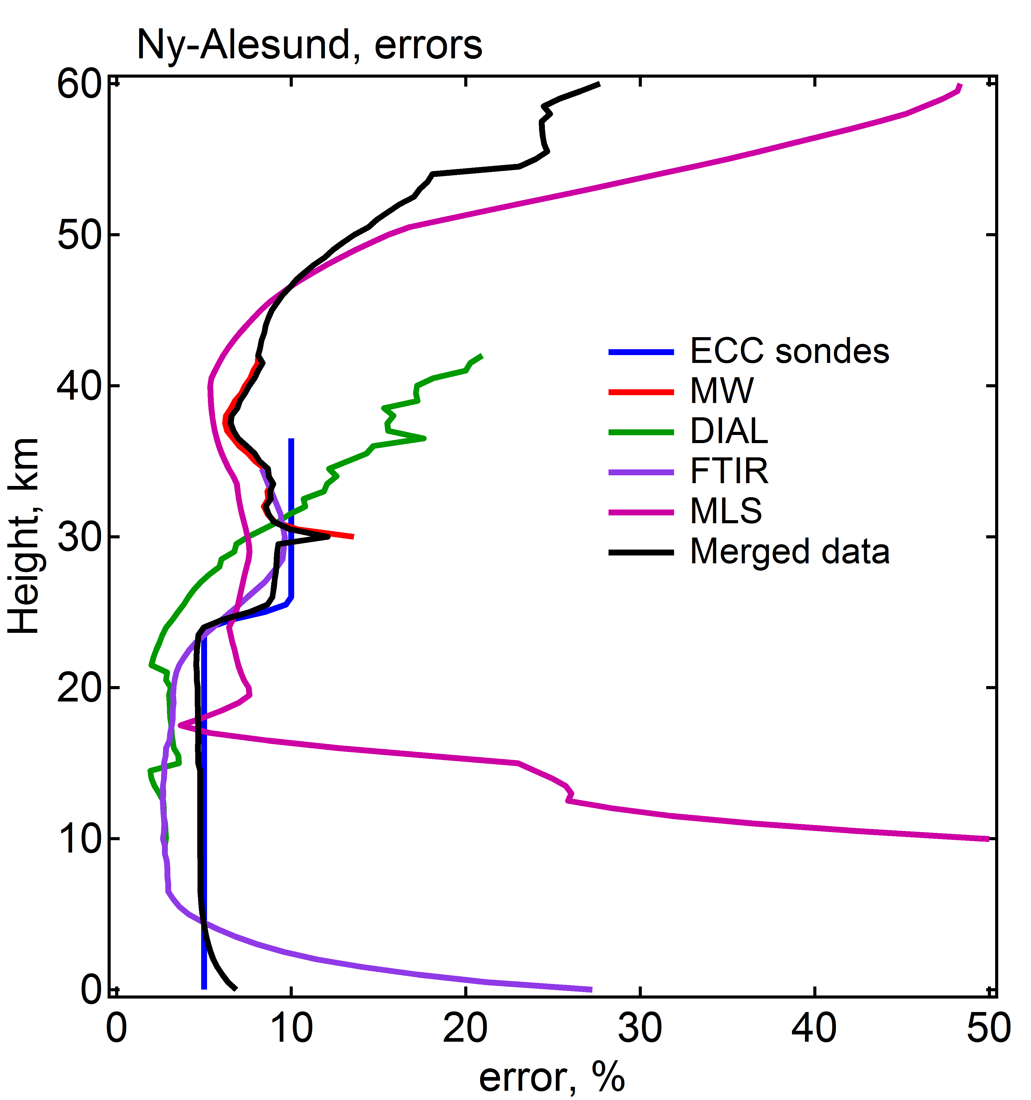
Ozone profile integration
Main steps:
Smooth higher resolved profiles using AVK (FTIR, MW)
Check for difference in a priori
Check for systematic bias (MLS)
Alpine station
Data integration
Geophysical bias
Ny Alesund
Error weight
Instrumental bias
Merged ozone profile reported for more than one measurement at the station
VIII WLMLA , 6 – 10 April 2015, Cayo Coco, Cuba

Slide 10
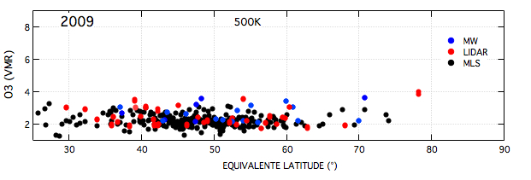
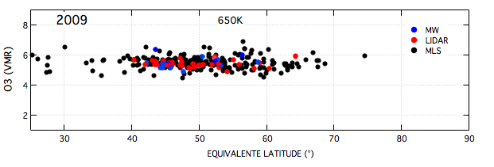
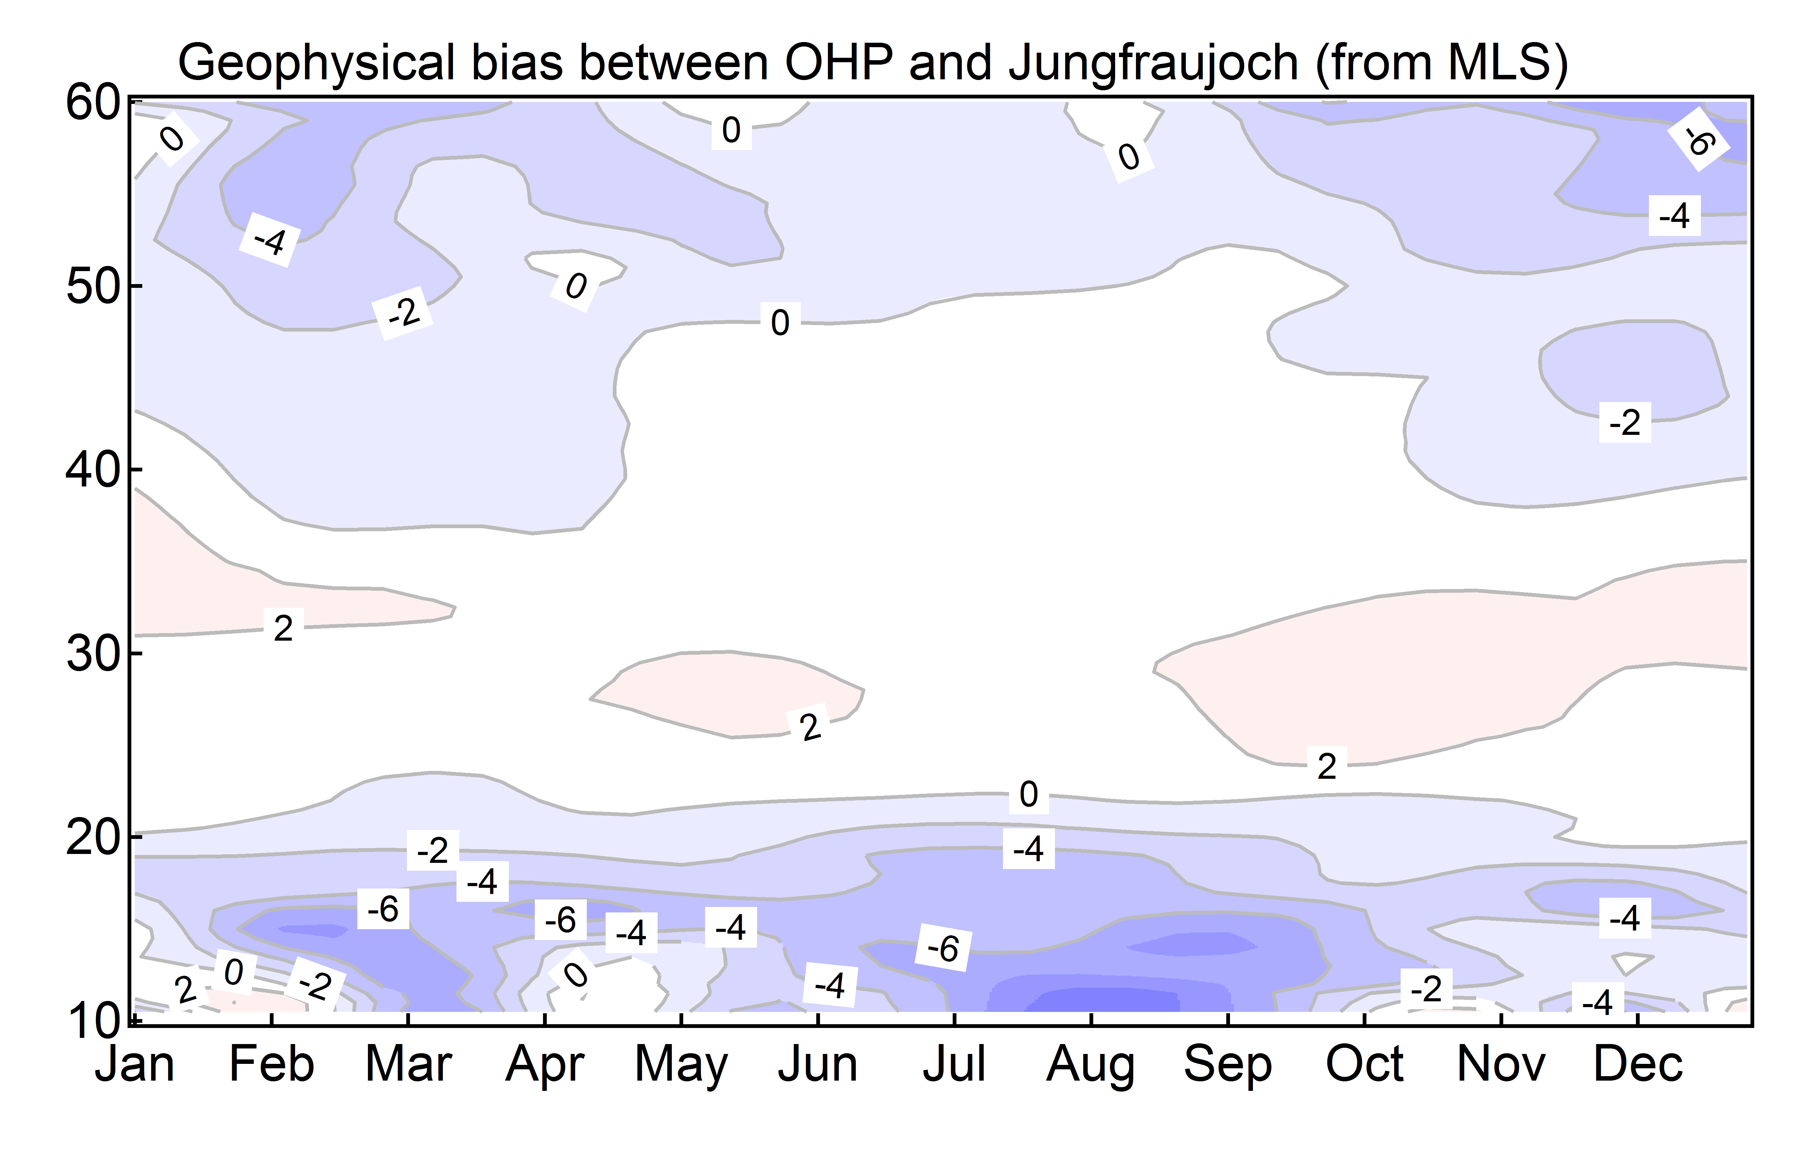
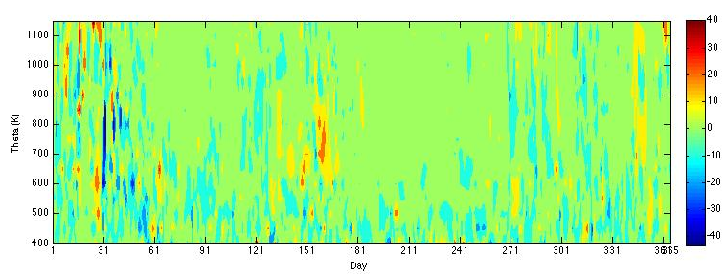
Geophysical bias
Ozone mixing ratio vs equivalent latitude
Distance between stations:
Bern – Jungfraujoch: ~ 60 km
OHP – both other stations: ~ 400 km
500 K
Difference between coincident MLS ozone measurements at OHP and Jungfraujoch
650 K
Equivalent latitude difference between OHP and Bern (°) - 2013
Very small geophysical bias between the stations
VIII WLMLA , 6 – 10 April 2015, Cayo Coco, Cuba

Slide 11
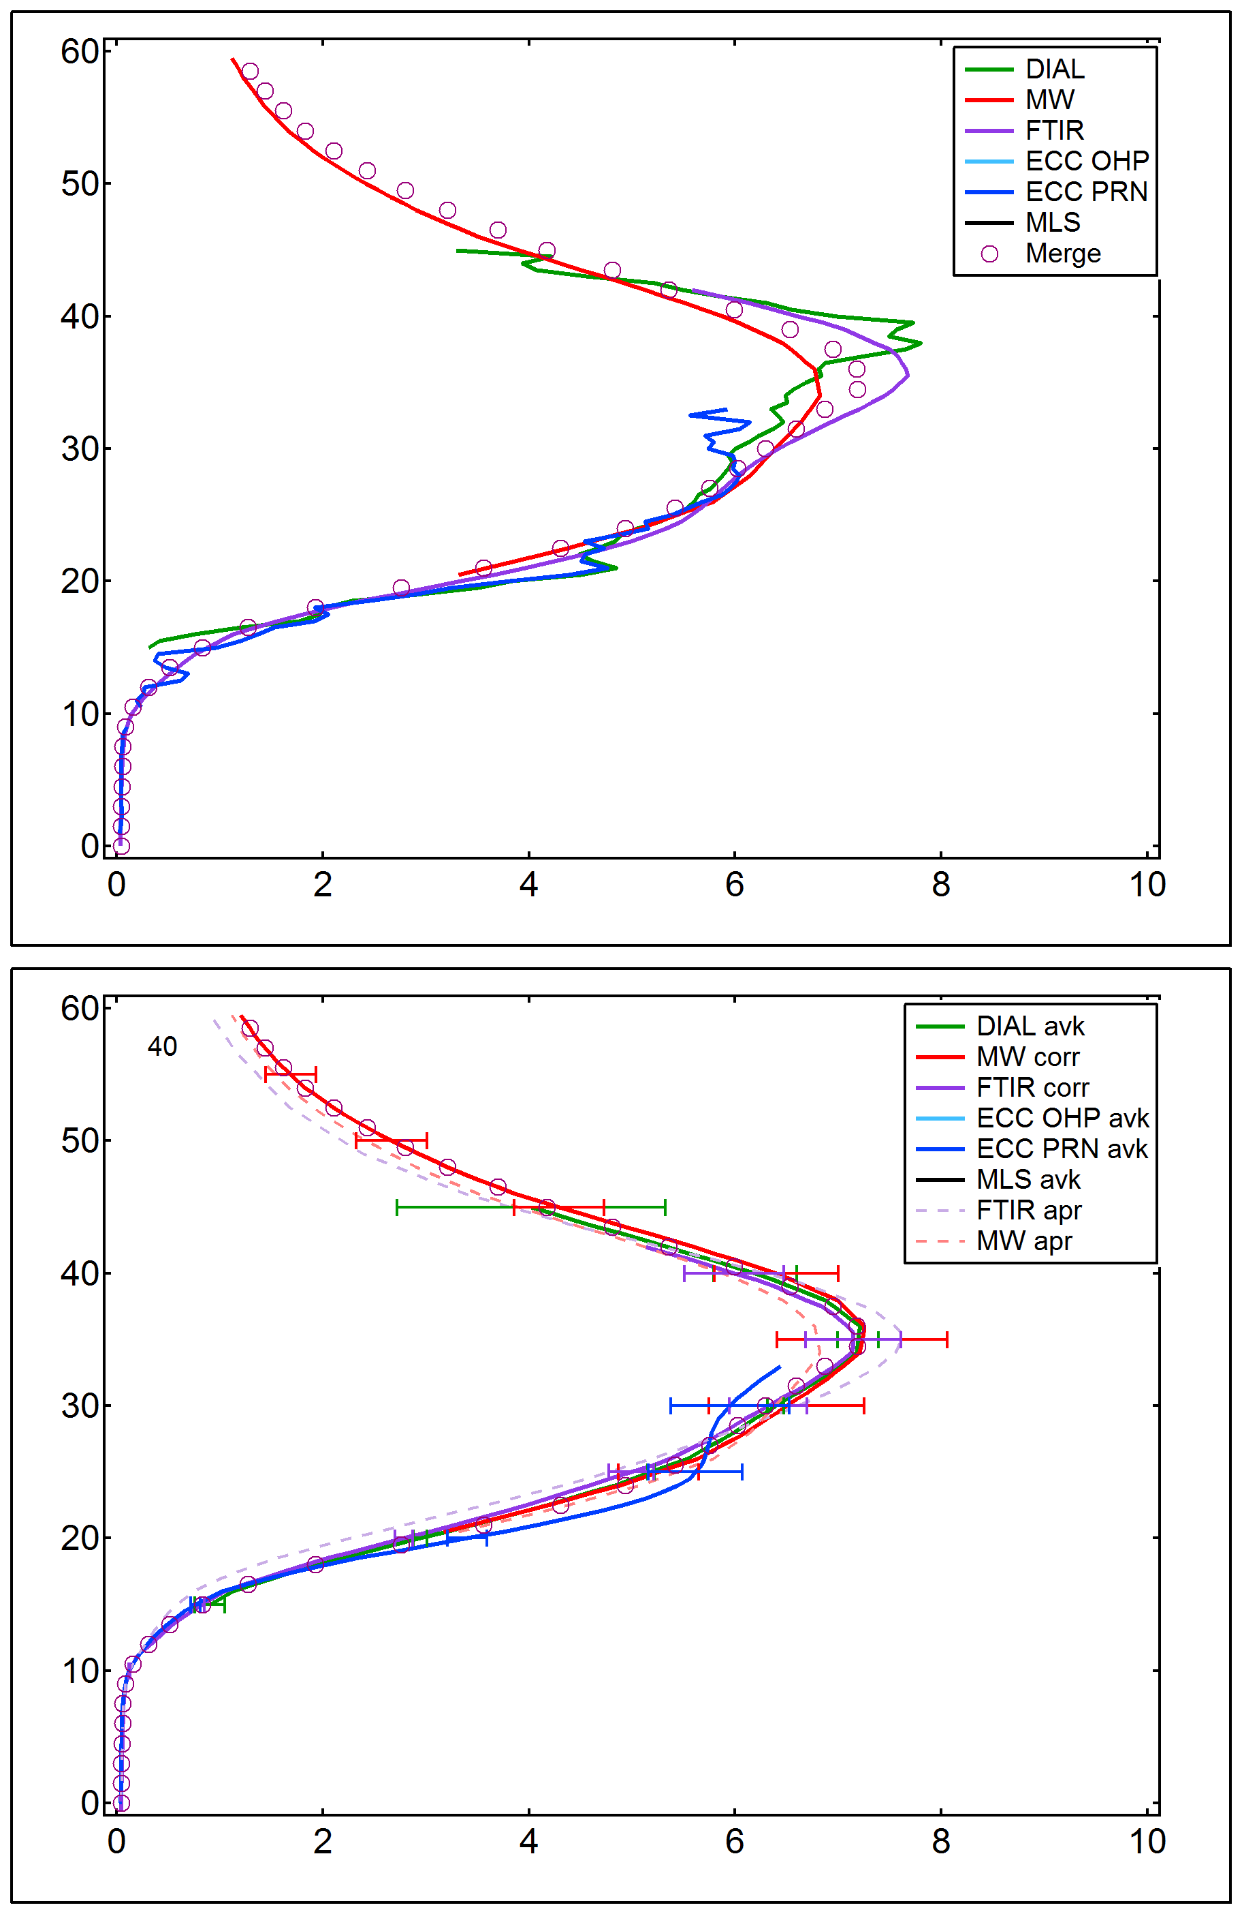
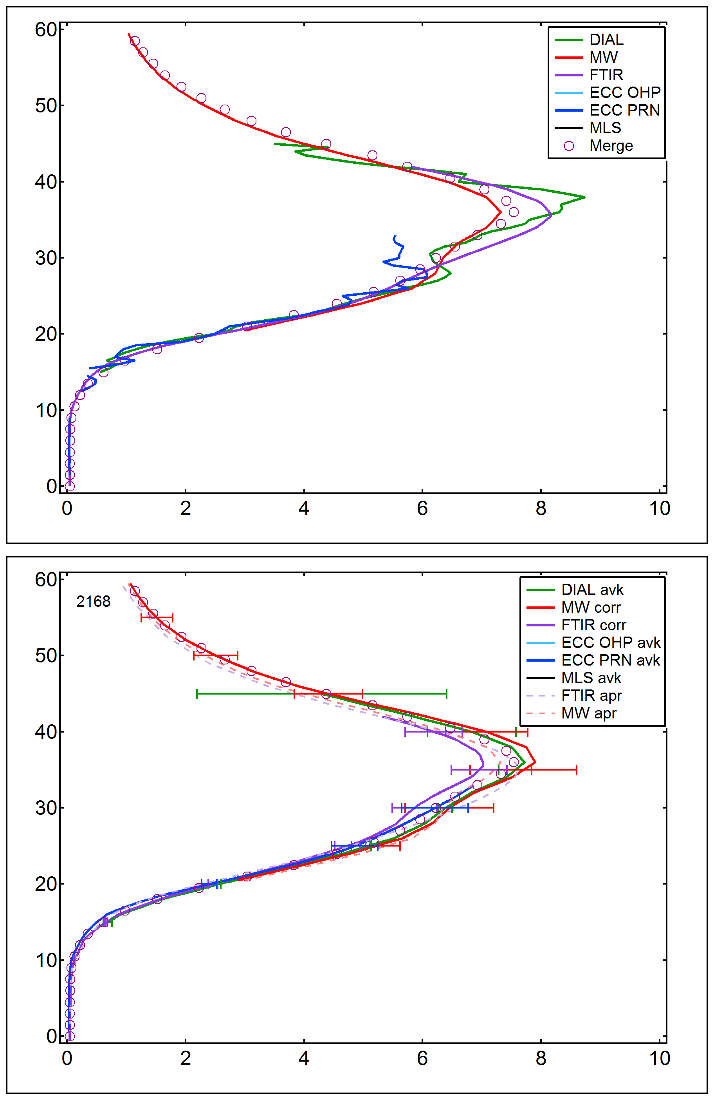
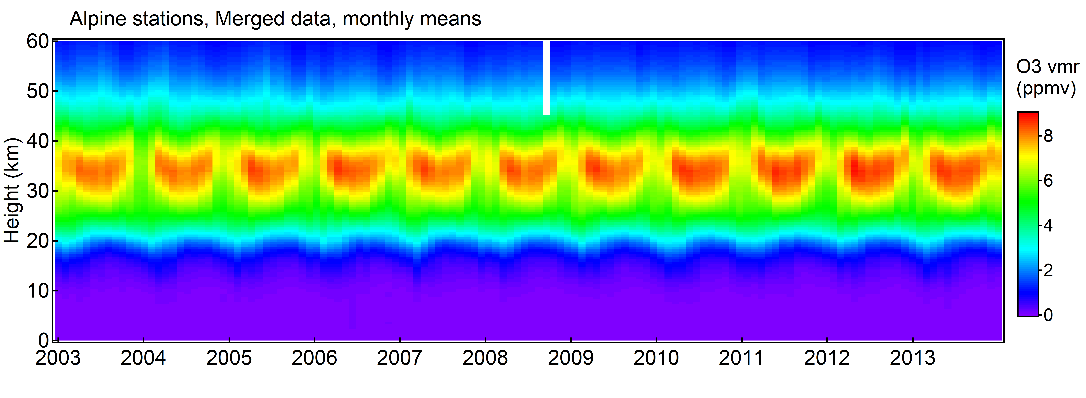
Alpine station
Merged ozone profile data: nb of meas.
Smoothed OHP lidar data (Bern MW averaging kernels) 1299
Bern MW data corrected from climatological bias with MLS 3798
Jungfraujoch FTIR data corrected using MW a priori profiles 1169
Smoothed OHP ozone sonde data (Jungfraujoch FTIR averaging kernels) 448
Smoothed Payerne ozone sonde data (Jungfraujoch FTIR averaging kernels) 1521
Coincidences:
1389 more than 2 meas.
869 more than 3 meas.
VIII WLMLA , 6 – 10 April 2015, Cayo Coco, Cuba

Slide 12
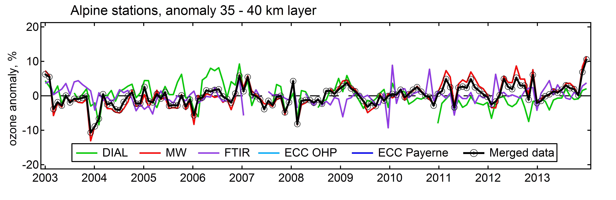
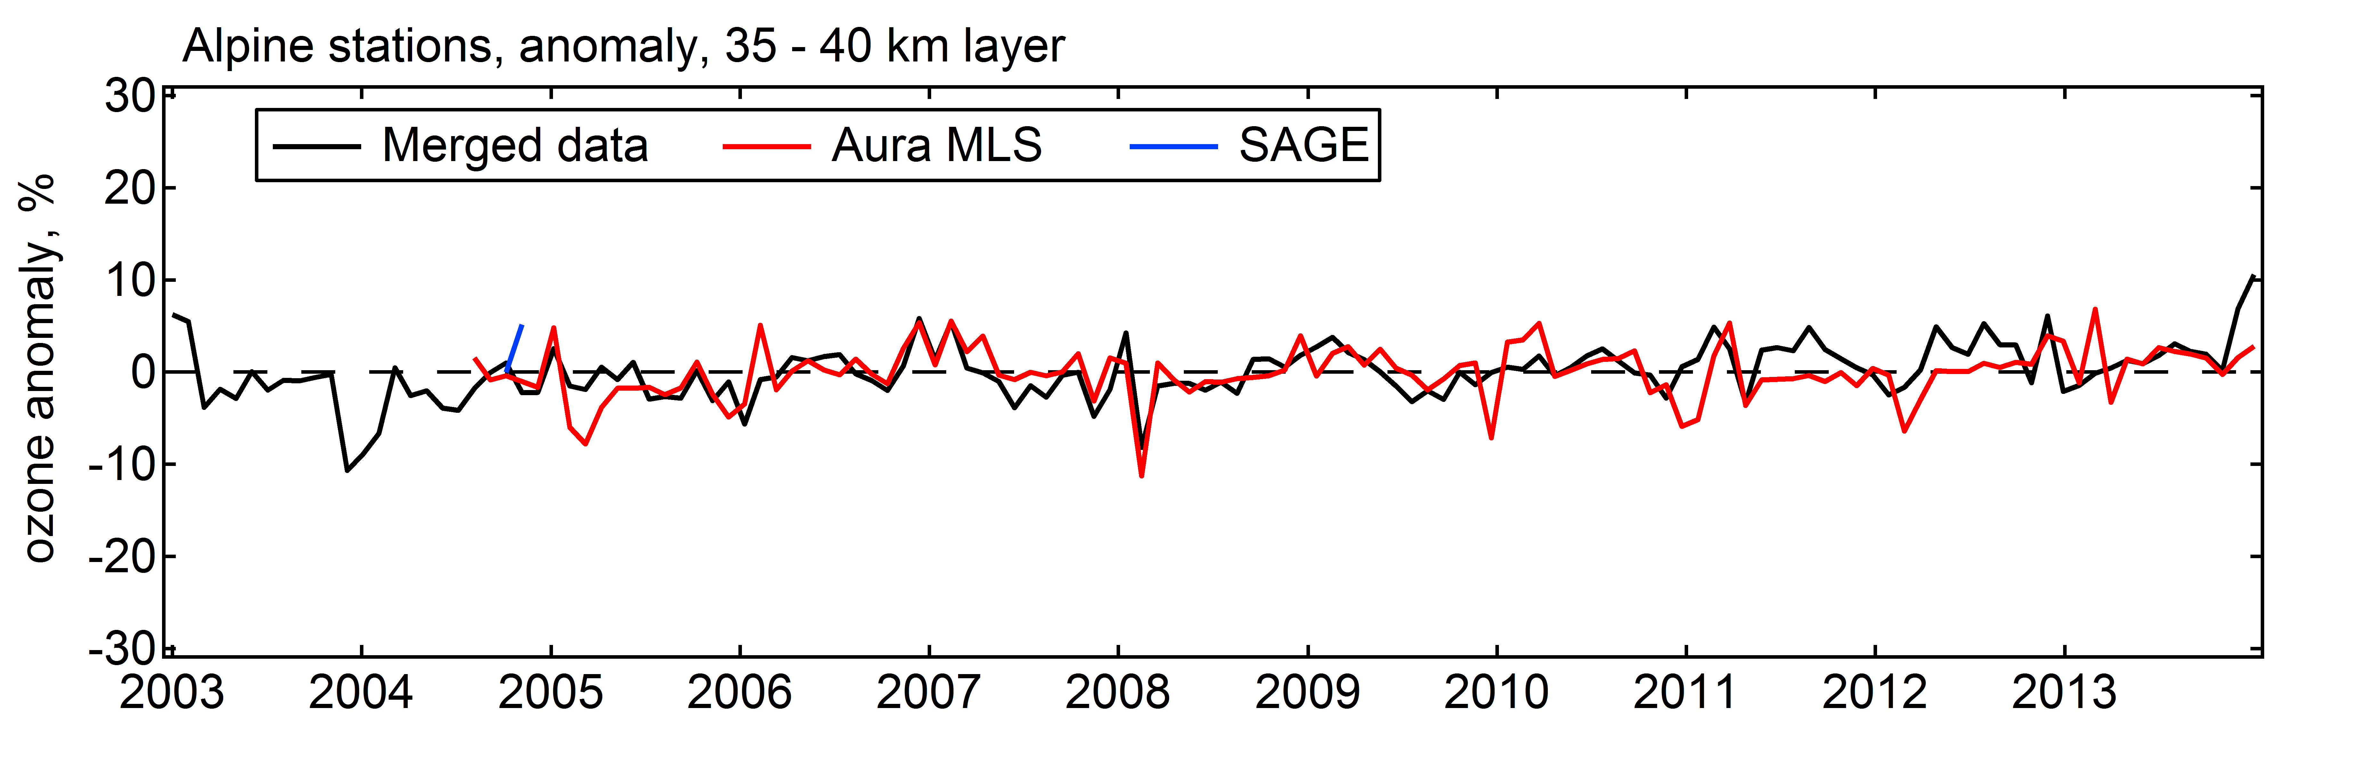
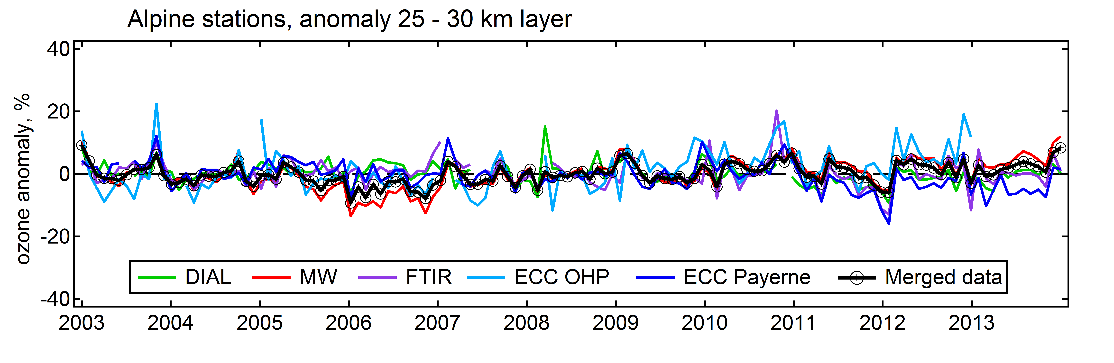
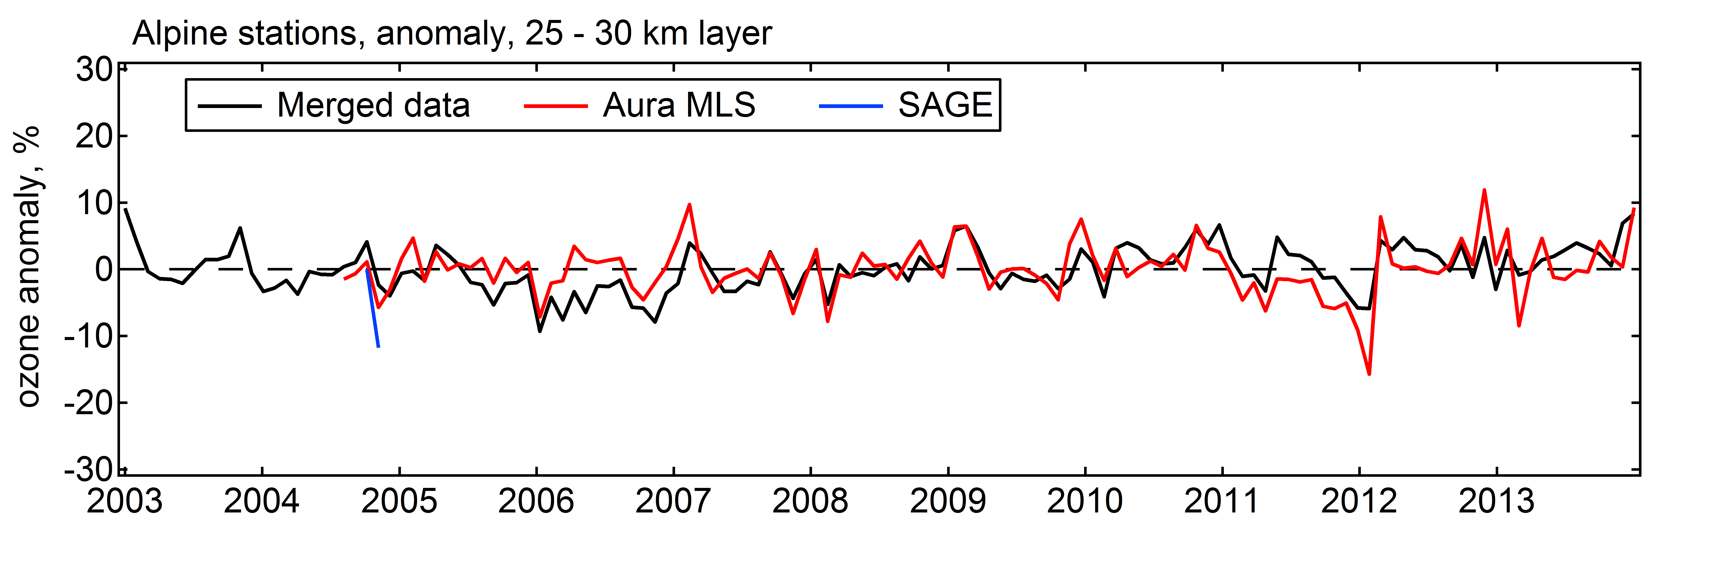
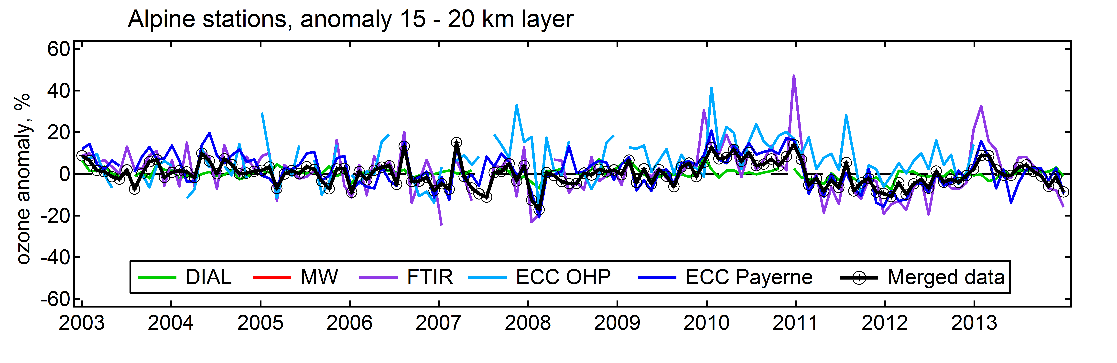
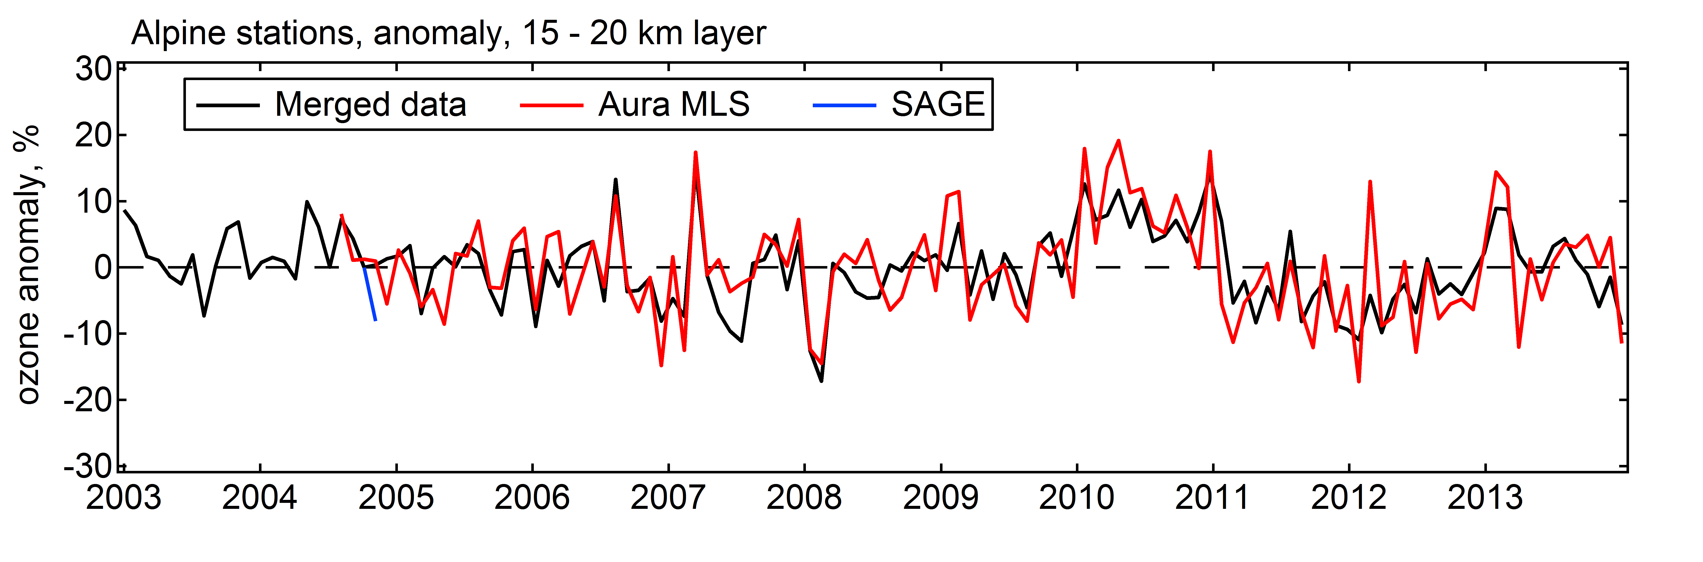
Alpine station
merged O3 vs individual
merged O3 vs MLS
35 – 40 km
25 – 30 km
15 – 20 km
VIII WLMLA , 6 – 10 April 2015, Cayo Coco, Cuba

Slide 13
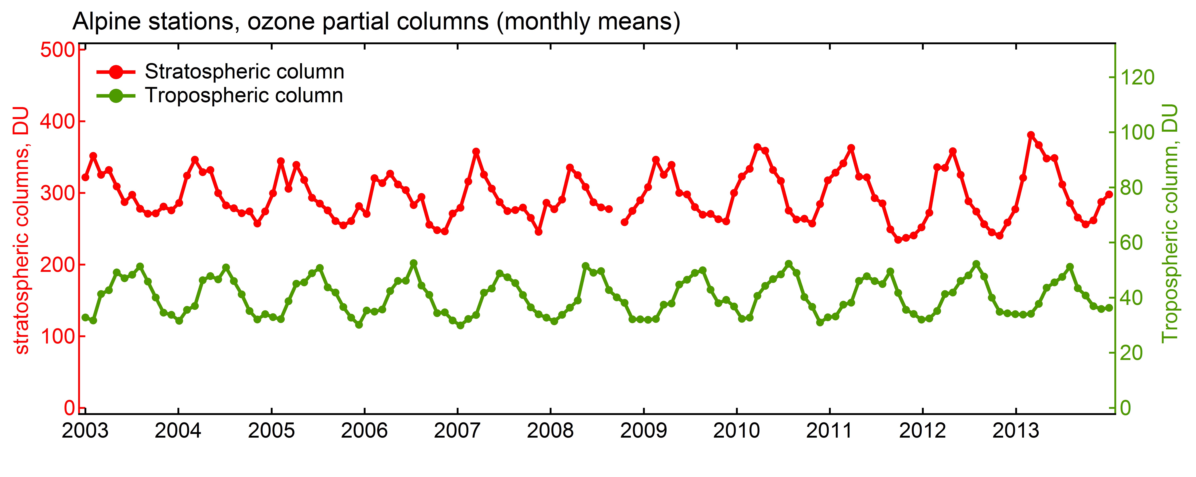
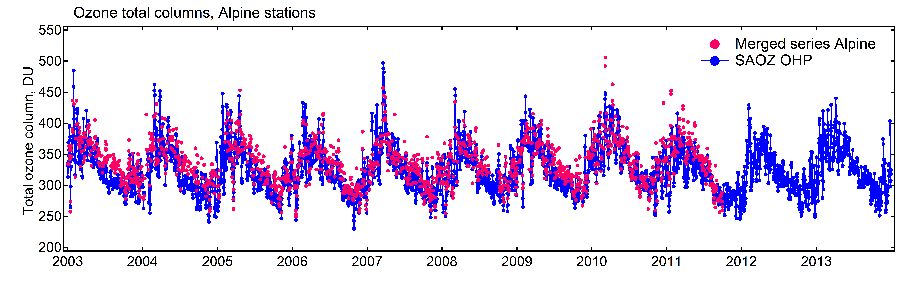
Alpine station
Ozone partial columns
Calculation of tropopause altitude using NCEP data
Comparison of total ozone columns with SAOZ measurements
VIII WLMLA , 6 – 10 April 2015, Cayo Coco, Cuba

Slide 14
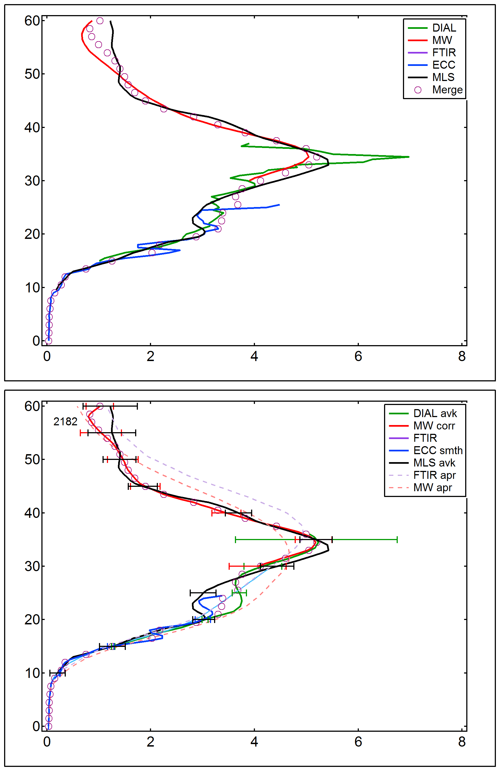
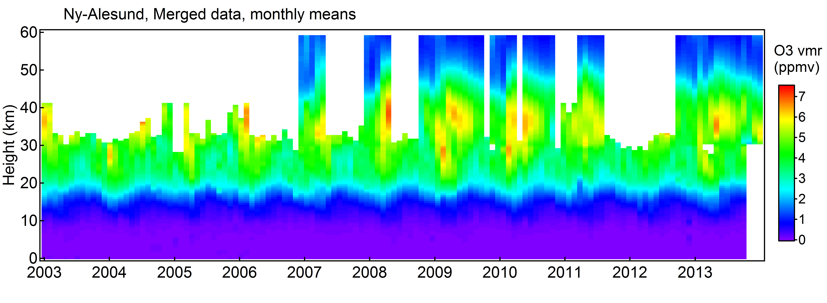
NyAlesund (Norway)
Merged ozone profile data: nb of meas.
Smoothed lidar data (MW averaging kernels) 129
MW data corrected from bias with MLS data 1216
FTIR data 83
Smoothed ozone sonde data (FTIR averaging kernels) 811
Coincidences:
310 more than 2 meas.
17 More than 3 meas.
VIII WLMLA , 6 – 10 April 2015, Cayo Coco, Cuba

Slide 15
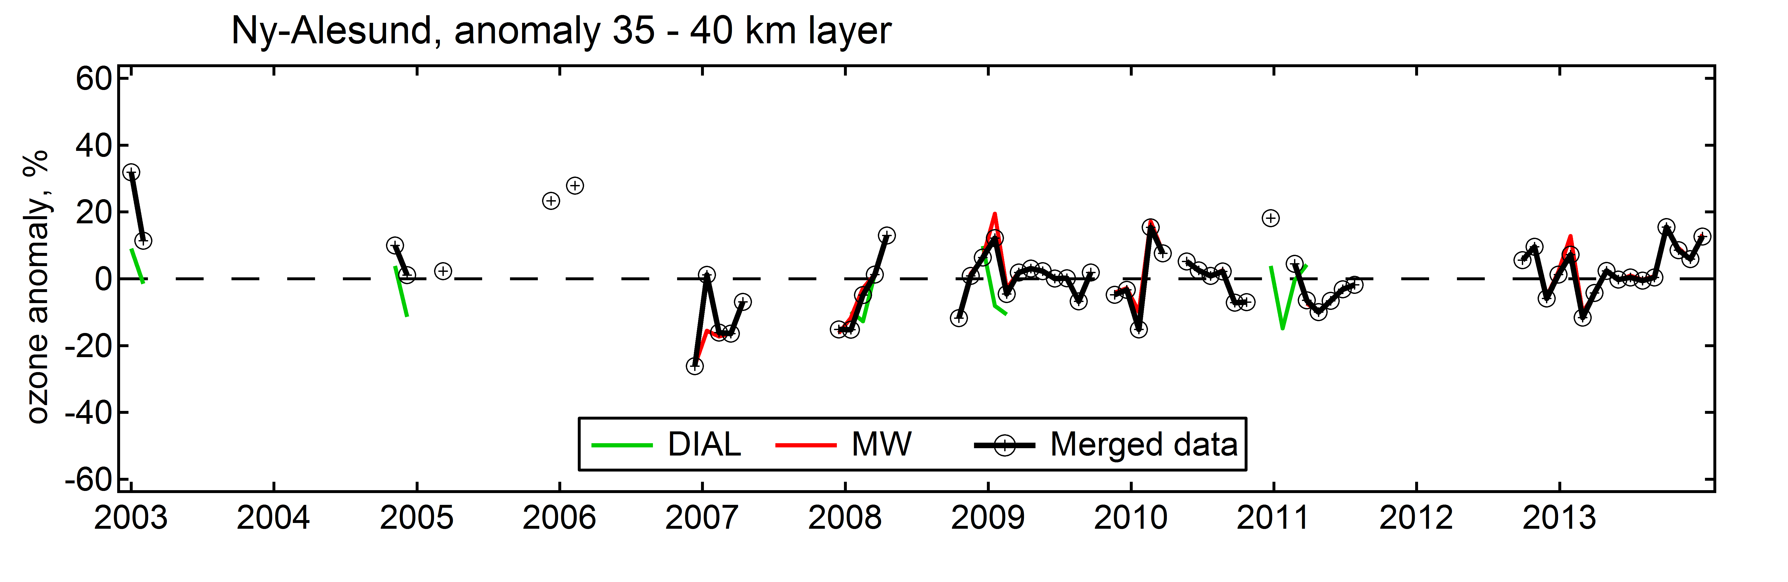
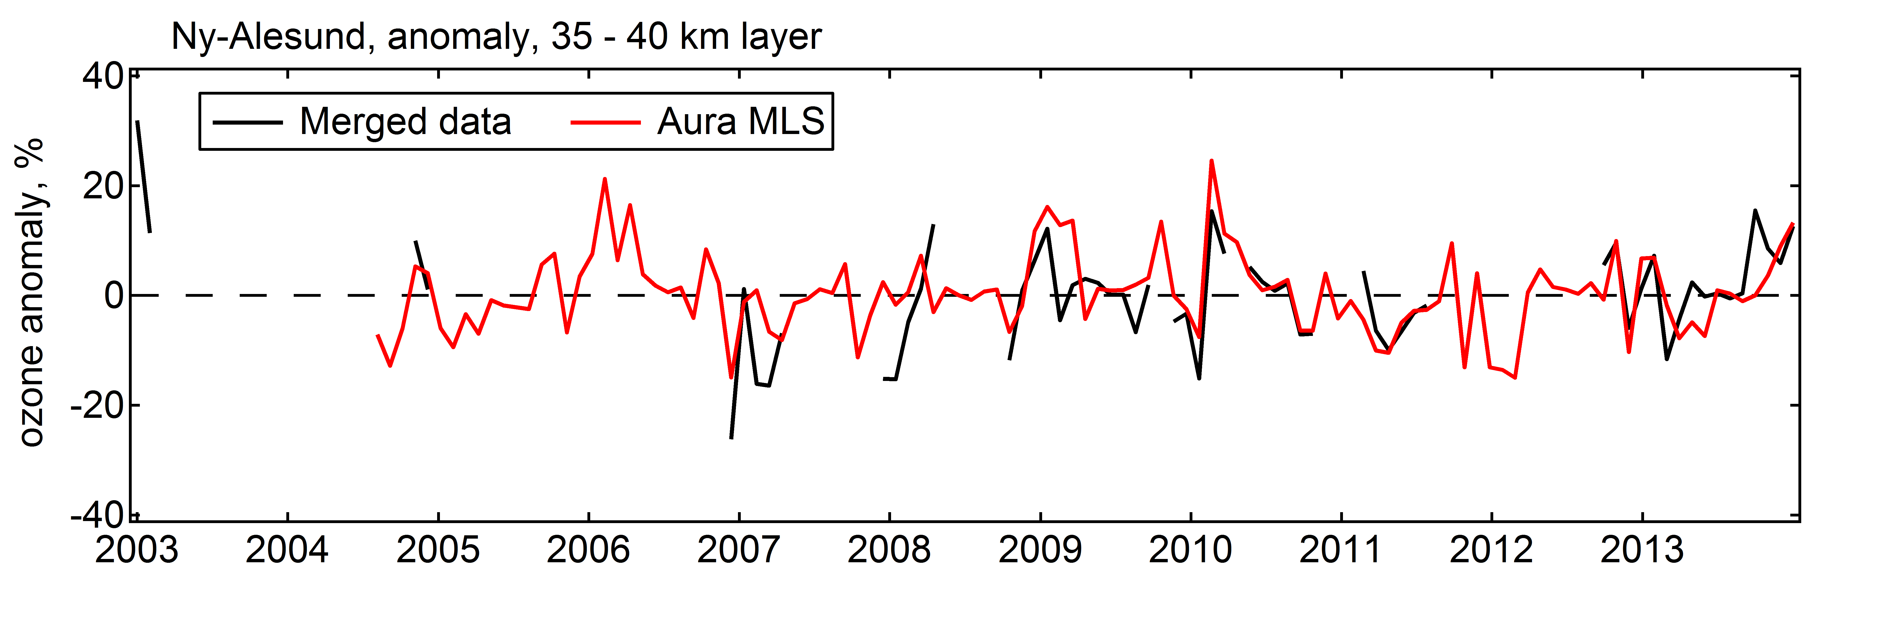
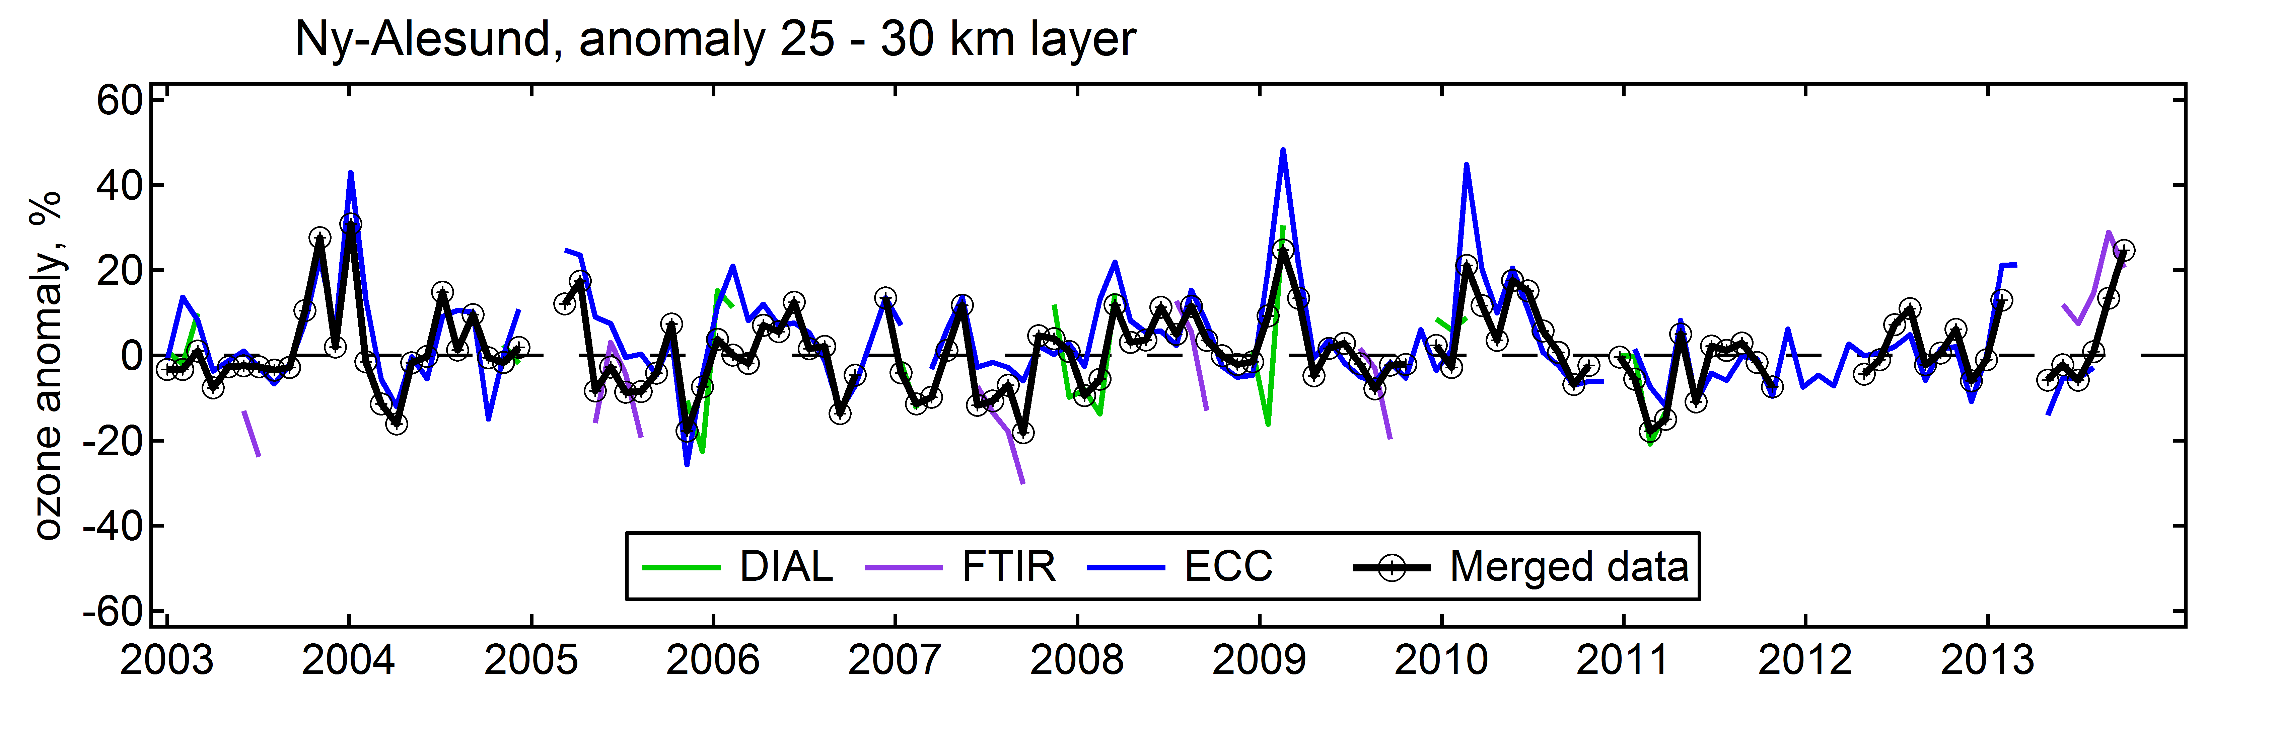
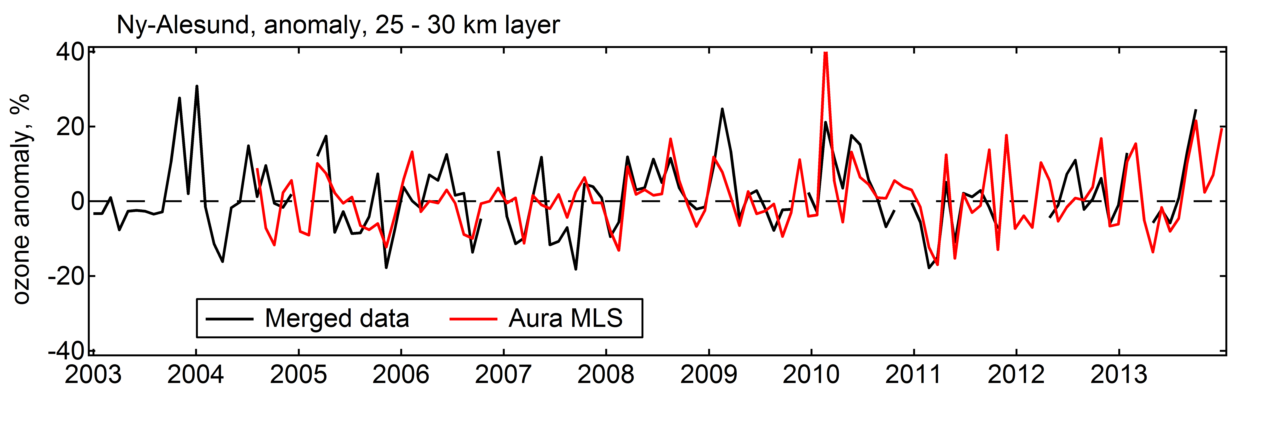
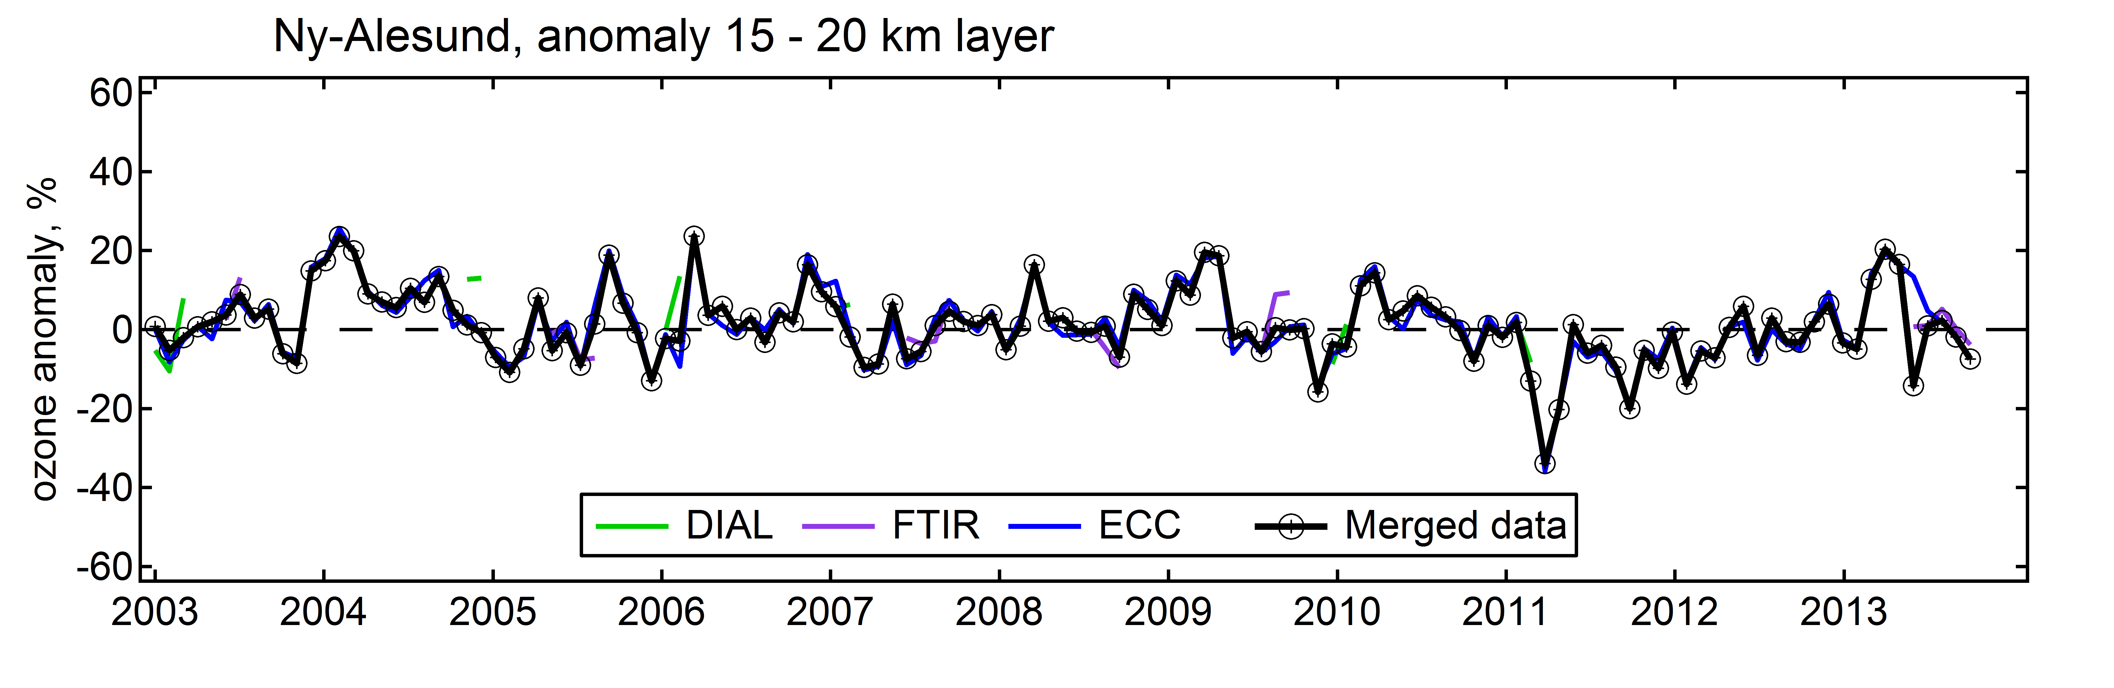
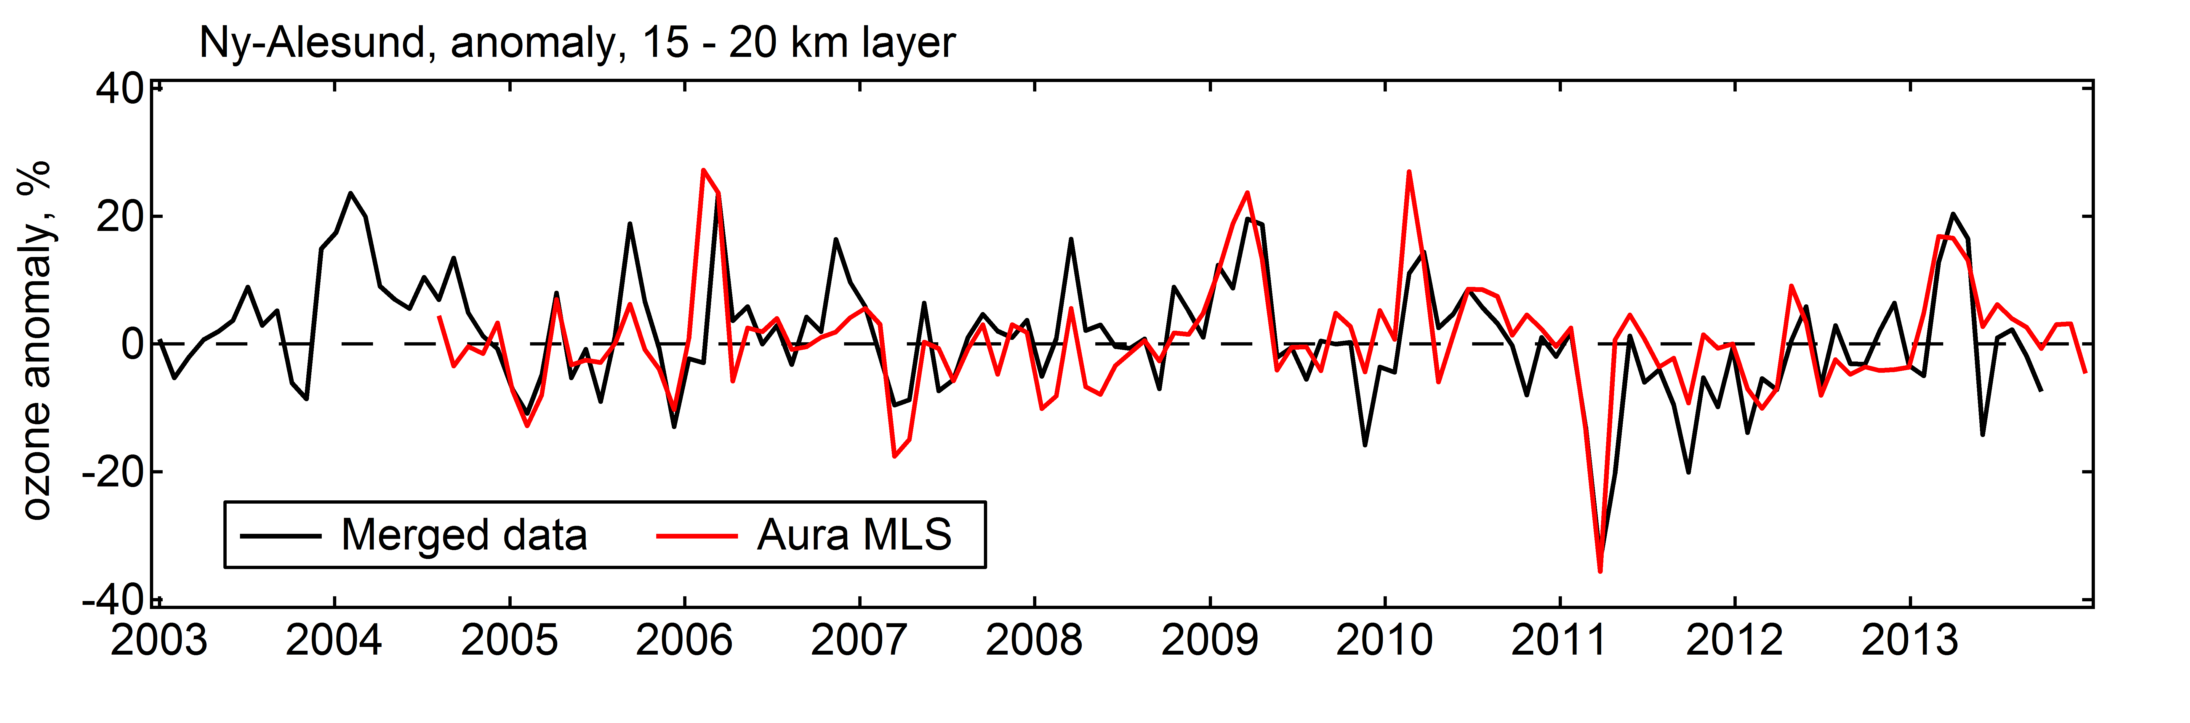
Ny Alesund
merged O3 vs individual
merged O3 vs MLS
35 – 40 km
25 – 30 km
15 – 20 km
VIII WLMLA , 6 – 10 April 2015, Cayo Coco, Cuba

Slide 16
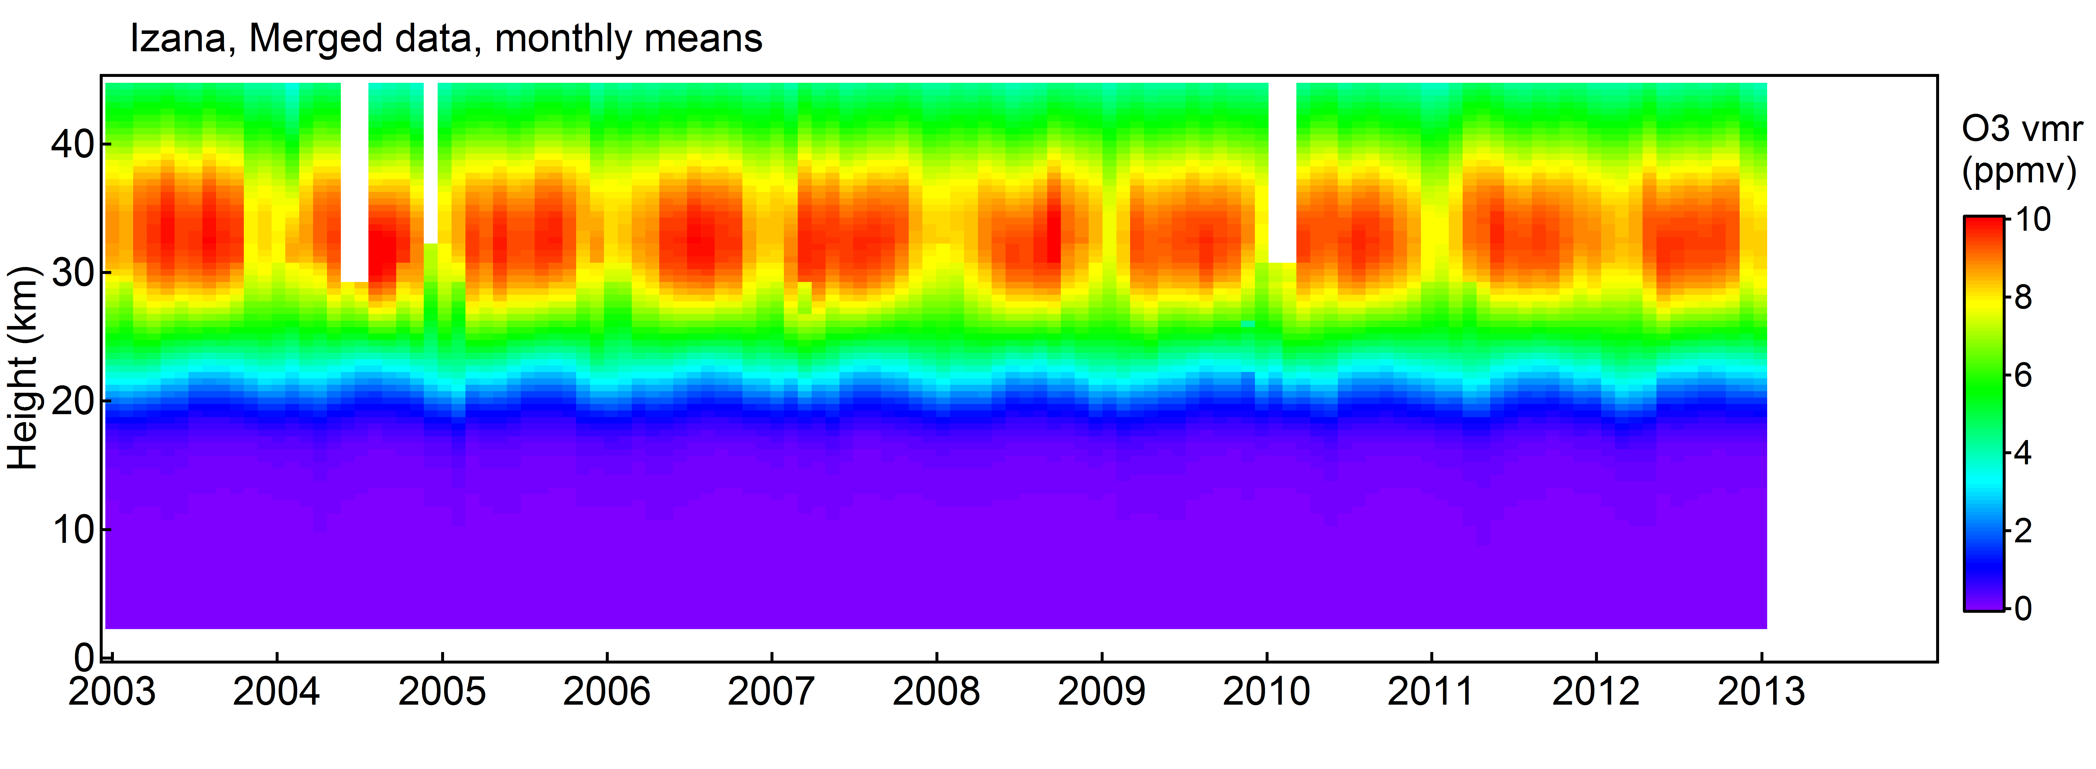
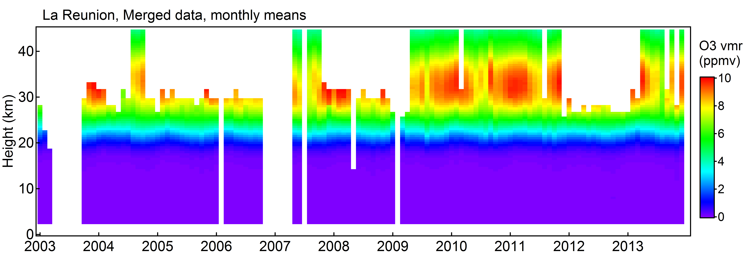
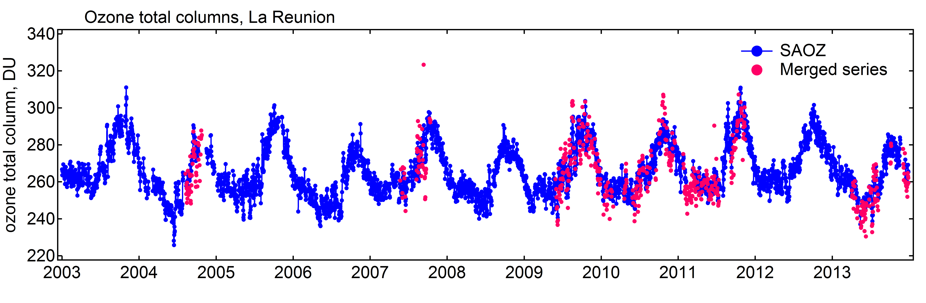
Izaña and La Réunion Island
Only FTIR and ozone sondes measurements at both stations
few ozone lidar measurements at La Réunion Island over the period
Izaña
362 coincidences
La Réunion
48 coincidences
VIII WLMLA , 6 – 10 April 2015, Cayo Coco, Cuba

Slide 17
Conclusions
Long-term ozone profile time series characterized by different vertical resolution and altitude ranges are available since the early nineties at NDACC stations.
Combined ozone profile data sets have been produced at 4 NDACC stations together with stratospheric and tropospheric partial columns
Good consistency of the data products with satellite measurements and good comparison with total ozone measurements (SAOZ)
Data delivered within the European NORS project and available for use upon request
Next step: detailed comparison with MACC ozone products
VIII WLMLA , 6 – 10 April 2015, Cayo Coco, Cuba

Slide 18
Thank you for your attention!
VIII WLMLA , 6 – 10 April 2015, Cayo Coco, Cuba

