Slide 1
Angular Aerosol Profiling over the city of La Paz, Bolivia
Laboratorio de Física de la Atmósfera
Universidad Mayor de San Andrés
(A preliminary study)
Cayo Coco – April 2015
Notes:
GOOD MORNING EVERYBODY, WHAT I WOULD LIKE TO SHOW YOU TODAY DURING THIS PRESENTACION IS OUR FIRST ATTEMPT TO HAVE ANGULAR AEROSOL PROFILING OVER THE CITY OF LPZ BOLIVIA.
I WILL SHOW YOU JUST A PRELIMINARY STUDY.
Resumen del trabajo a presentar
Se presentará un "over view" del estado de la estación GAW de Chacaltaya mostrando algunos de
los resultados relevantes relacionados a la medida de aerosoles en la región. Se mostrará los
avances realizados para realizar el estudio de los flujos de aire entre la ciudad de La Paz y el monte
Chacaltaya. Como parte de este estudio, se mostrará los primeros resultados obtenidos con el
lidar LIPAZ sobre la ciudad de La Paz empleando sus capacidades de escaneo.
Adicionalmente, se dará a conocer y se mostrará los avances de un proyecto que involucra
mediciones de la atmosfera en la región de la estación GAW de Chacaytaya empleando
ceilómetros calibrados con el sistema LIPAZ .

Slide 2
OUTLINE
The Chacaltaya GAW station
  Overview
  Goals
  Instrumentation
  Some results
How our lidar system can help to GAW station
  Boundary layer studies
Future challenges
Notes:
I WILL START WITH THE CHACALTAYA GAW STATION. I WILL SHOW YOU AN OVERVIEW OF THE STATION, THE GOALS THAT WE HAVE, SOME OF THE INSTRUMENTATION AND SOME OF THE RESULTS
THEN, I WILL TALK ABOUT HOW OUR LIDAR SYSTEM CAN HELP TO IMPROVE THE GAW STATION MEASUREMENTS.
IN THIS SENSE, I WILL EXPOSE SOME OOF OUR BOUNDARY LAYER STUDIES.
AND FINALLY, I WILL TALK ABOUT OUR FUTURE CHALLENGES
PRESENTACION DEL LUGAR
Unique GAW high altitude station over the Continent

Slide 3
The Chacaltaya GAW station

Slide 4
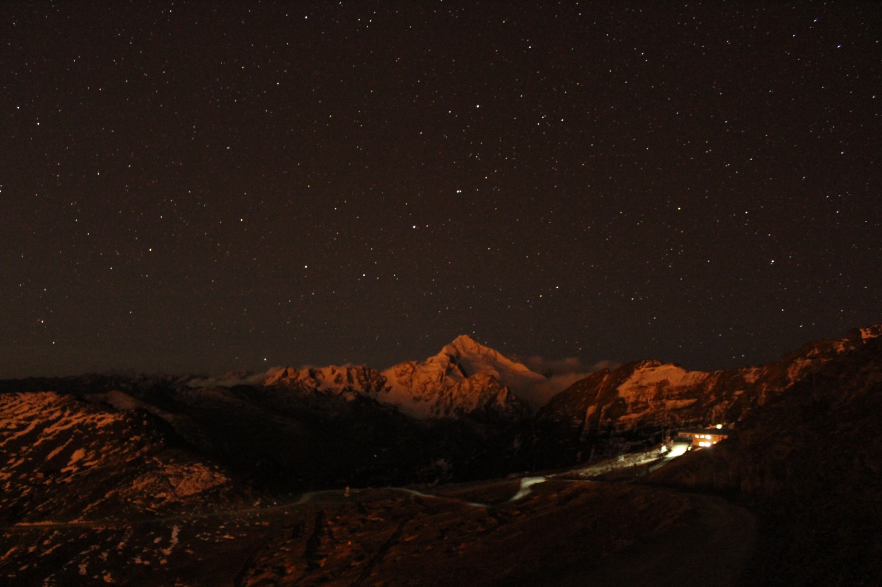
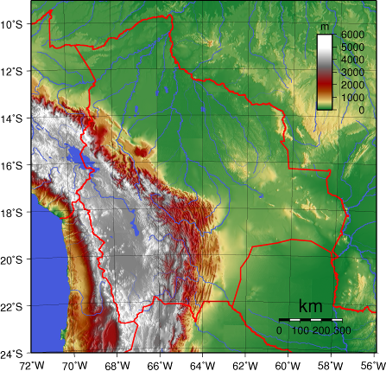
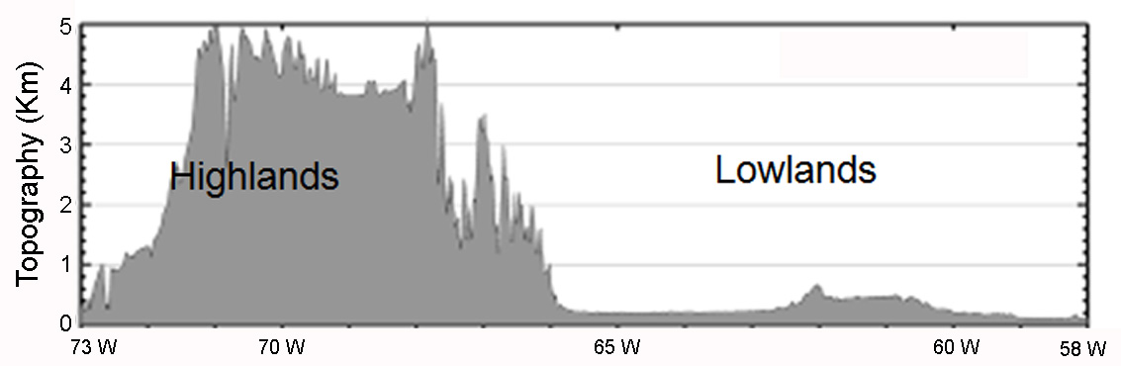
  Chacaltaya GAW station: overview
Lowlands
Highlands
5380 m asl
Chacaltaya GAW Station
5240 m asl
16º21'1.81"S, 68º7'53.46"W
Notes:
THE CHACALTAYA GAW STATION IS LOCATED IN A VERY PARTICULAR PLACE. IT CAN MEASURE AEROSOLS THAT ARE COMMING FROM THE LOW LANDS OF BOLIVIA AND BRASIL. IT CAN ALSO MEASURE AEROSOLES FROM THE ALTIPLANO PLATO, AND SOMETIMES, FROM THE PACIFIC OCEAN.
THE STATION IS LOCATED IN A TROPICAL PLACE AND AT A VERY HIGH ALTITUDE. THE MAIN BUILDING IS AT 5240masl, AND WE ALSO HAVE SOME INSTRUMENTATION AT THE PEAK OF THE MOUNTAIN A LITTLE HIGHER.
PRESENTACION DEL LUGAR
Unique GAW high altitude station over the Continent

Slide 5
  Chacaltaya GAW station: Goals
Goals
Fill existing gaps in the global observation network in South America
    Monitor the atmospheric composition at a high altitude site at the tropical Central Andes
    Study the atmospheric behavior at the free troposphere
    Contribute to the understanding of the causes of the Chacaltaya glacier retreat (aerosols)
Fill existing gaps in the global observation network in South America
  in-situ monitoring of reactive gases, aerosol properties and
  greenhouse gases
    Get Information from the free troposphere
    Study the Chacaltaya glaser retreat
Chacaltaya GAW Station
Notes:
LET ME TALK ABOUT OUR GOALS:
OUR FIRST GOAL IS TO TRY TO FILL THE GAPS IN THE GLOBAL OBSERVATION NETWORK IN SOUTH AMERICA.
THEN, WE WANT TO MEASURE THE ATMOSPHERIC COMPOSITION AT THIS HIGH ALTITUDE LOCATION
WE ALSO INTEND TO CONTRIBUTE IN THE UNDERESTANDING OF THE BEHAVIOUR OF THE FREE TROPOSPHERE. WE CAN DO THIS, BECAUSE OF THE HIGH ALTITUDE OF OUR STATION.
OUR FINAL GOAL FOR THE MOMENT IS TO STUDY THE EFFECTS THAT THE AEROSOLS ARE HAVING OVER THE CHACALTAYA GLACIER.
METAS DE LA ESTACION Y SU RELEVANCIA LOCAL Y REGIONALA first
* conclusion from working groups on atmospheric observation strategies points to the need for additional information from the
free troposphere.
Observations of the free troposphere are needed to understand long-range transport, climate
change and trends in the oxidizing capacity of the atmosphere, as well as, to provide a
‘baseline’ for the characterization of atmospheric chemistry and physics (IGACO Theme
Team, 2004; WMO, 2007).
.

Slide 6
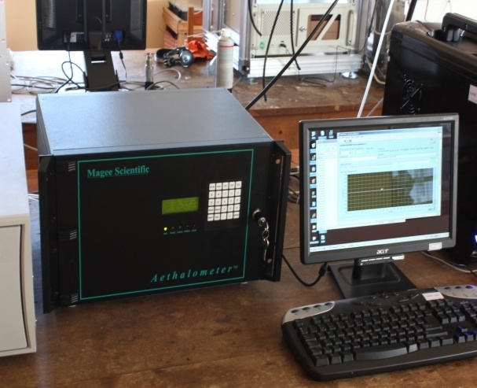
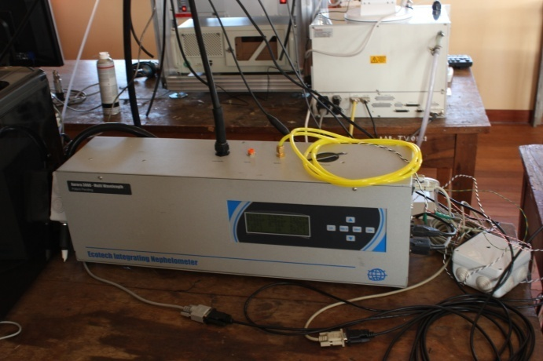
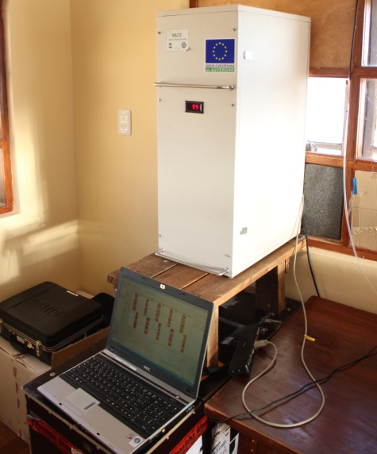
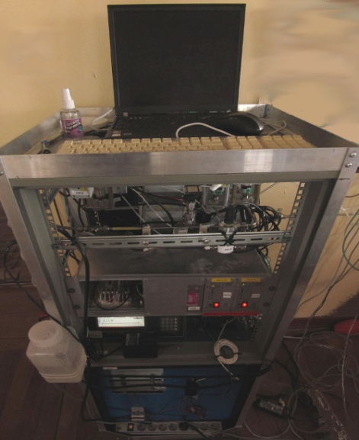
  Chacaltaya GAW station: Instrumentation (1)
Multiangle absortion photometer
Aethalometer
Nephelometer
Chacaltaya GAW Station
Scanning mobility particle sizer
Air ion spectrometer
HTDMA
aerosols physical properties
Notes:
IN THE NEXT SLIDES, LET ME SHOW YOU SOME OF OUR INSTRUMENTATION.
AS YOU CAN SEE IN THIS SLIDE, WE HAVE MANY INSTRUMENTATION RELATED TO THE MEASUREMENTS OF THE AEROSOL PHYSICAL PROPERTIES.
WE HAVE PHOTOMETERS, NEPHELOMETERS…ETC….
INCLUIR LOS NUEVOS EQUIPOS

Slide 7
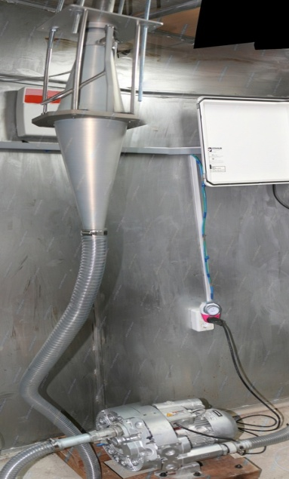
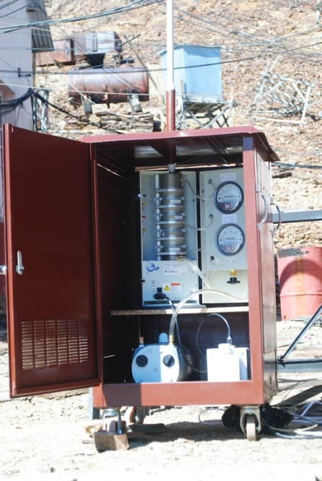
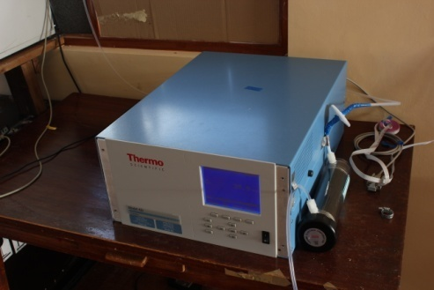
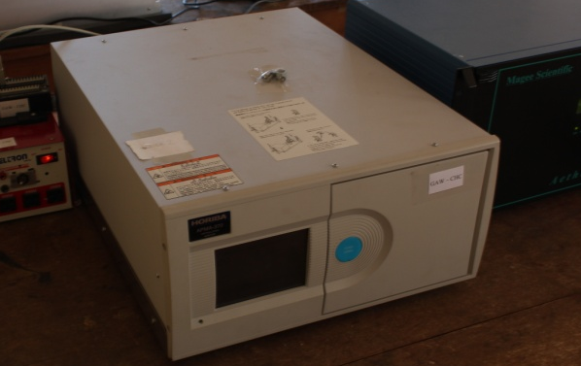
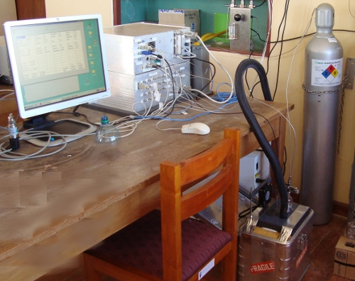
  Instrumentation: aerosols physical properties + gases
  Chacaltaya GAW station: Instrumentation (2)
High Volume Air Sampler
MOUDI cascade impactor
Chacaltaya GAW Station
Ozone analyzer
CO analyzer
CO₂ analyzer
aerosols physical properties + gases
Notes:
IN ADDITION, WE HAVE SOME IMPACTORS AND GAS MONITORS SUCH AS THE OZONE, CO AND CO2 ANALYZERS
ALL THIS INSTRUMENTATION HAS TO FOLLOW THE STANDARD CALIBRATION PROCEDURES OF THE GAW STATIONS.
INCLUIR LOS NUEVOS EQUIPOS (picarro)

Slide 8
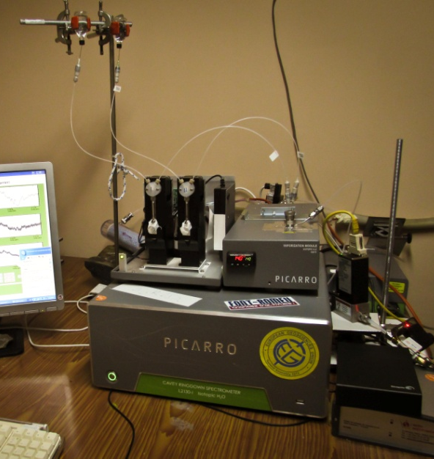
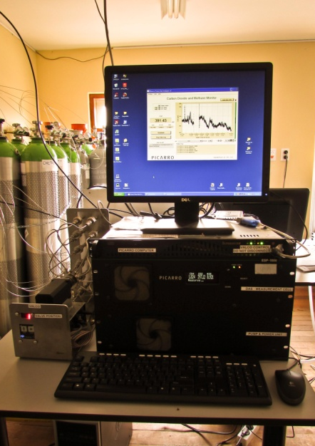
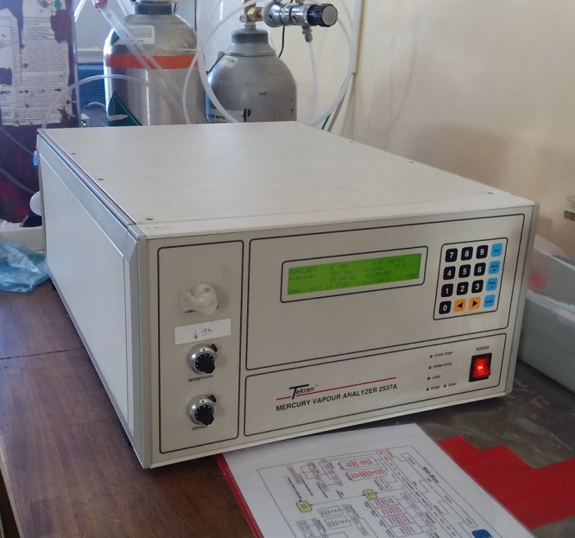
  Instrumentation: aerosols physical properties + gases
  Chacaltaya GAW station: Instrumentation (3)
Chacaltaya GAW Station
Picarro - Water Analyzer
Picarro CO₂ and CH₄
Tekran (Hg)
Notes:
THESE IS OUR NEWEST INSTRUMENTATION AT CHACALTAYA.
WE HAVE 2 PICARROS:
ONE FOR THE WATER ANALYSIS AND THE OTHER ONE, FOR CO2 AND METHANE MEASUREMENTS
WE ALSO HAVE A TEKRAN INSTRUMENT FOR MERCURY MONITORING
INCLUIR LOS NUEVOS EQUIPOS (picarro)

Slide 9
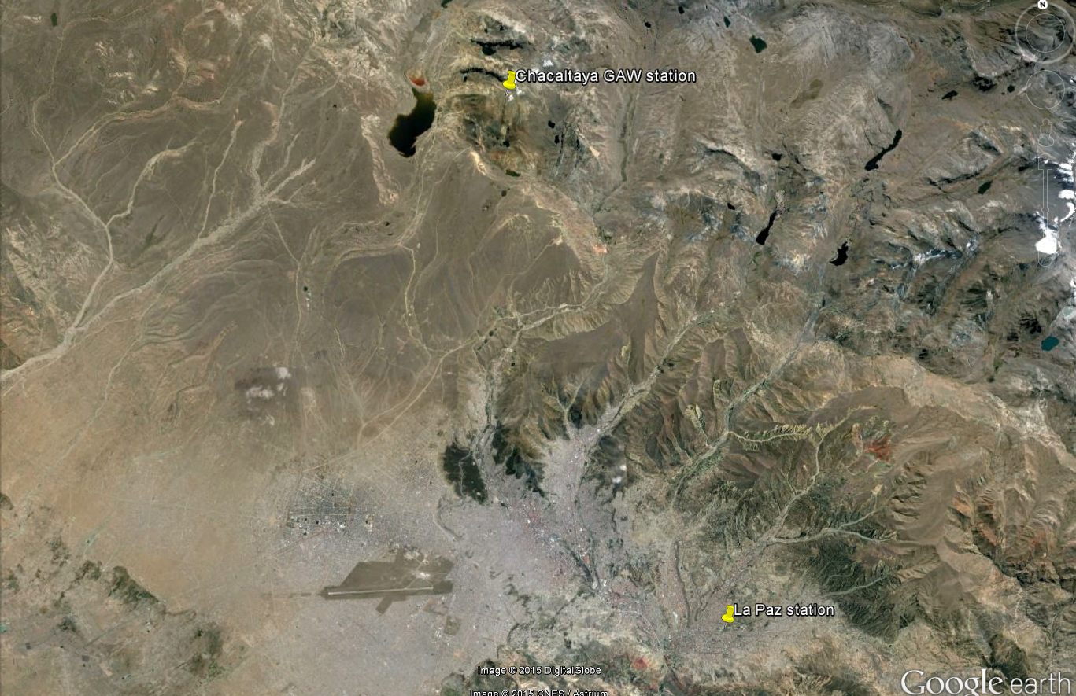
LFA Stations
  5240 m asl
  4000 m asl
  3420 m asl
Notes:
IN THIS GOOGLE MAP PICTURE, YOU CAN SEE THE LOCATION OF OUR STATIONS. THE CHACALTAYA STATION IS HERE, AND THE LA PAZ CITY STATION IS HERE. THE DISTANCE BETWEEN THE TWO STATIONS IS 22KM.
SOMETIMES WE USE THE AIRPORT FACILITIES IN ORDER TO RUN SOME OBSERVATION CAMPAIGNES.
EXPLICAR LA IMPORTANCIA DE LAS MEDIDAS CON CEILOMETROS

Slide 10
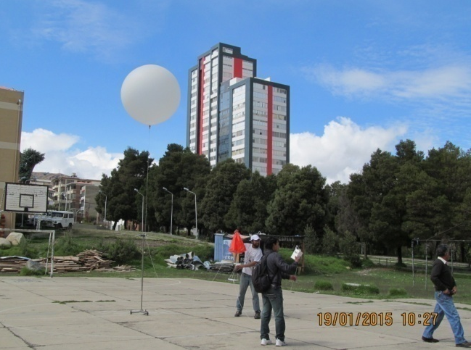
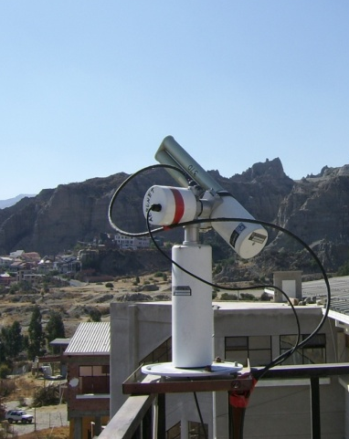
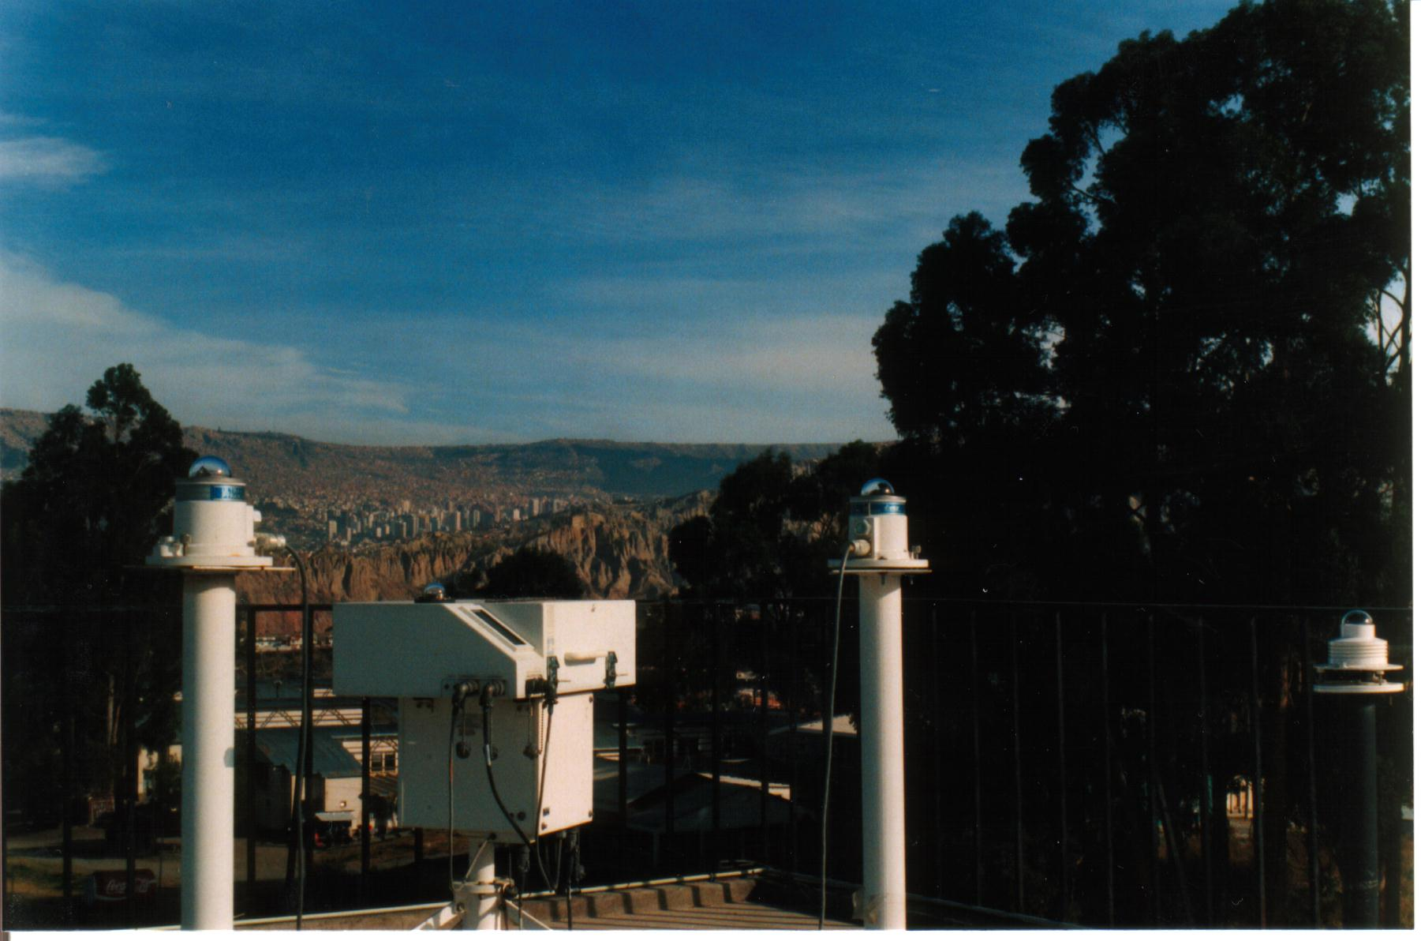
  Instrumentation: Cota-Cota
  La Paz station: Instrumentation
Radiosoundings
CIMEL- AERONET
La Paz Station
Brewer / UVB radiometers
Notes:
THERE ARE SOME OTHER INSTRUMENTS AT LA PAZ STATION.
EVERY MONDAY WE SEND BALLOONS DURING THE LIDAR MEASUREMENTS.
THERE ALSO IS A CIMEL SUN PHOTOMETER AND MANY UVB RADIATION INSTRUMENTS, INCLUDING A BREWER SPECTRO PHOTOMETER.
QUE NOVEDADES EN COTA COTA?
GRUAN?

Slide 11
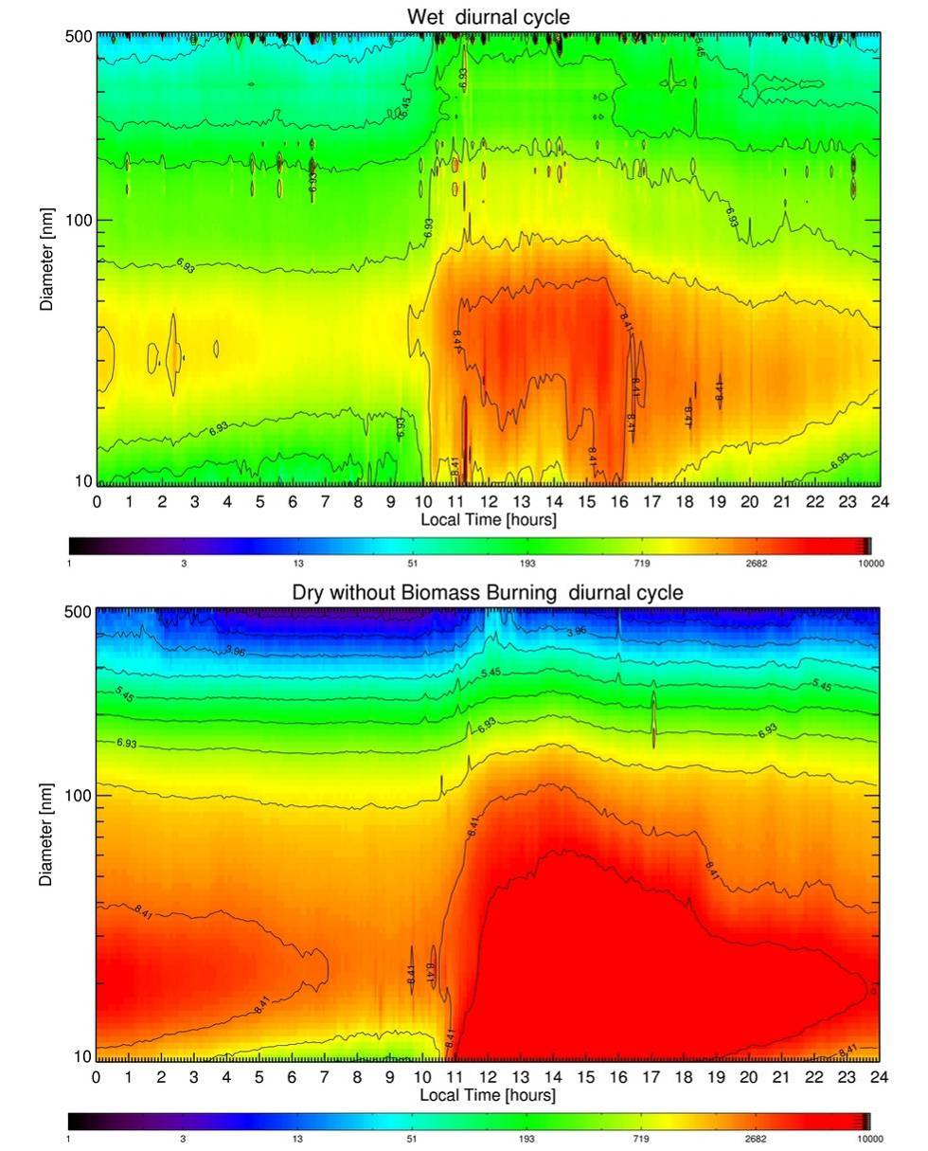
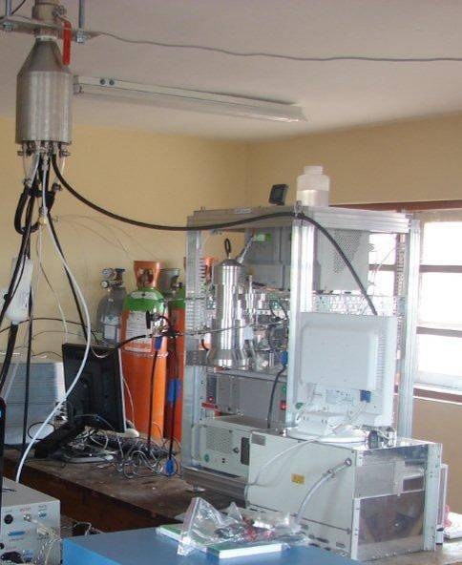
Mean particle size distribution
Wet
Mobility Particle Size Spectrometer
Chacaltaya GAW Station: some resoults
Dry
Notes:
LET ME SHOW YOU SOME INTERESTING RESULTS THAT WE GOT AT THE CHACALTAYA GAW STATION
USING THIS M.P.S.S. WE OBTAINED THE MEAN PARTICLE SIZE DISTRIBUTION DURING THE WET AND DRY SEASONS. THE LAST ONE WITHOUT BIOMAS BURNING.
THE “x” AXIS IS THE LOCAL TIME, AND THE “y” AXIS IS THE PARTICLES DIAMETER IIN NANOMETERS.
THE COLOR SCALE REPRESENTS THE PARTICLES CONCENTRATION, AND IT IS A LOGARITMIC SCALE.
NEAR THE NOON TIME, WE CAN SEE THAT A LOT OF PARTICLES REACH THE GAW STATION. THAT MEANS THAT THE P.B.L. IS PLAYING AN IMPORTANT ROLE IN OUR MEASUREMENTS.

Slide 12
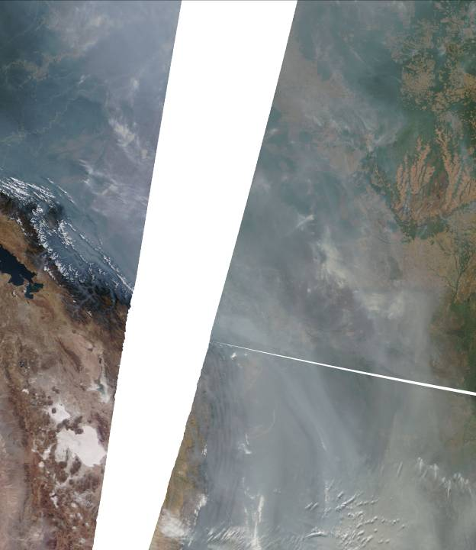
Smoke over Bolivia
August 19, 2010
From MODIS on-board of Terra
Smoke over Bolivia
Notes:
IN THIS PICTIURE TAKEN BY THE MODIS INSTRUMENT, YOU CAN OBSERVE THE SMOKE OVER BOLIVIA LOWLANDS, DURING THE BIOMAS BURNING.
LET ME ZOOM IN IN THIS SPECIFIC REGION.

Slide 13
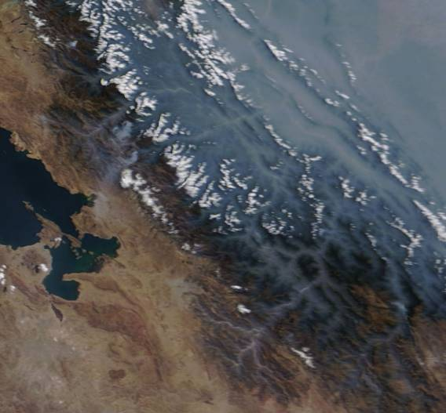
Smoke transported above Andean mountains
Low-lands
Titikaka
Smoke over Bolivia
Chacaltaya
La Paz
Notes:
HERE YOU CAN SEE HOW THE SMOKE GOES UP MOUNTAIN THROUGH THE BASINS. THIS SMOKE CAN SOMETIMES REACH LA PAZ CITY, AND THE GAW STATION.
IT IS IMPORTANT TO KNOW WHEN THIS OCCURS.

Slide 14
How our lidar system can help?
Notes:
THE QUESTION IS HOW HOUR LIDAR SYSTEM CAN HELP

Slide 15
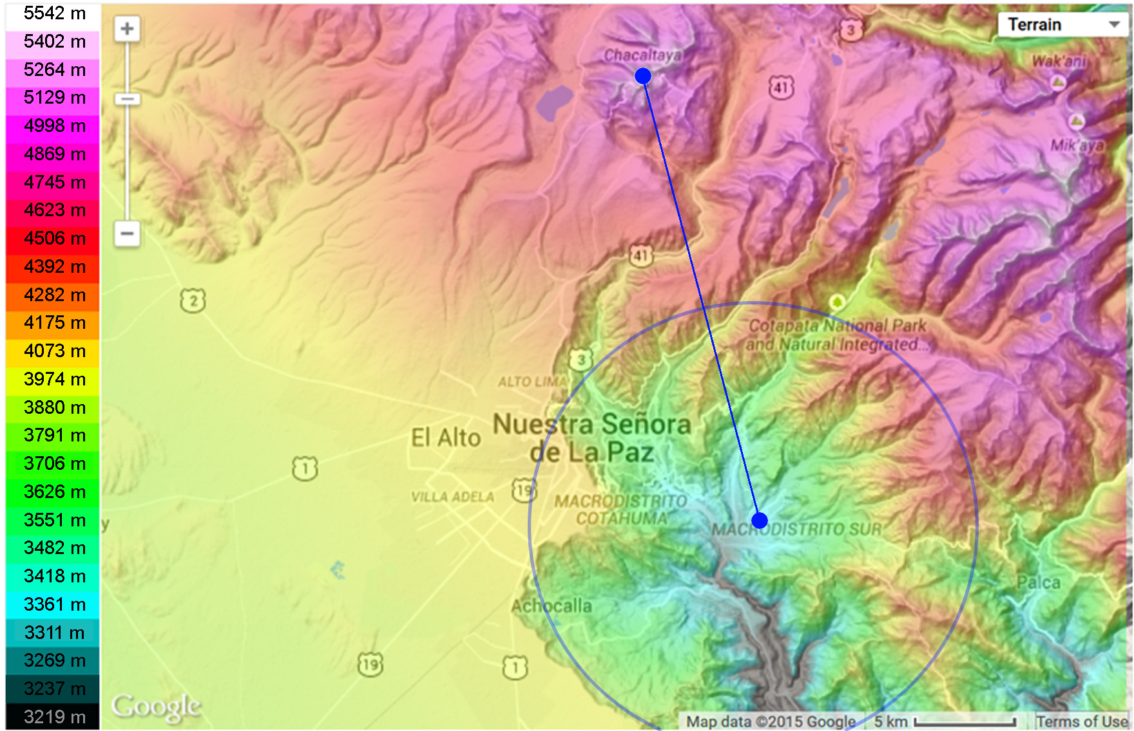
How our lidar system can help?
Notes:
IN THIS SLIDE YOU AN SEE THE TOPOGRAPHY OF THIS REGION.
THIS IS THE COLORED HEIGHT SCALE
OUR LIDAR SYSTEM IS LOCATED HERE, AND THE GAW STATION IS HERE.
UNFORTUNATELY, THE SIGNAL-TO-NOISE RATIO ALLOWS US TO GET GOOD MEASUREMENTS ONLY WOTHING THIS BLUE CIRCLE. HOWEVER, THESE STUDIES CAN HELP US TO UNDERESTAND THE BEHAVIOUR OF THE BOUNDARY LAYER
THE IDEA IS TO RUN MEASUREMENTS USING THE SCANNING CAPABILITIES OF OUR LYDAR SYSTEM OVER THE CIRCLED AREA
ANOTHER IMPORTANT PLACE TO STUDY IS THIS PARTICULAS BASIN, BECAUSE THE PARTICLES PRODUCED AT LA PAZ CITY, CAN REACH THE CHACALTAYA GAW STATION THROUGH IT
EXPLICAR LA IMPORTANCIA DE LAS MEDIDAS CON CEILOMETROS

Slide 16
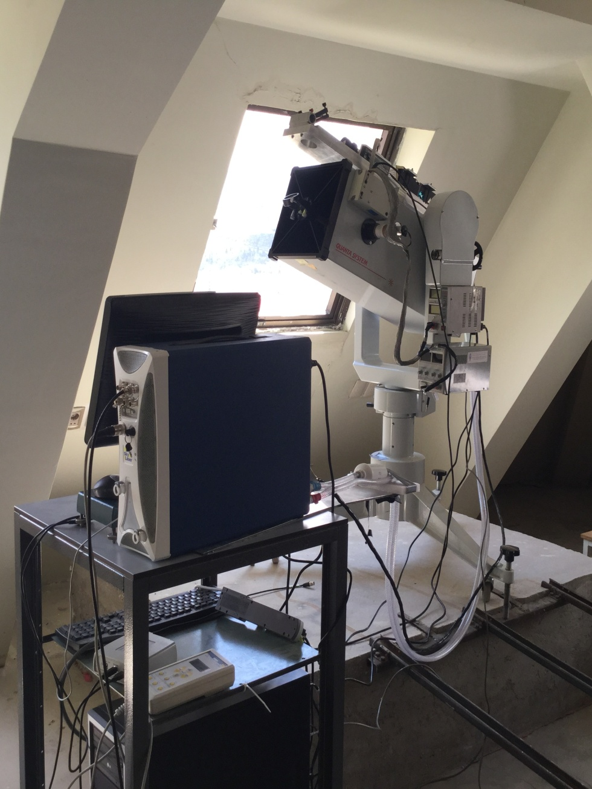
    Lidar system
Improvements
  Better stability
  New location
  New algorithms
How our lidar system can help?
CHARACTERISTICS
Configuration | Coaxial – elastic (532nm)
Telescope | Newtonian
Main mirror f(mm) | 250
Focal length (mm) | 700
Pinhole (mm) | 0.8
Field of view | 0.6 mrad
Notes:
IN ORDER TO RUN THESE SCANNING MEASUREMENTS, WE IMPROVED THE STABILITY OF OUR SYSTEM, AND MOVED IT TO A BETTER LOCATION.
WE ALSO DEVELOPED NEW RETRIEVAL ALGORITHMS, INCLUDING THE KLETT ALGORITHM.
MOSTRAR LIDAR EN FUNCIONAMIENTO CON ESCANEO
MOSTRAR PRIMEROS RESULTADOS DE SCANEO

Slide 17
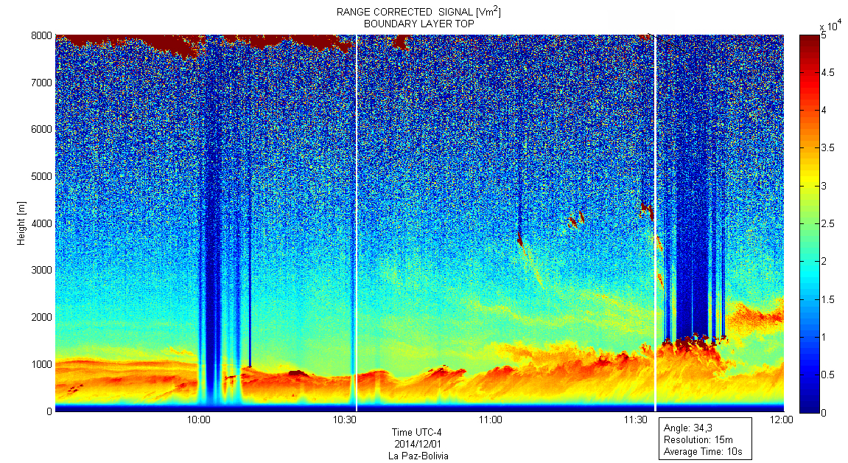
    Angular Aerosol Profiling over La Paz (34°)
Angular Aerosol Profiling over La Paz
Notes:
IN THIS LYDAR PICTIURE, YOU CAN SEE AN EXAMPLE OF OUR REGULAR MEASUREMENTS. WE GET THIS KIND OF DATA EVERY MONDAY MORNING AS A PART OF THE LALINET NETWORK ACTIVITIES.
IT IS INTERESTING TO SEE THAT THE SLOPE IN THIS DATA WAS CAUSED BY THE 34.3 TILT DEGREES OF THE SCANNING SYSTEM.
IN THE PICTIURE, THE “x” AXIS……AND THE “y” AXIS
MOSTRAR LIDAR EN FUNCIONAMIENTO CON ESCANEO
MOSTRAR PRIMEROS RESULTADOS DE SCANEO

Slide 18
    Angular Aerosol Profiling over La Paz (° to °)
Angular Aerosol Profiling over La Paz
Notes:
IN ORDER TO OBTAIN THIS PICTIURE, WE CHANGED THE SCANNING ANGLE FROM 16 TO 37 DEGREES, IN ONE DEGREE STEPS EVERY 30 SECONDS.
THE “x” AXIS IS THE HORIZONTAL DISTANCE FROM LYDAR, AND THE “y” AXIS IS THE ALTITUDE.
WE ARE WORKING WITH THE DEVELOPMENT OF THE ALGORITHMS FOR THESE KIND OF MEASUREMENTS
THE MAIN IDEA IS TO USE THIS TECHNIQUE IN ORDER TO STUDY THE BOUNDARY LAYER WITHIN THE BLUE CIRCLE THAT I TALKED ABOUT
MOSTRAR LIDAR EN FUNCIONAMIENTO CON ESCANEO
MOSTRAR PRIMEROS RESULTADOS DE SCANEO

Slide 19
Future challenges

Slide 20
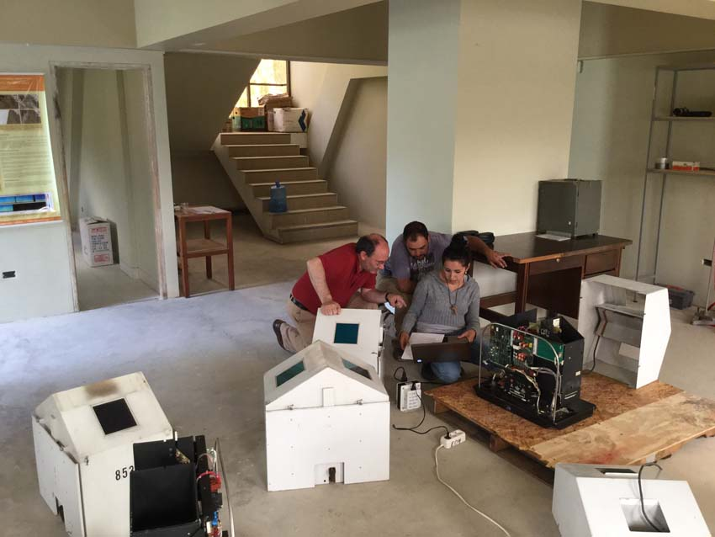
Ceilometers
Future challenges
Notes:
OUR NEXT CHALLENGE IS TO SET UP THESE CEILOMETERS THAT DAVID WHITEMAN FROM GODAR SPACE FLIGHT CENTER SENT US A FEW WEEKS AGO.
FOR THE MOMENT, WE ARE IMPROVING THESE INSTRUMENTS DATA ACQUISITION SYSTEM IN ORDER TO USE THEM AS VERY SIMPLE LIDARS.
MEJORAS AL SISTEMA
HARDWARE
Retroceso en el pinhole
SOFTWARE
Algoritmo de KLETT

Slide 21
Future Goals

Slide 22
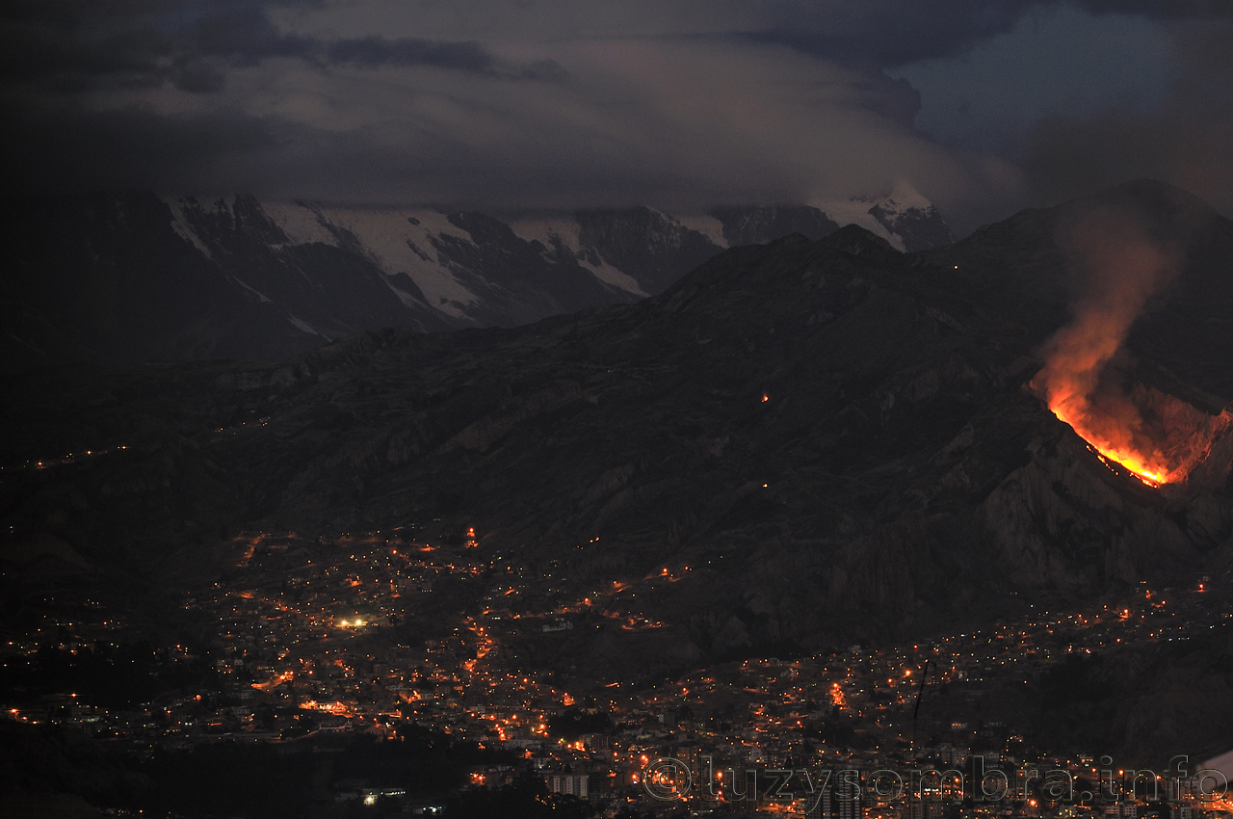
Future goals
Short term
    Improve retrieval algorithms
    Move the lidar system to different locations
    Decrease electronic noise
    Photon counting board
    Depolarization ratio
Long term
    Raman lidar
    Network of brand new ceilometer
Notes:
AS SHORT TERM GOALS, WE WANT TO IMPROVE THE RETRIEVAL ALGORITHMS, AND DEVELOP SPECIFIC ALGORITHMS FOR THE SCANNIG DATA. THEN WEARE THINKING TO MOVE THE LIDAR SYSTEM TO DIFFERENT LOCATIONS. FOR INSTANCE, THE AIRPORT.
MOREOVER, WE ARE PLANNING TO IMPROVE OUR DATA ACQUISITION SYSTEM BY GETTING A PHOTON COUNTING BOARD.
IN ADDITION, WE ARE ALMOST READY TO ADD A SECOND CHANNEL TO OUR SYSTEM IN ORDER TO HAVE DEPOLARIZATION INFORMATION
AS LONG TERM GOALS, WE WOULD LIKE TO INSTALL A RAMAN LIDAR SYSTEM, AND A NETWORK OF BRAND NEW CEILOMETERS

Slide 23
Summary
Aerosols properties as well as gas concentrations are measured at CHC since the end of 2011
There is a clear influence of La Paz city during daytime
  Lidar measurements at La Paz city suggest that the GAW station is:
    within the PBL during some of the daytime
    in the lower free troposphere during nighttime
Observations show a clear signal during biomass burning season
Preliminary data from angular measurements suggests that spatial behavior of the PBL could be studied through this method.
  More measurements must be taken.
Notes:
IN SUMMARY, OUR CHACALTAYA GAW STATION HAS BEEN TAKING MEASUREMENTS SINCE 2011. AND WE HAVE
LOT OF INFORMATION.
SOON YOU WILL SEE PAPERS AND REPORTS WITH THIS INFORMATION.
THERE IS A CLEAR EVIDENCE THAT LA PAZ CITY IS PLAYING AN IMPORTANT ROLE IN OUR MEASUREMENTS AND
DEEPER STUDY OF THE BOUNDARY LAYER MUST BE DONE
LEER LEER LEER
There is strong evidence of seasonal transport of smoke to the Central Andes
The main source seems to be related to biomass burning at the Amazon region
Meteorological conditions are important for the smoke to be transported to the Andes (not totally understood, especially on short time scales, at the moment)
Clear (although not discussed here) contribution of soot produced by nearby metropolitan area to measurements at Chacaltaya
Some questions:
Although climatological meteorological conditions necessary for smoke transport, are understood, a more detailed analysis for short time scales is necessary in order to explain the data measured at Chacaltaya
A better understanding of the planetary boundary layer is needed
How much of this particulate matter goes into the free troposphere?
Does smoke transported to the Andes play a role on the glacier retreat?

Slide 24







Paolo Laj, Jean-Luc Jafrezzo, Manuel Barret, Marco Zanatta
Alfred Wiedensohler, Kay Weinhold, Wolfram Birmili
Paolo Bonasoni, Paolo Cristofanelli, Elisa Vuillermoz,
Francescopiero Calzolari
Karine Sellegri, Clemence Rose
Radovan Krejci, Modris Matisans
Michel Ramonet, Victor Kazan, Olivier Laurent, Francoise Vimeux, Olivier Catani, Guillaume Tremoy
David Whiteman
Patrick Ginot
Marcos Andrade, Ricardo Forno, Francesco Zaratti, René Gutierrez, Isabel Moreno, Fernando Velarde. Fabricio Avila,
Manuel Roca, María Fernanda Sanchez, Juan Calle
and many students
Thank you

Slide 25
Marcos Andrade, Ricardo Forno, Francesco Zaratti, René Gutierrez, Isabel Moreno, Fernando Velarde. Fabricio Avila,
Manuel Roca, María Fernanda Sanchez, Juan Calle
and many students
Thank you

Slide 27
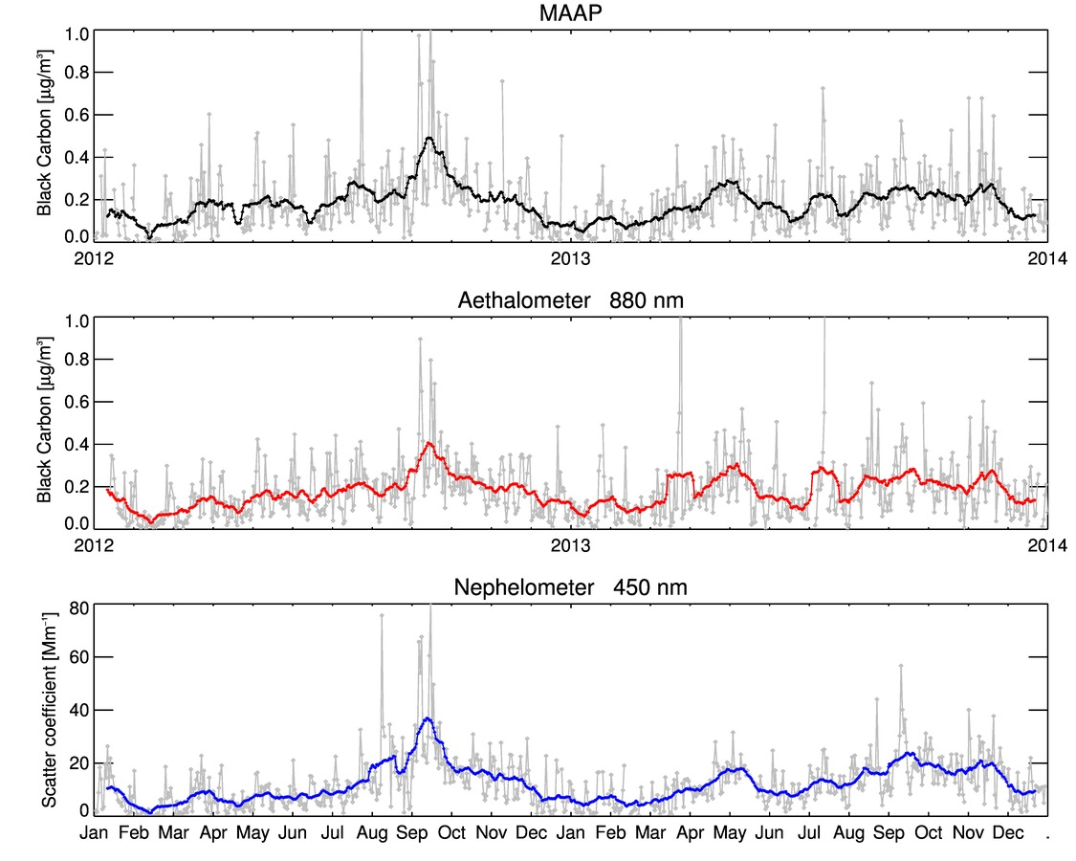
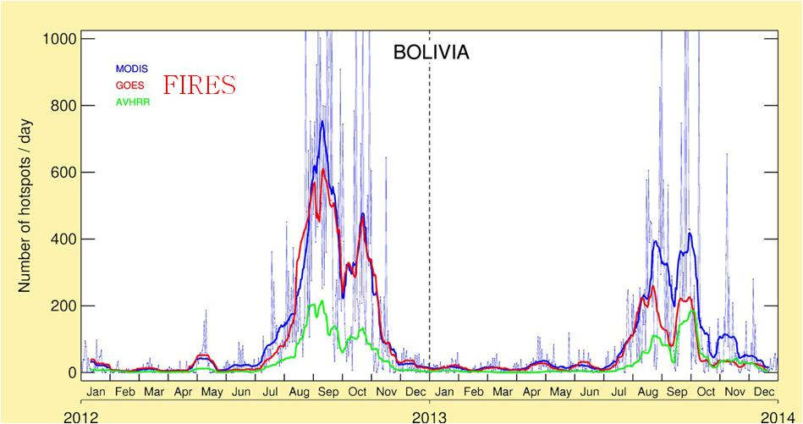
MAAP
eq
GAW/CHC Chacaltaya Station: some results (1)
MODIS GOES AVHRR

Slide 28
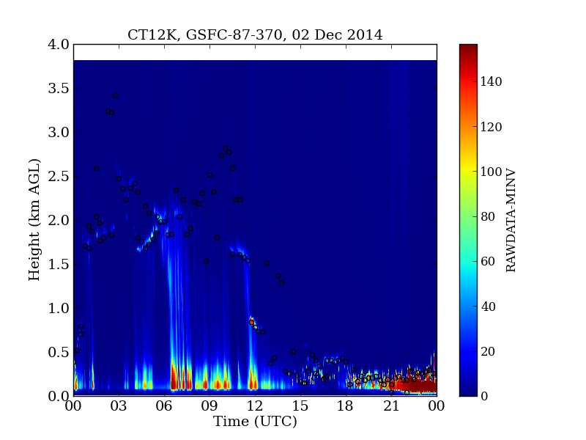
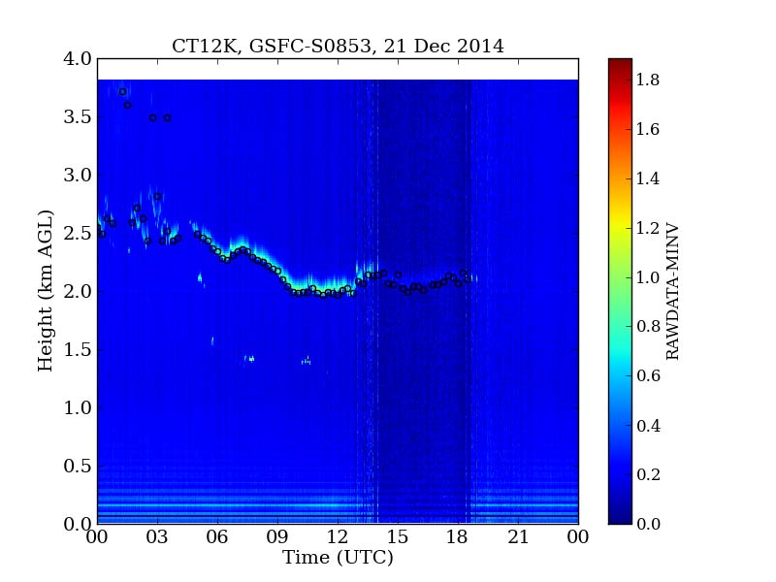
Ceilometers
Refurbishing of ceilometers
Notes:
MEJORAS AL SISTEMA
HARDWARE
Retroceso en el pinhole
SOFTWARE
Algoritmo de KLETT

Slide 29
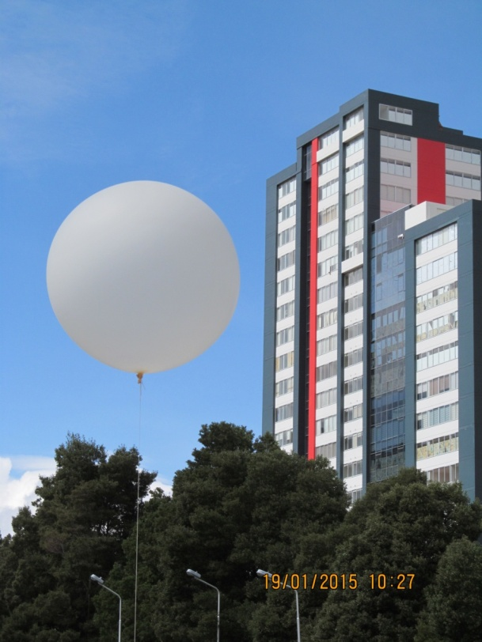

Radiosonde measurements
Radiosonde measurements
Notes:
crowdfunding

Slide 30
LIPAZ system: General characteristics
Configuration | Coaxial – Elastic (532nm)
Telescope | Newtonian
Main mirror diameter (mm) | 250
Focal length (mm) | 700
Pinhole (mm) | 0.3 (0.4 mrad)
LASER Nd:YAG working at 532 nm | Quantel, model BRIO
Wave length (nm) | 1064 | 532 | 355
Pulse duration (ns) | 4 | 3 | 3
Energy per pulse (mJ) | 115 | 80 | 25
Maximun power (W) | 2.3 | 1.6 | 0.5
Beam divergence (mrad) | 1.9
Repetition frecuency (Hz) | 20
Acquisition | PMT-> oscilloscope-> PCI-GPIB LabView acquisition software
Detector | PMT : Hamamatsu R988OU-210
LIPAZ - LIDAR

Slide 31
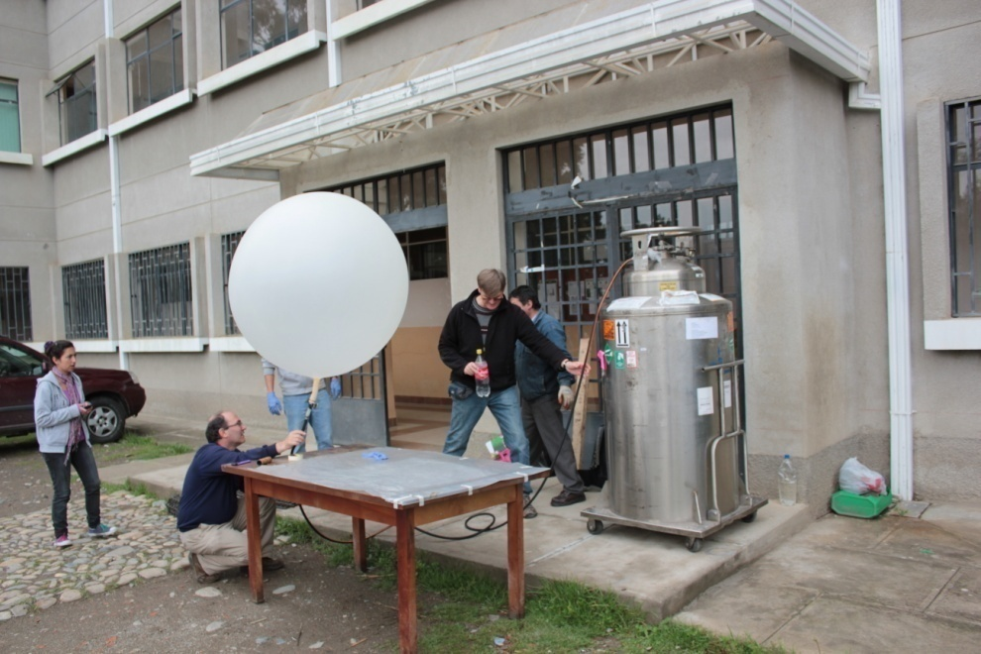
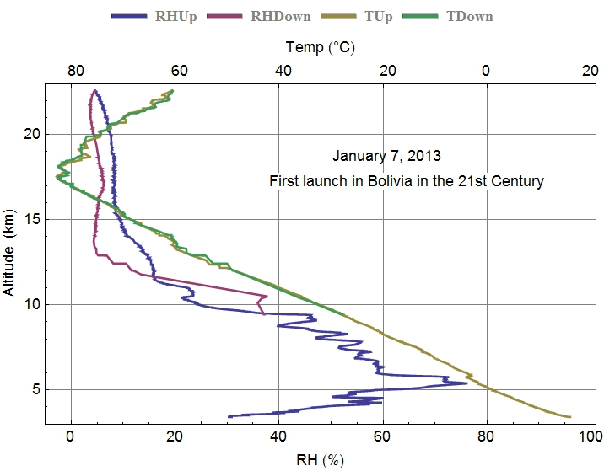
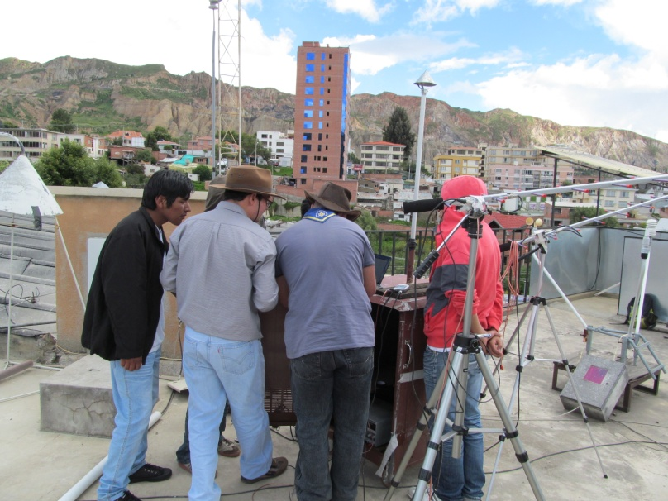
Radiosondings
RADIOSOUNDING SYSTEM

Slide 32
Scanning Mobility Particle Sizer (SMPS)
The submicron aerosol size distribution is measured with a SMPS technique using a TSI Inc. 3010 Condensation Particle Counter and a custom-made Differential Mobility Analyzer assembled, tested and quality controlled according to EUSAAR recommendations (http://www.eusaar.net/). The interdependence between the mobility and size of the particle allows converting particle mobility distribution into size distribution, thus the size range of the SMPS extends from about 10 nm to 650 nm. Data are stored with a five-minute time resolution.
The SMPS measures the submicron aerosol size distribution from about 10 nm to 650 nm. Data are stored with a five-minute time resolution.
LIPAZ - LIDAR

Slide 33
Neutral Cluster & Air Ion Spectrometer (NAIS)
The NAIS is a device for the measurement of the number concentration of both ions and not charged particles (neutral clusters) in the atmosphere according to their electrical mobility distribution. The instrument processes particles with positive and negative charges in two different columns. Controlled charging, together with electrical filtering, enables to extend measurements to the neutral aerosol particles. Parallel charging of particles by ions of both polarities enables to study the effect of the charge polarity on charging. The dependence of nucleation and particle formation on particle charge polarity can be studied by combining the charging, filtering and recharging measurements. Distribution measurements obtained are in a wide mobility range: ±3.2 to ±1.2∙10-3 cm2V-1s-1, which corresponds to 0.5 nm to 40 nm (http://airel.ee/).
Measures the number concentration of ions and not charged particles (neutral clusters) in the atmosphere .
(range: 0.5 nm to 40 nm)
LIPAZ - LIDAR

Slide 34
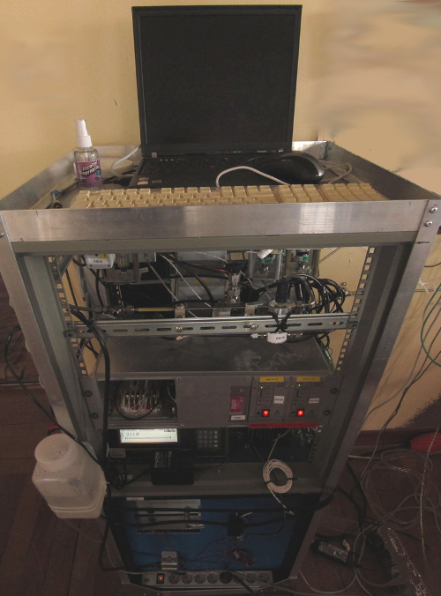
Hygroscopic Tandem Differential
Mobility Analyzer (HTDMA)
The custom-made HTDMA set up in Chacaltaya allows to measure the hygroscopicity (water uptake) of aerosols. It is suitable for any application where information is required on how particles of a selected diameter grow when they are exposed to controlled conditions of relative humidity.
It consists in two Differential Mobility Analyzers sequentially assembled. The first one allows the selection the size of the dry particle to characterize and the second one measures the size distribution of the hydrated particle after it has passed through a humidified chamber. The ratio between the wet and dry diameters is referred to as the particle's growth factor.
Measures the hygroscopicity (water uptake) of aerosols. It is suitable for any application where information is required on how particles of a selected diameter grow when they are exposed to controlled conditions of relative humidity.
LIPAZ - LIDAR

Slide 35
Multi-Angle Absorption Photometer (MAAP)
Measures the aerosol light absorption properties at 670 nm. It registers the modification of radiation fields in the forward and back hemisphere (at 3 different angles) of a glass-fibre filter caused by deposited particles. The aerosol light absorption coefficient is related with ambient black carbon (BC) concentration by applying a specific attenuation factor. BC is primarily derived from carbonaceous particulate emissions from combustion sources, but includes also dust and inorganic salts. At Chacaltaya data is stored with a one-minute resolution.
The Thermo Scientific Model 5012 MAAP measures the aerosol light absorption properties at 670 nm. It registers the modification of radiation fields in the forward and back hemisphere (at 3 different angles) of a glass-fibre filter caused by deposited particles. The aerosol light absorption coefficient is related with ambient black carbon (BC) concentration by applying a specific attenuation factor. BC is primarily derived from carbonaceous particulate emissions from combustion sources, but includes also dust and inorganic salts. At Chacaltaya data is stored with a one-minute resolution.
LIPAZ - LIDAR

Slide 36
Aethalometer
The Magee Aethalometer measures aerosol light absorption properties in 7 different wavelengths: 370 nm (UV), 470 nm (blue), 520 nm (green), 590 nm (yellow), 660 (red), 880 nm (IR1m “standard BC”) and 950 nm (IR2).
The Magee Aethalometer measures aerosol light absorption properties (though applying a different attenuation factor from the MAAP) in 7 different wavelengths: 370 nm (UV), 470 nm (blue), 520 nm (green), 590 nm (yellow), 660 (red), 880 nm (IR1m “standard BC”) and 950 nm (IR2). The Aethalometer measures the rate of change of optical transmission through a spot on a filter on which aerosol is being continuously collected, and converted this to a calculation of the concentration of optically-absorbing material in the sampled air stream. At Chacaltaya data one data per wavelength is stored every five-minutes.
LIPAZ - LIDAR

Slide 37
Integrating Nephelometer
The Ecotech Aurora 3000 Integrating Nephelometer measures both aerosol total (σsp) and back (σb) scattering coefficients at three wavelengths: 450 nm (blue), 525 nm (green) and 635 nm (red). The scattering coefficient measurements (light scattering angle sampled: 10° – 170°) are combined with backscatter measurements (light backscattering angle sampled: 90° - 170°). Forward scatter can be calculated from subtracting backscatter from total scatter. The measured values are adjusted automatically and in real-time by on-board temperature and pressure sensors. The dimension of σsp are inverse length (inverse megameters Mm-1) and the instrument measurement range goes from <0.25 to 2000 Mm-1. At Chcacaltaya, data is stored every minute. Zero checks are performed every 3 months.
LIPAZ - LIDAR

Slide 38
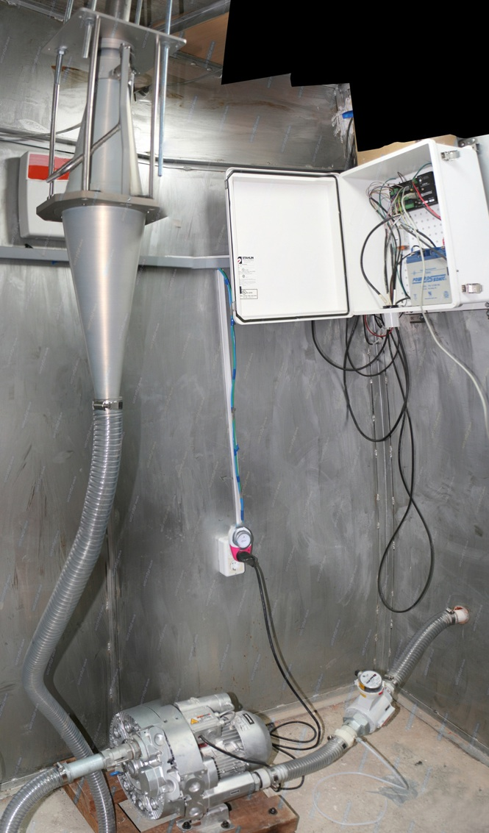
High Volume Air Sampler
This device samples aerosol particulate matter in the northwestern shoulder of Chacaltaya. It has two interchangeable DIGITEL impactors, which allow to sample particles with aerodynamic diameter lower than 10 or 2.5 µm (i.e., PM10 and PM2.5 fractions) at a flow rate of 30 m3 h-1. Samples are collected on pre-baked quartz fibre filters (Ø 150 mm) on a weekly basis or at higher frequency for high filter loadings. Filters are transported and stored at -18ºC and then shipped to the LGGE in France, where the soluble fraction is analyzed to determine its content of major and minor ions (in a Dionex Ion Chromatograph), organic and elemental carbon (in a Sunset Lab TOC applying the EUSSAAR_2 protocol) and anhydrous monosaccharides (in a High Performance Liquid Chromatography coupled to a Pulse Amperometric Detector).
LIPAZ - LIDAR

Slide 39
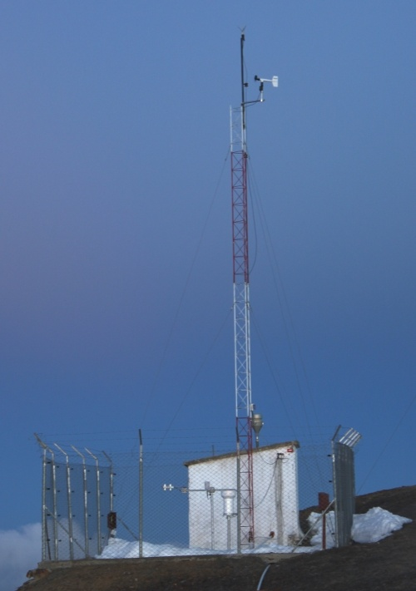
Automatic Weather Station (AWS)
A complete Cambpell Scientific AWS is located in the northwestern shoulder of Chacaltaya. Eight parameters are obtained: Wind speed and direction (at 10 m) with a vertical anemometer, precipitation in a heated pluviometer, atmospheric pressure, temperature and relative humidity (at 2 m and at ground level) with a thermohygrometer and incident and reflected radiation by a piranometer and a pirgeometer, respectively. At Chacaltaya, all parameters are averaged every 15 minutes.
LIPAZ - LIDAR

Slide 40
Carbon dioxide analyzer
The CO2 analyzer is custom made on a Licor 6252 differential, non-dispersive, infrared (4.26 nm) gas analyzer. Air is pumped trough the instrument where two optical cells are used: one for the sample and the other for a reference gas. As measurements should be performed in dry air, ambient moisture is trapped in a cooling system (ethanol at <-60ºC) prior to the entrance of the instrument. CO2 concentrations are stored with a one-minute resolution. Monthly four-point calibrations are performed.
LIPAZ - LIDAR

Slide 41
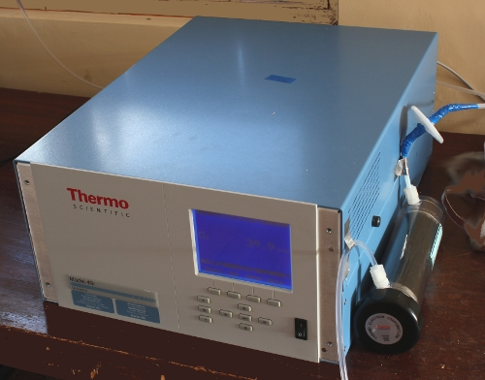
Ozone analyzer
Thermo Scientific Model 49i Ozone Analyzer is a dual-cell, UV Photometric analyzer for the measurement of ozone concentrations in ambient air ranging from 0.05ppb to 200ppm. As O3 molecules absorb UV light at a wavelength of 254 nm, the degree to which the UV light is absorbed is directly related to the ozone concentration as described from Beer-Lambert Law (www.thermoscientific.com). The response time of this instrument is of 20 seconds but at Chacaltaya data are stored with a one-minute resolution. Automatic zero checks are performed daily.
LIPAZ - LIDAR

Slide 42
CONCLUSIONS
The lidar system was improved significantly over the last year and preliminary studies of boundary layer height over La Paz have been done.
The data collection system has to be improved or changed to a new location to enable measurements over Chacaltaya.
New algorithms need to be developed or improved to obtain more quantitative information, such as aerosol backscatter and extinction.
The new scanning capabilities of our system will allow us to study the atmosphere over La Paz and El Alto.
http://www.chacaltaya.edu.bo/

Slide 43
OUTLINE
The Chacaltaya GAW station
  Goals and Instrumentation
  Some results
The LIPAZ system
  General characteristics
  Improvements
  Future goals

Slide 44
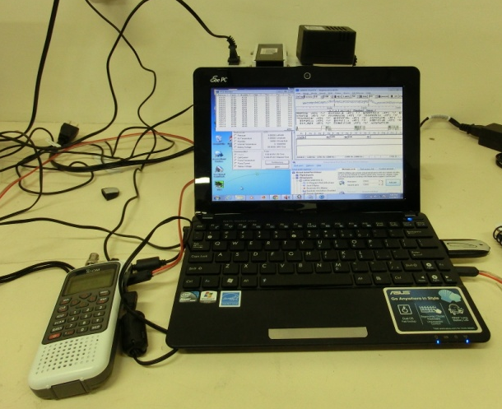
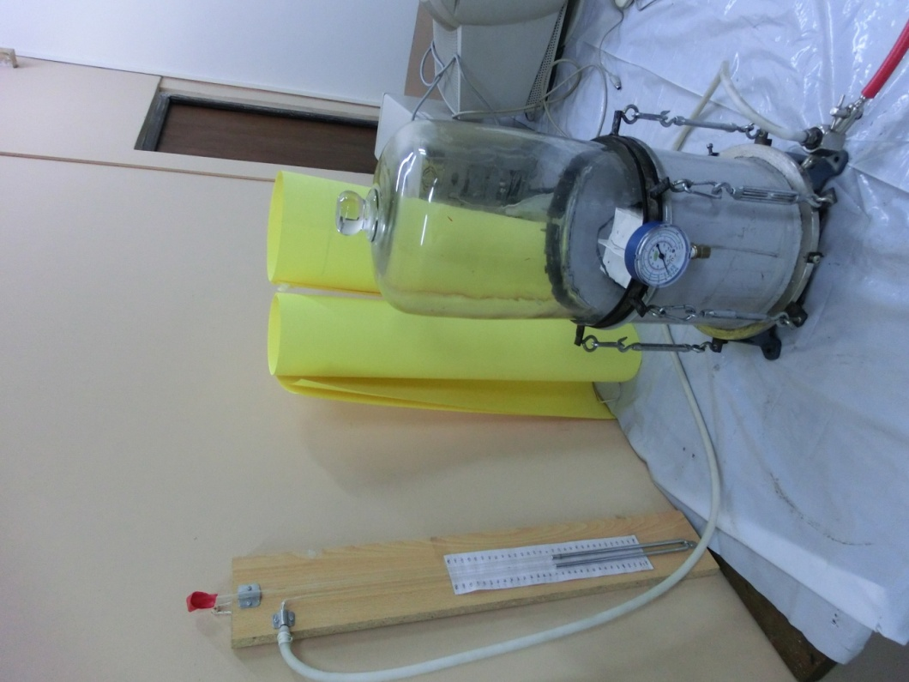
Dual radiosonde receiving stations
  offers possibility of dual soundings at different locations
RADIOSOUNDING SYSTEM
Pressure chamber for simulating launches
  permitted extensive debugging of ground station software and hardware

Slide 45


Slide 46
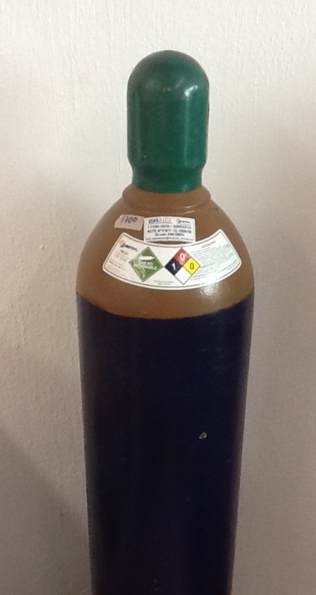
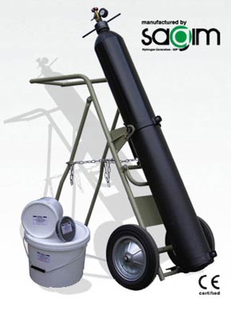
1000 u$/ cylinder
RADIOSOUNDING SYSTEM
CHEMICAL HYDROGEN GENERATOR
7,830 Euros + 1,276 Euros shipping to US

Slide 47
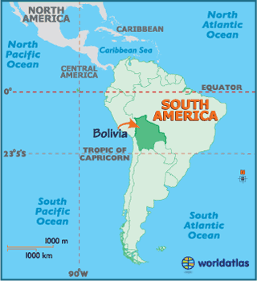
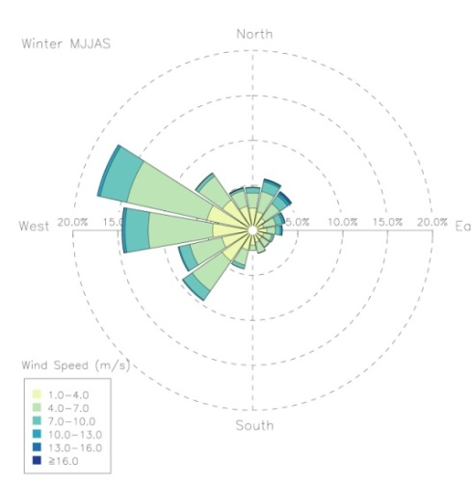

  Chacaltaya GAW station: overview
Winter
Summer
Lowlands
Highlands
16º21'1.81"S, 68º7'53.46"W
GAW/CHC Chacaltaya Station
Notes:
PRESENTACION DEL LUGAR
Unique GAW high altitude station over the Continent

Slide 48
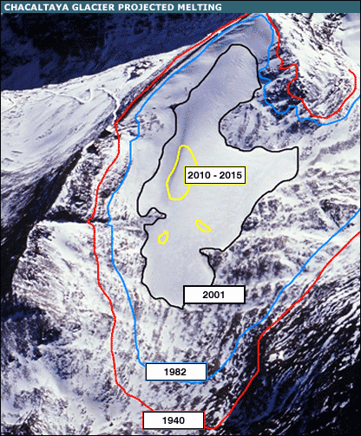

Slide 49
Winter
Summer

