Slide 1


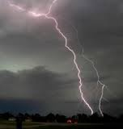
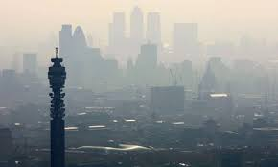
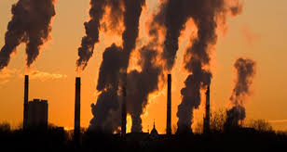
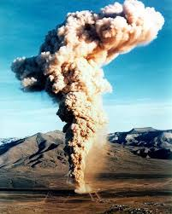
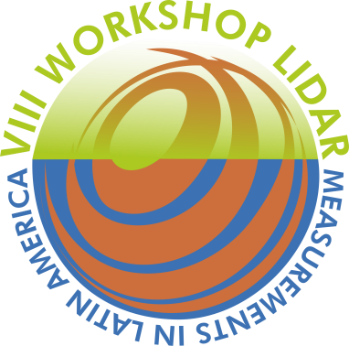





Cloud impact study in solar surface radiation using the R2-SOLAR network in Argentine territory
Elian Wolfram, Jacobo Salvador, Facundo Orte, Pablo Vasquez, Gabriel Amanchatoux, Raul D’Elia, Daniela Bulnes, E. Quel

Slide 2


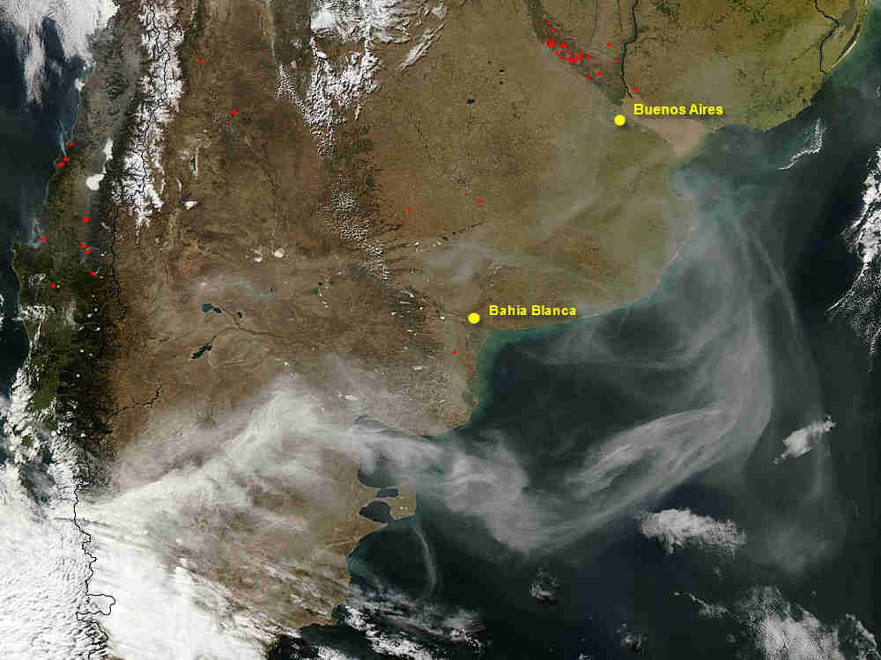
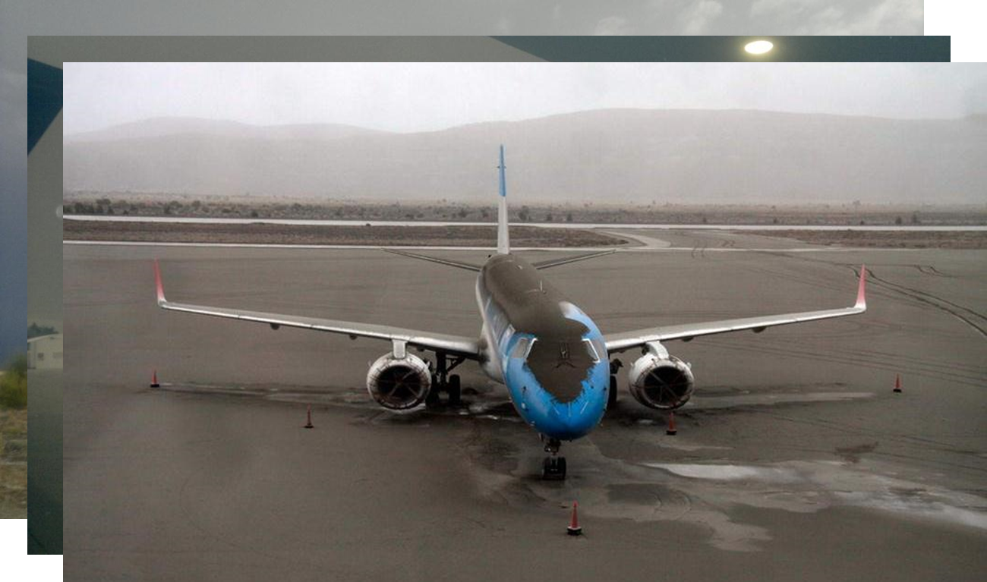
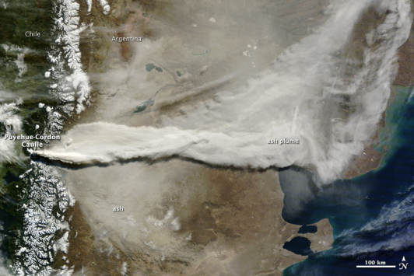
Trigger of the network
Puyehue-Cordón Caulle
(40,590º S; 72,117º O; 2240 m),
June 2011
Volcanic Ash

Slide 3


Projects that support the network
Development of the Social Management System for Atmospheric Environmental Risks in South America
(2013-2017). JST-JICA
MINDEF Special Project
MD 31554/11 (2011-2013).Argentina

Slide 4
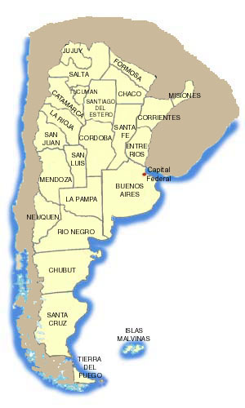
Site location
7
Station Num. | Site | Lat (S) | Lon (W) | Elev (m)
1 | Bs As | 34,57 | 65,31 | 15
2 | Bariloche | 41,15 | 71,16 | 840
3 | Comodoro | 45,79 | 67,46 | 49
5 | Neuquen | 38,95 | 68,14 | 271
6 | Rio Gallegos | 51,60 | 69,32 | 15
7 | Tucuman | 26,82 | 65,22 | 431
8 | Córdoba | 31,42 | 64,18 | 300
8
4
1
5
2
3
6
9

Slide 5
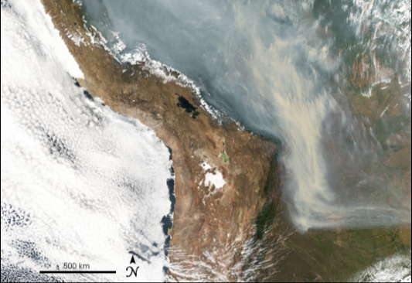
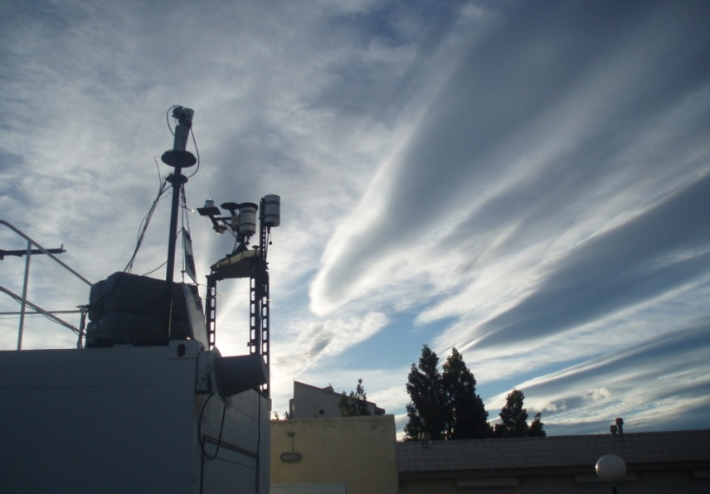
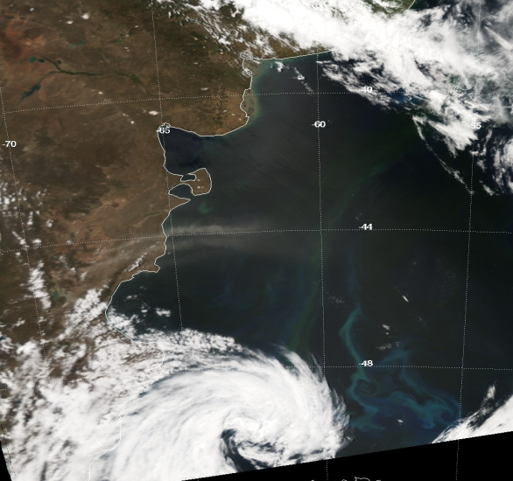
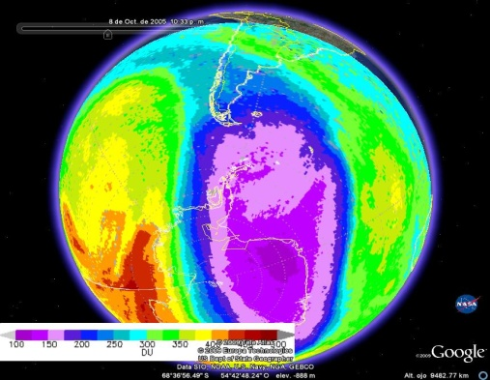
Biomass Burning
Cloud cover impact
7
Volcanic Ash
8
4
1
5
2
PATAGONIAN DUST
3
Trelew
Dust
6
Strong winds
Ozone Hole Intrusion –
UV impact
9

Slide 6
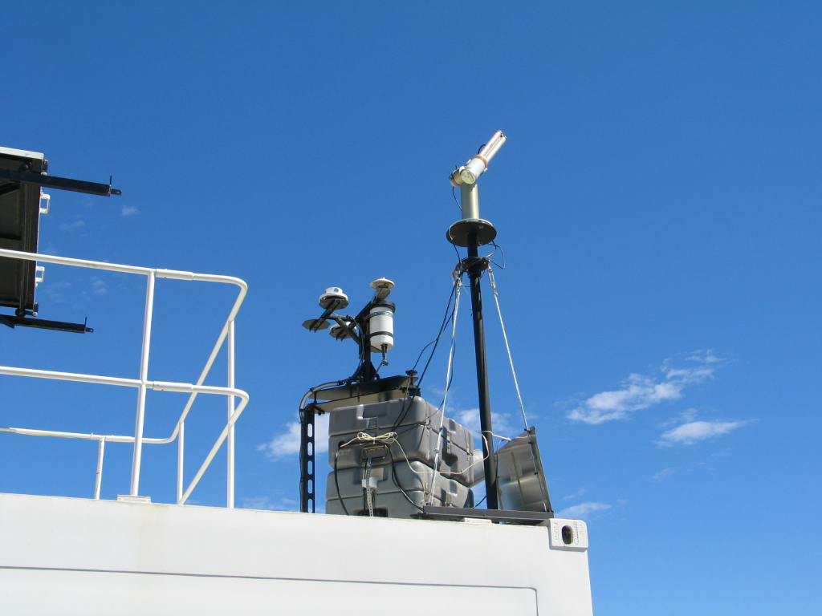
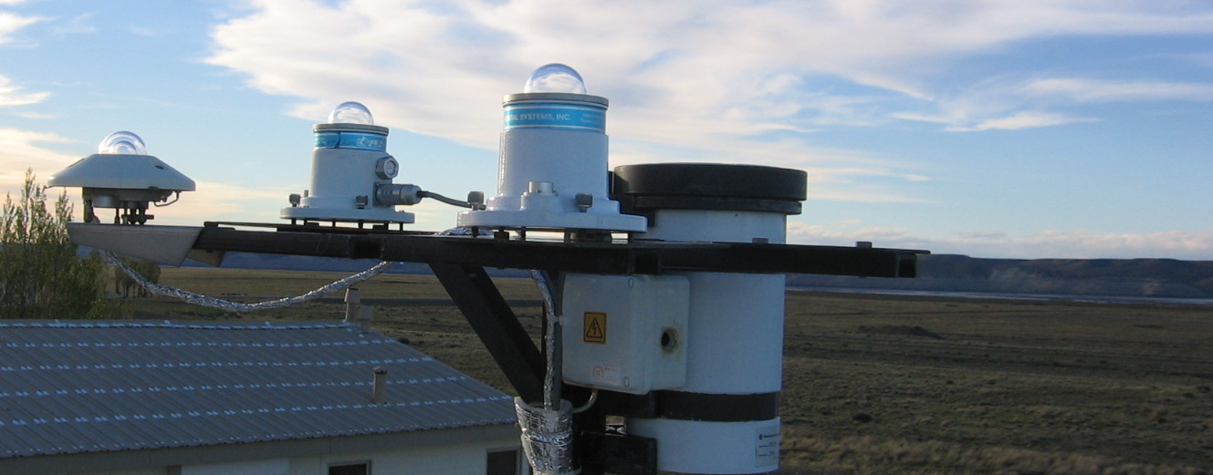
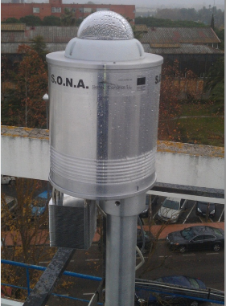
Radiation instruments in each site
Pyra
Sunphotometer
UV-A
UV-B
GUV 541
Cloud Observation Camera

Slide 7
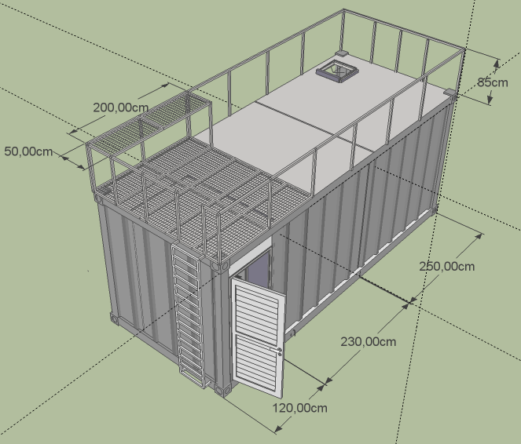
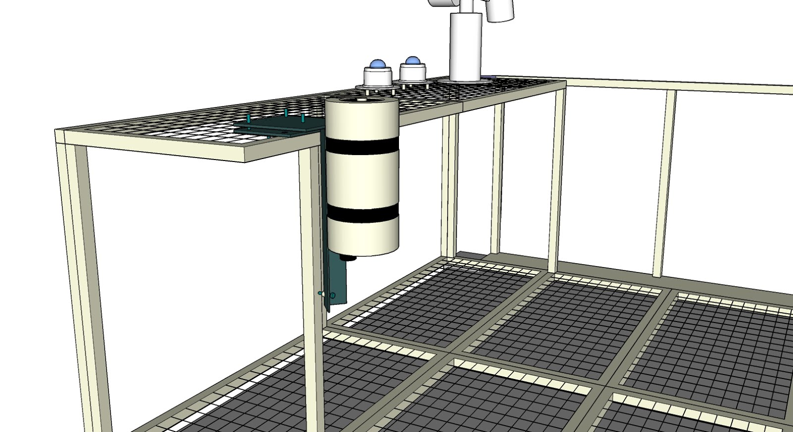
Proyecto de Desarrollo del Sistema de Gestión de Riesgos Medioambientales Atmosféricos en Sudamérica

Slide 8
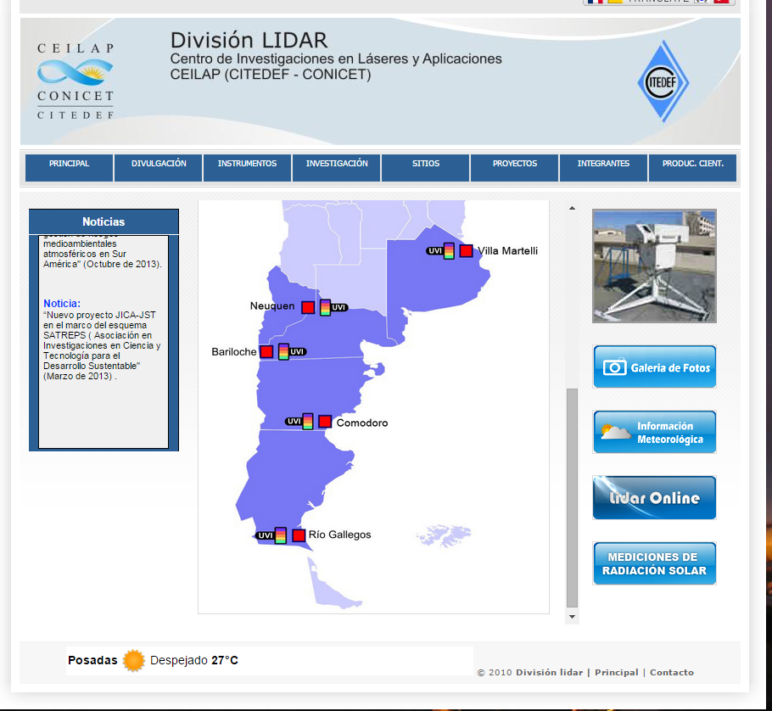
Public visualization of real time monitoring

Slide 9

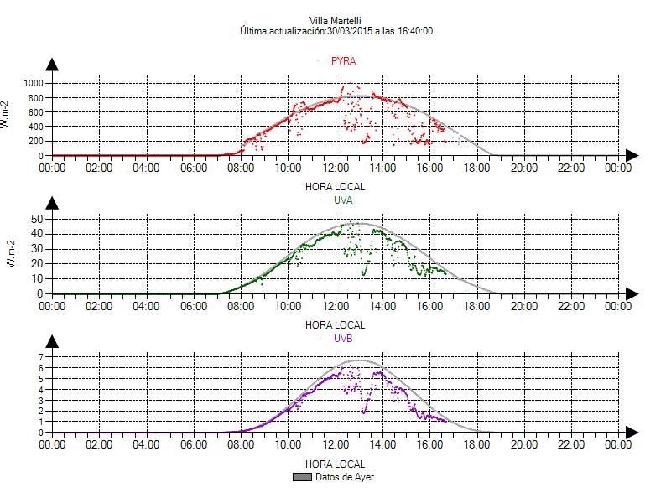
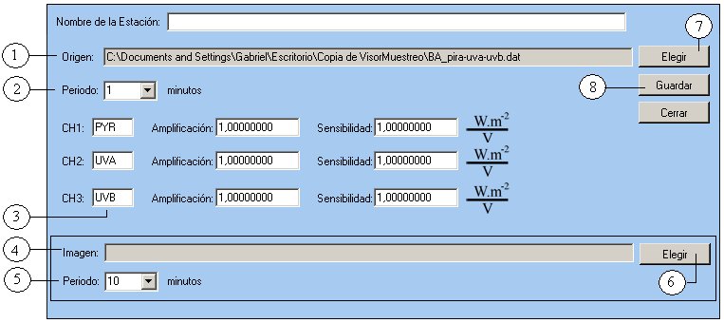
Visualization of Solar Radiation at each Station
Pyranometer
UV-A Radiometer
UV-B Radiometer (UVI)

Slide 10
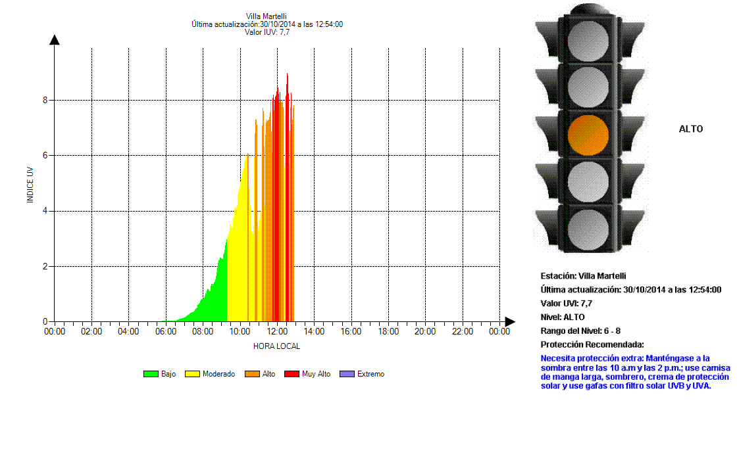
Online Real time UV index and Daily Time Evolution of UV Index at each Station

Slide 11

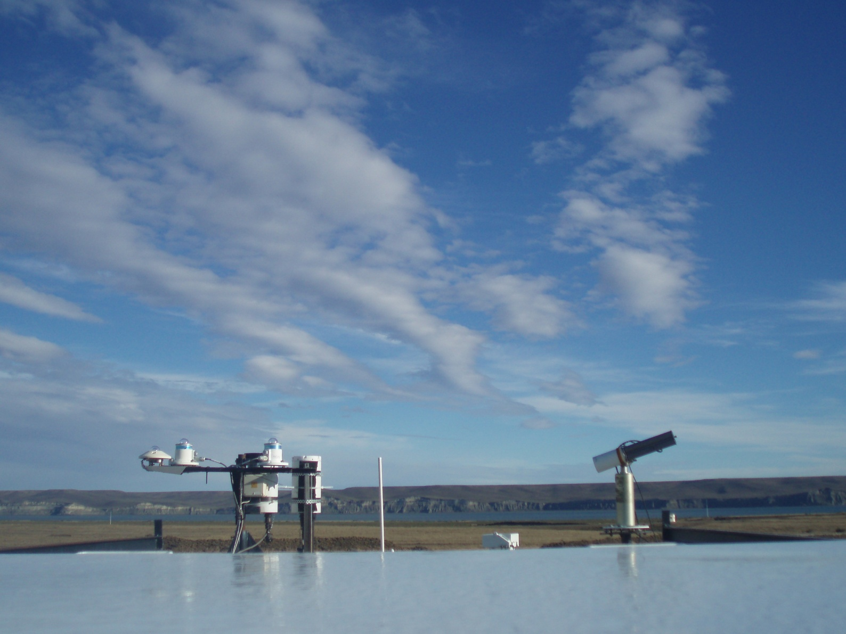
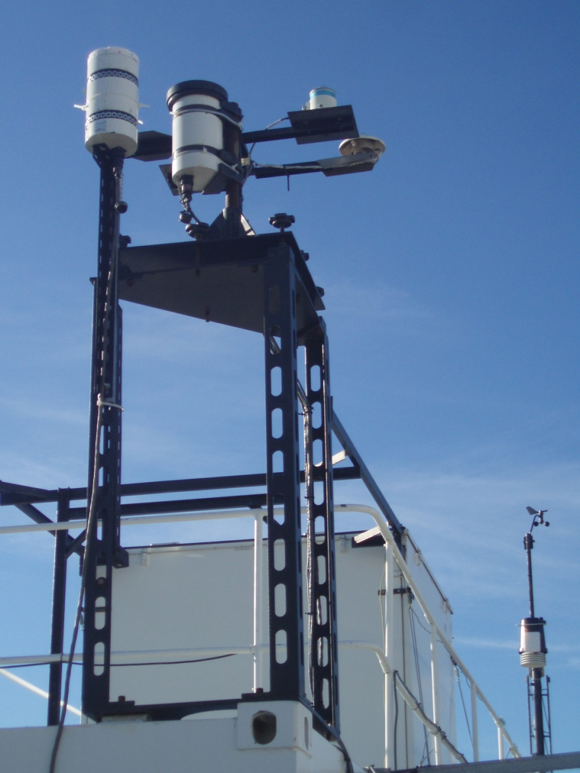
Cloud impact on Solar Radiation

Slide 12
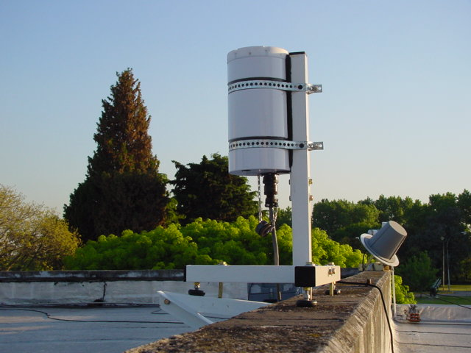
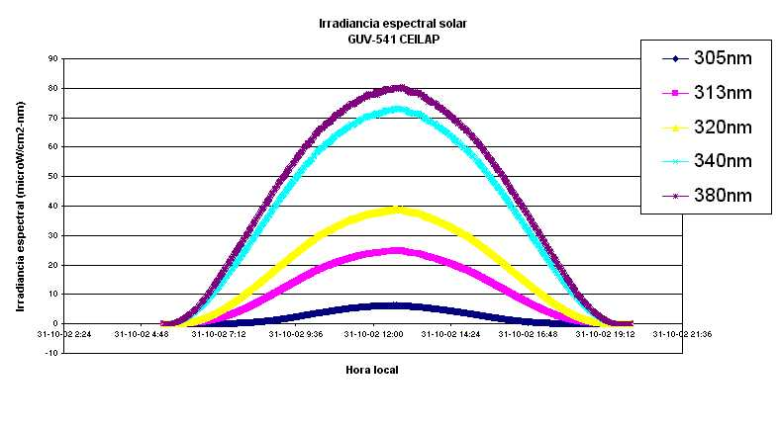

Espectrorradiómetro de banda angosta
GUV 541 Biospherical Instruments
Typical Measurement in a clear day

Slide 13
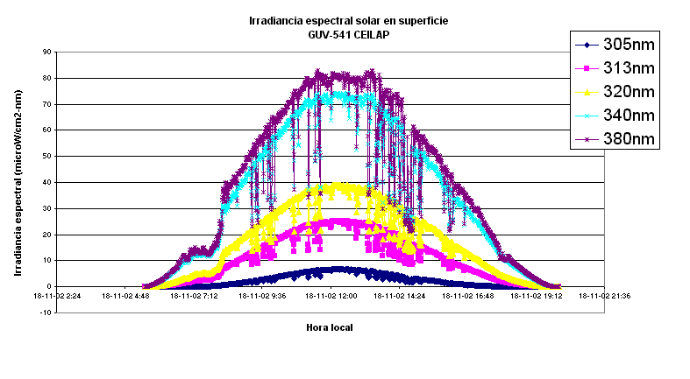
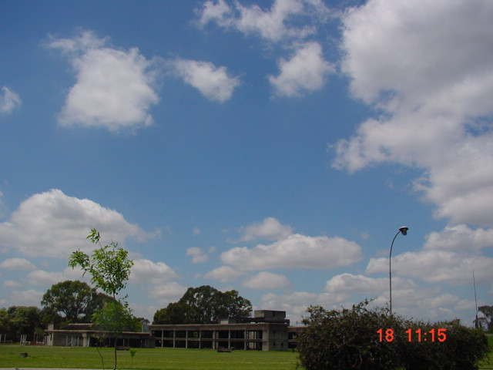
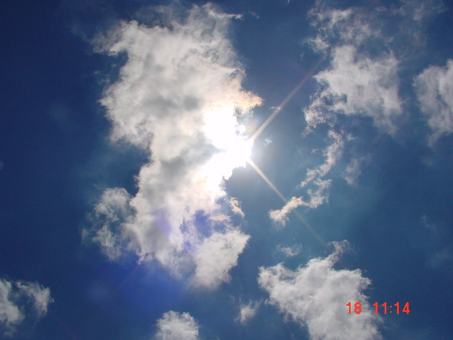
Attenuation of surface solar radiation by cumulus clouds

Slide 14
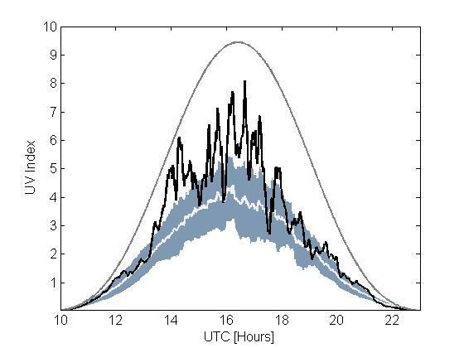
Cloud Cover Impact in UVI
Attenuation
UV Index
Clear Sky Model
reference

Slide 15
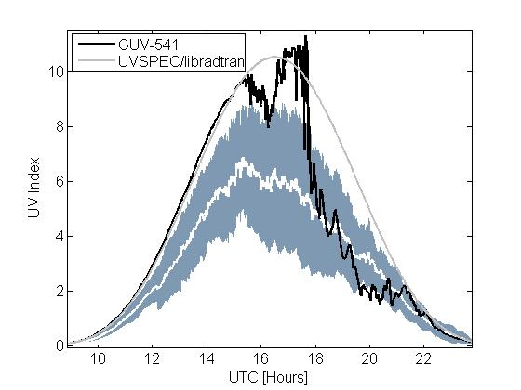
Cloud Cover Impact in UVI
Enhancement
UV Index
Clear Sky Model
reference
UTC (hs)

Slide 16
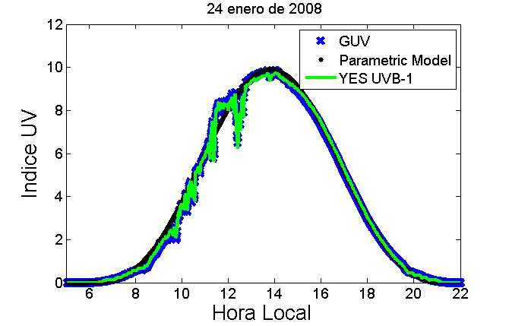
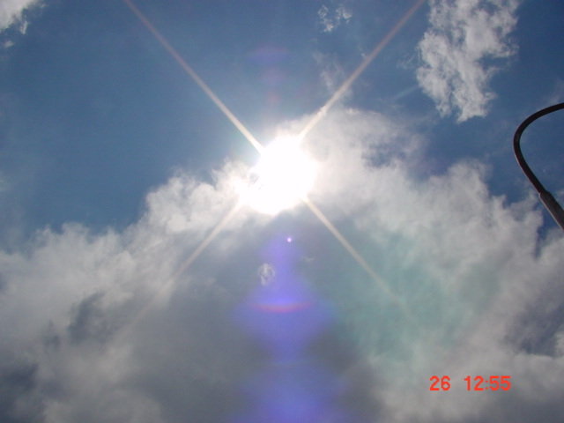
Resultados:
Local Time

Slide 17
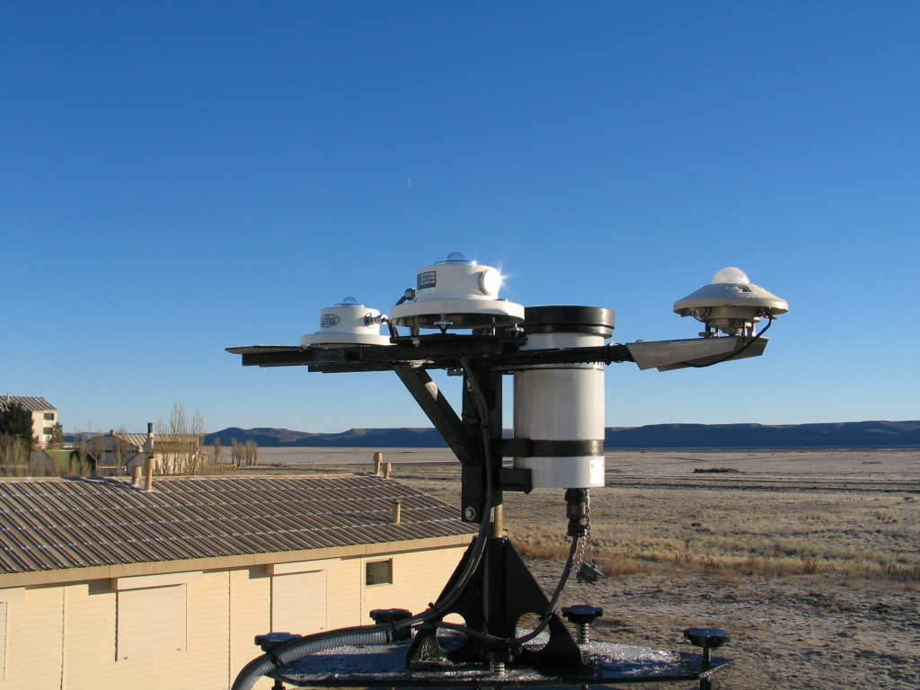
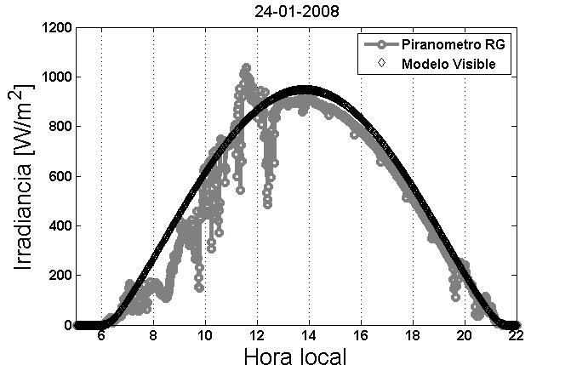

Cloud cover impact:
UV
VIS
Measurements ; minutal time rate
Model : represent clear sky condition

Slide 18
Cloud Modification Factors
Río Gallegos site (2006)

Slide 19
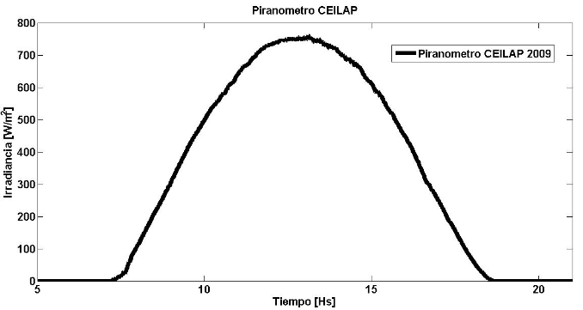
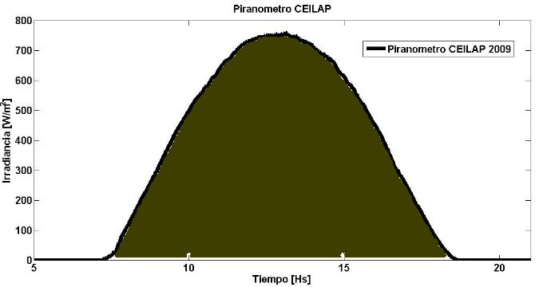
Cloud impact in the visible
ANÁLISIS:
It= solar irradiance (W/m2)
Irr=Daily Global solar irradiation (kWh/m2)
Irradiancia Solar instantánea (It).
Irradiación Solar
Global Diaria (Irr)

Slide 20
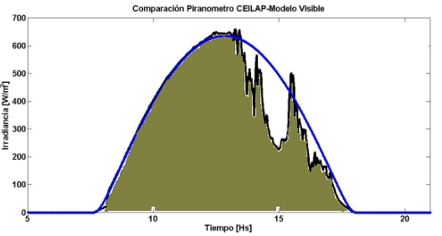
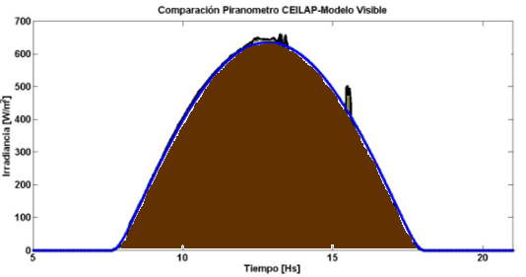
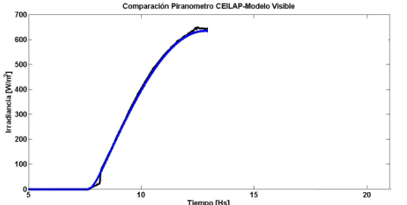
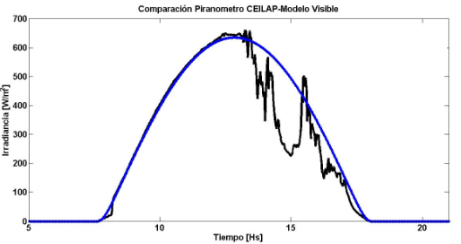
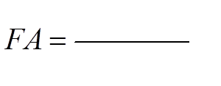


Cloud impact in the visible
Comparación con el modelo paramétrico: 6-5-2009
Trans
Transmission
FA: Factor de Atenuación
Model : represent clear sky condition

Slide 21
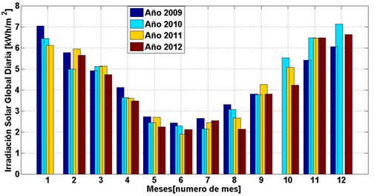
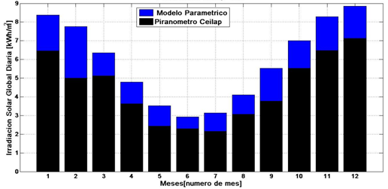
Results
Promedio mensual de los valores de irradiación solar diaria
Variación estacional de la Irradiación Solar Global
Year | 2009 | 2010 | 2011 | 2012
Annual mean of TRANS | 0,7774 | 0,7459 | 0,7433 | 0,6904

Slide 22
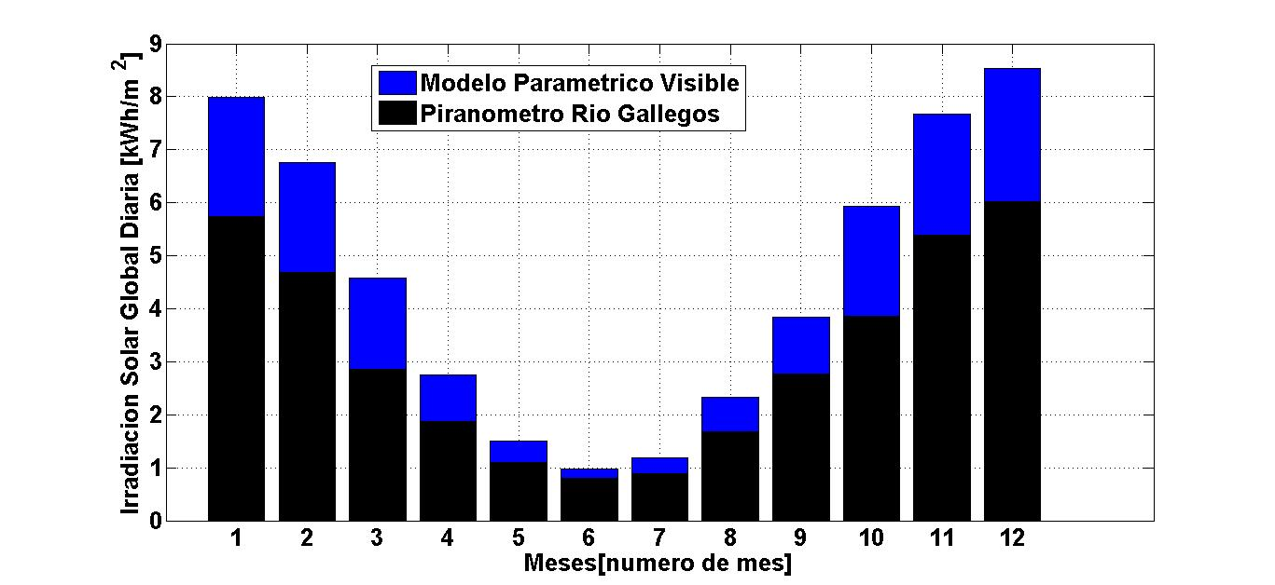
Results for Río Gallegos:
Montly mean of daily solar irradiation for RG
The cloud impact is higher in the spring – summer time

Slide 23

Patagonian Dust
Trelew
Dust
Strong winds
MODIS del
1 de enero 2007,
17h55 UTC

Slide 24
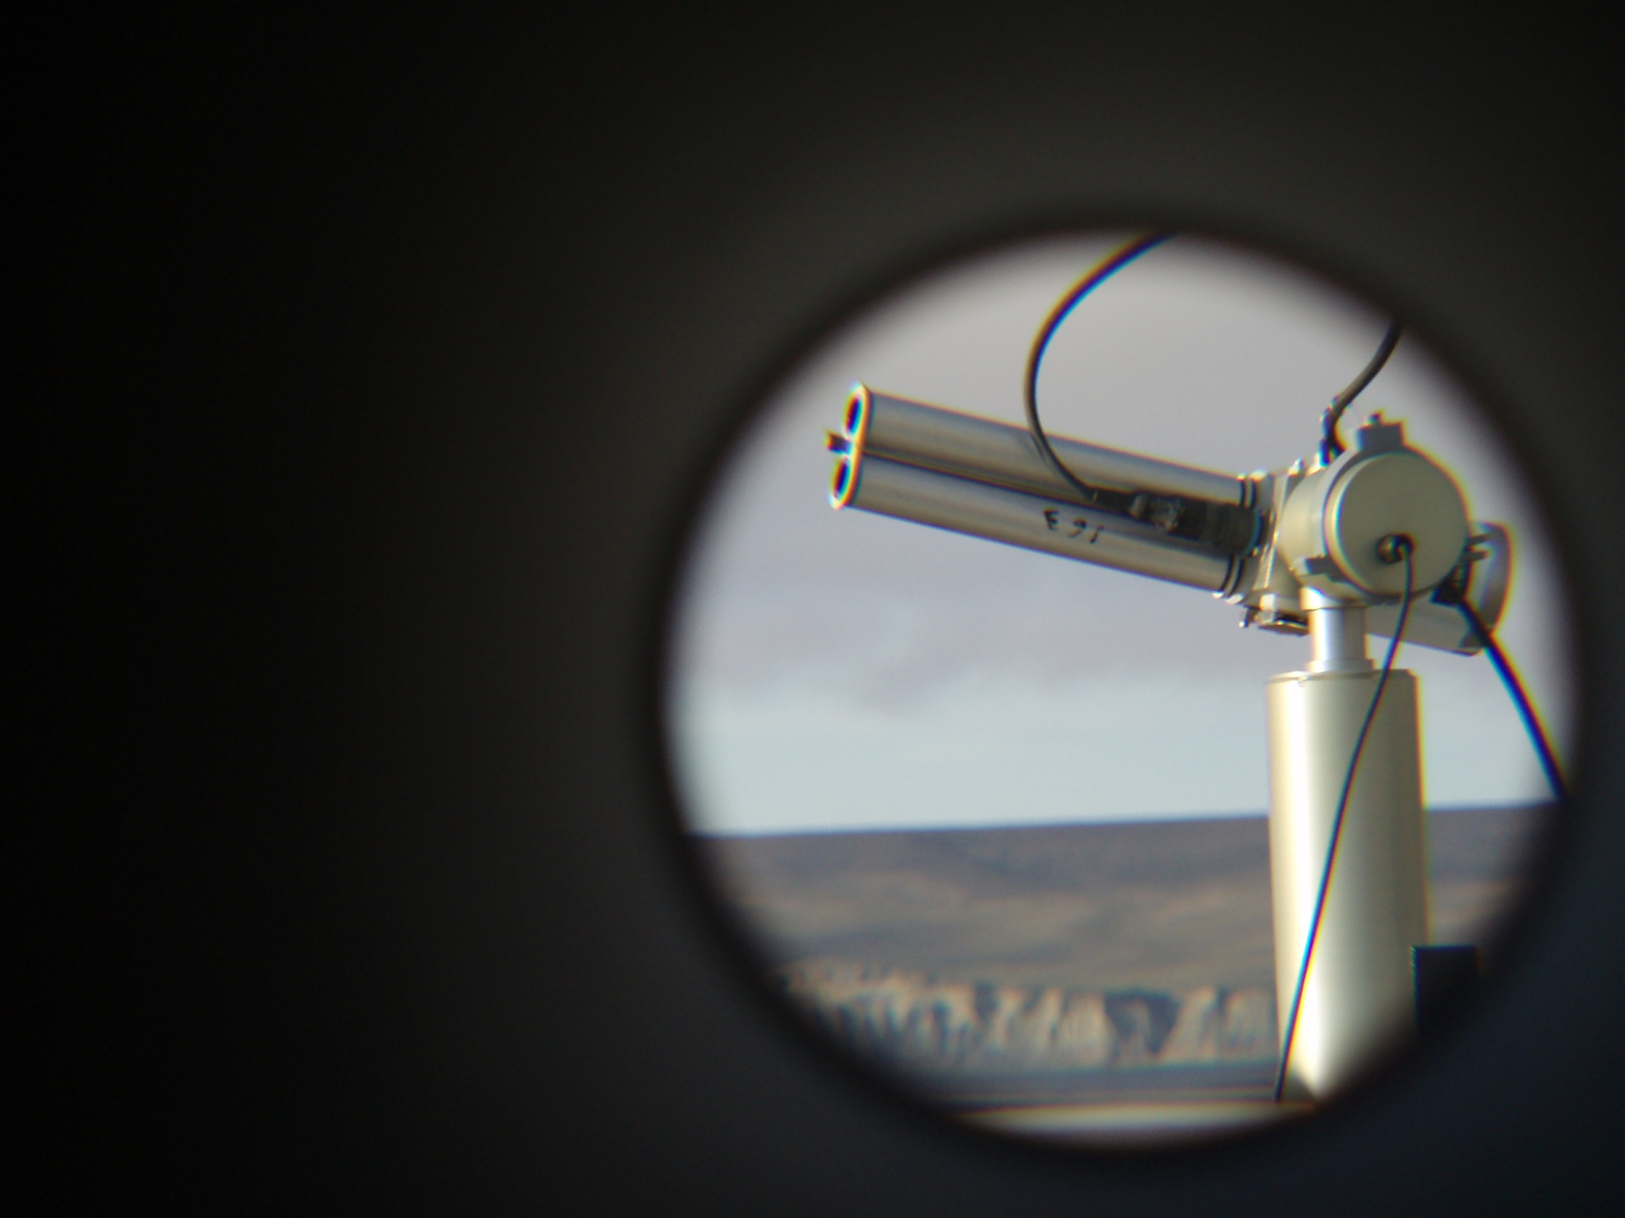
Solar Photometer
AERONET Network
Five instruments in Argentina
2 of them deployed in CEILAP sites

Slide 25
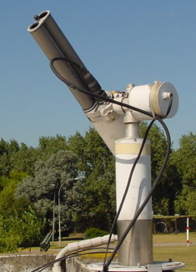
AOT/Aeronet Trelew
Study cases
Dec 27, 2006
Jan 1, 2007
Jan 6, 2007
Reference Day
Jan 9 - 2007
Valores de AOT (500nm, L 2) para los cuatro días seleccionados

Slide 26
AOT/Aeronet Trelew
Study cases
Valores de AOT (500nm, L 2) por hora para los cuatro días seleccionados

Slide 27
GUV 380 nm solar irradiance at
Trelew
Atenuación 2,7 %
Radiación global y AOT medidas en Trelew para los días
del 27 de diciembre 2006 y del 9 de enero 2007

Slide 28
GUV 380 nm solar irradiance at
Trelew
Atenuación 2,4 %
Atenuación 2,7 %
Radiación global y AOT medidas en Trelew para los días del 6 de enero y del 9 de enero 2007

Slide 29
GUV 380 nm solar irradiance at
Trelew
Atenuación 12,8 %
Diagrama de vientos para el día 1 de enero 2007, en Trelew, hora UTC: 03Z = 03hs, 500 mb = aprox. 5000m
Radiación global y AOT medidas en Trelew para los días del 1 de enero y del 9 de enero 2007

Slide 30
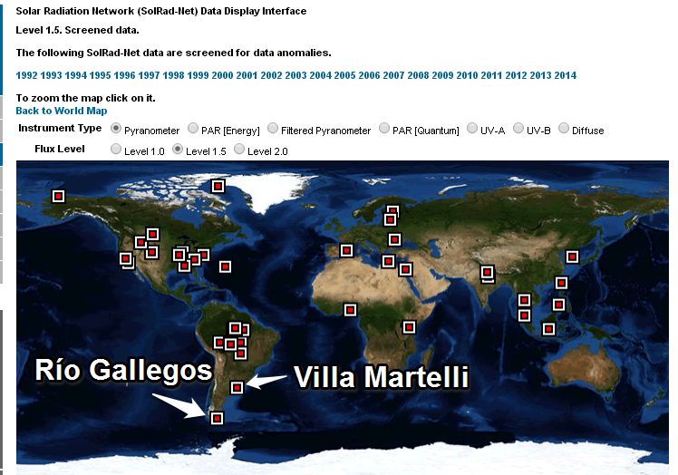
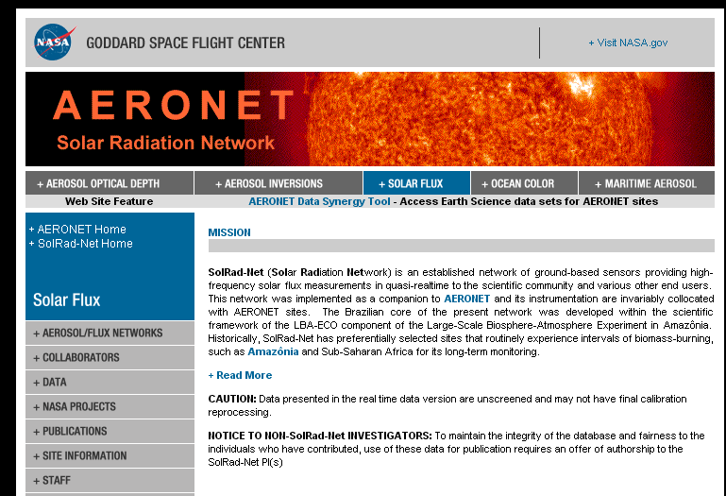
SOLRADNET/NASA, Visible and UV Solar radiation with broadband radiometers
http://solrad-net.gsfc.nasa.gov/cgi-bin/type_piece_of_map_flux?long1=-180&long2=180&lat1=-90&lat2=90&multiplier=2&what_map=4&nachal=1&formatter=0&level=1&shef_code=P

Slide 31
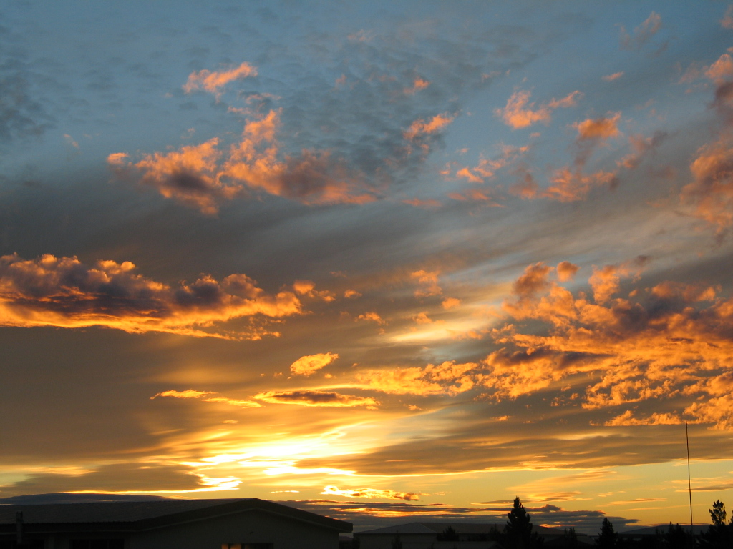
Conclusions
Cloud cover modulate strongly the surface UV radiation, producing attenuation of 80% (CMF=0.2) and increment of 20% (CMF=1.2) in UVI (cloud border) in event as long as 20 min.
The cloud cover affect strongly the visible radiation that rich the surphase reducing the solar irradiation in 30% in mean.
Did not present season variation in Buenos Aires and for Rio Gallegos the cloud impact is stronger dung spring-summer seasons.
Attenuation of global surface UV irradiance (380 nm) of 12% due to Patagonian dust has been observed.
Synergy of this measurements with lidar products will increase the correct description to the atmosphere

Slide 32

But!!! Take a little of care: Not always the attenuation is coming from the atmosphere…..
Gracias
Thanks
ewolfram@gmail.com
www.division-lidar.com.ar
Thanks to the LOC for the financial support
Proyecto de Desarrollo del Sistema de Gestión de Riesgos Medioambientales Atmosféricos en Sudamérica

